Slide 1

人生大利 《提前6章6 -10》
The Great Gain in Life
(1 Timothy 6:6–10)

Slide 2

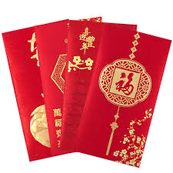

Slide 3
提前6:6 然而，敬虔加上知足的心便是大利了；7 因为我们没有带什麽到世上来，也不能带什麽去。8 只要有衣有食，就当知足。9 但那些想要发财的人，就陷在迷惑、落在网罗和许多无知有害的私欲里，叫人沉在败坏和灭亡中。10 贪财是万恶之根。有人贪恋钱财，就被引诱离了真道，用许多愁苦把自己刺透了。
1Ti 6:6 But godliness with contentment is great gain,7 for we brought nothing into the world, and we cannot take anything out of the world.8 But if we have food and clothing, with these we will be content.9 But those who desire to be rich fall into temptation, into a snare, into many senseless and harmful desires that plunge people into ruin and destruction.10 For the love of money is a root of all kinds of evils. It is through this craving that some have wandered away from the faith and pierced themselves with many pangs.

Slide 4
【1】 敬虔加上知足
Godliness with Contentment.

Slide 5
不知足的危害 (The Dangers of Discontentment)
失去喜乐 (Loss of joy)
活在痛苦中 (Suffering)
贪恋别人的 (Coveting what belongs to others)
妒忌 (Envy)
埋怨 (Grumbling)
对神不满 (Discontent toward God)
离开真道 (Departing from the truth)

Slide 6
提前6:6 然而，敬虔 加上 知足的心便是大利了；
1Ti 6:6 But godliness with contentment is great gain,

Slide 7
【2】 什么是不知足 ？
What Is Discontentment?

Slide 8
知足不是什么？ (What Is Contentment Not?)
不是不努力工作 (It is not refusing to work hard)
不是不想赚钱 (It is not avoiding the desire to earn money)
不是不能买更好的物品 (It is not being unable to buy better things)
不是不计划更好的未来 (It is not failing to plan for better future)

Slide 9
知足是什么？ (What Is Contentment?)
神是我生命最重要的，胜过一切 (God is the most important in my life, surpassing everything)
相信上帝对我生命的主权与安排，在永恒中是良善而智慧的。 (Believing that God’s sovereignty and arrangement over my life are ultimately good and wise in eternity.)
以神为我最大的满足与喜乐。 (Taking God as my greatest satisfaction and joy, not external circumstances or earthly gain.)
在缺乏中仍有平安，常存感谢与赞美。 Having peace in lack and continually giving thanks and praise.)
心灵安稳，处于知足的状态。 (A heart that is stable and in a state of contentment.)

Slide 10
检验自己是否得了不知足之症： (Examine Whether You Have Fallen into Discontentment)
怀疑上帝不爱你。 (Doubting that God loves you.)
失去平安与喜乐。 (lost peace and joy.)
常有埋怨与怨言。 (Frequent complaining and grumbling.)
羡慕与嫉妒他人的境况与福分。 (Envying others’ circumstances and blessings.)
对名利金钱有极大渴望。 (Having an excessive desire for fame, status, and money.)
对追求神与神的事无兴趣。 (Losing interest in pursuing God and the things of God.)

Slide 11
【3】 如何对付内心的不知足
How to Deal with Inner Discontentment.

Slide 12
提前6:7
因为我们没有带什麽到世上来，也不能带什麽去。8 只要有衣有食，就当知足。
1Ti 6:7 for we brought nothing into the world, and we cannot take anything out of the world.8 But if we have food and clothing, with these we will be content.

Slide 13
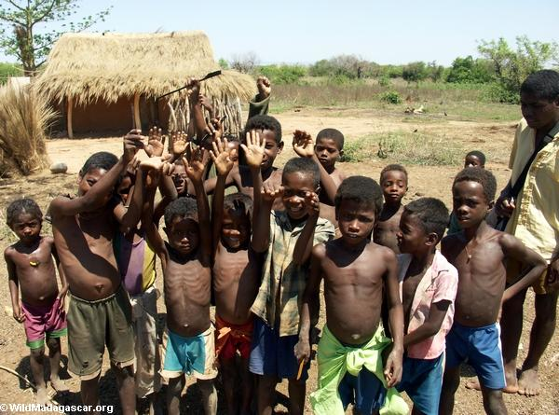
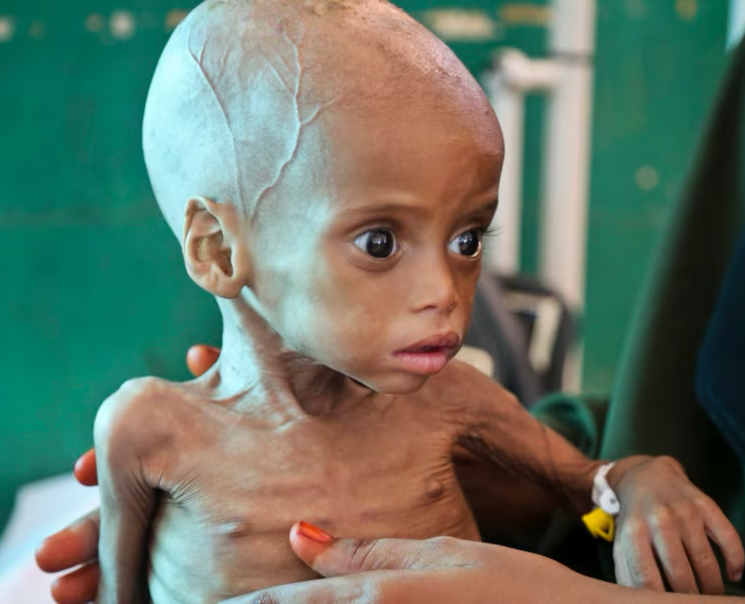

Slide 14
太6:19 不要为自己积攒财宝在地上；地上有虫子咬，能锈坏，也有贼挖窟窿来偷。20 只要积攒财宝在天上；天上没有虫子咬，不能锈坏，也没有贼挖窟窿来偷。
Mat 6:19 “Do not lay up for yourselves treasures on earth, where moth and rust destroy and where thieves break in and steal,20 but lay up for yourselves treasures in heaven, where neither moth nor rust destroys and where thieves do not break in and steal.

Slide 15
【4】 避开网罗与灭亡
Avoid the Snare and Destruction.

Slide 16
提前6:9
但那些想要发财的人，就陷在迷惑、落在网罗和许多无知有害的私欲里，叫人沉在败坏和灭亡中。
1Ti 6:9 But those who desire to be rich fall into temptation, into a snare, into many senseless and harmful desires that plunge people into ruin and destruction.

Slide 17
提前6:10
贪财是万恶之根。有人贪恋钱财，就被引诱离了真道，用许多愁苦把自己刺透了。
1Ti 6:10 For the love of money is a root of all kinds of evils. It is through this craving that some have wandered away from the faith and pierced themselves with many pangs.

Slide 18
诗篇51:10 神啊，求你为我造清洁的心，使我里面重新有正直的灵。
Psa 51:10 Create in me a clean heart, O God, and renew a right spirit within me.
诗篇 119:36 求你使我的心趋向你的法度，不趋向非义之财。
Psa 119:36 Incline my heart to your testimonies, and not to selfish gain!

Slide 19
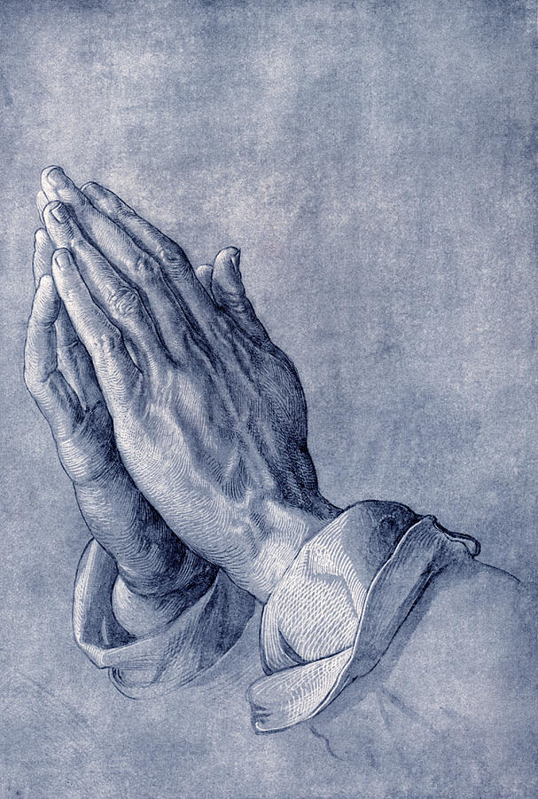
祈求主帮助我们，赐我们一颗敬虔的心，加上知足而喜乐的心。
Pray that the Lord would help us and grant us a godly heart, together with a contented and joyful heart.

