Slide 1
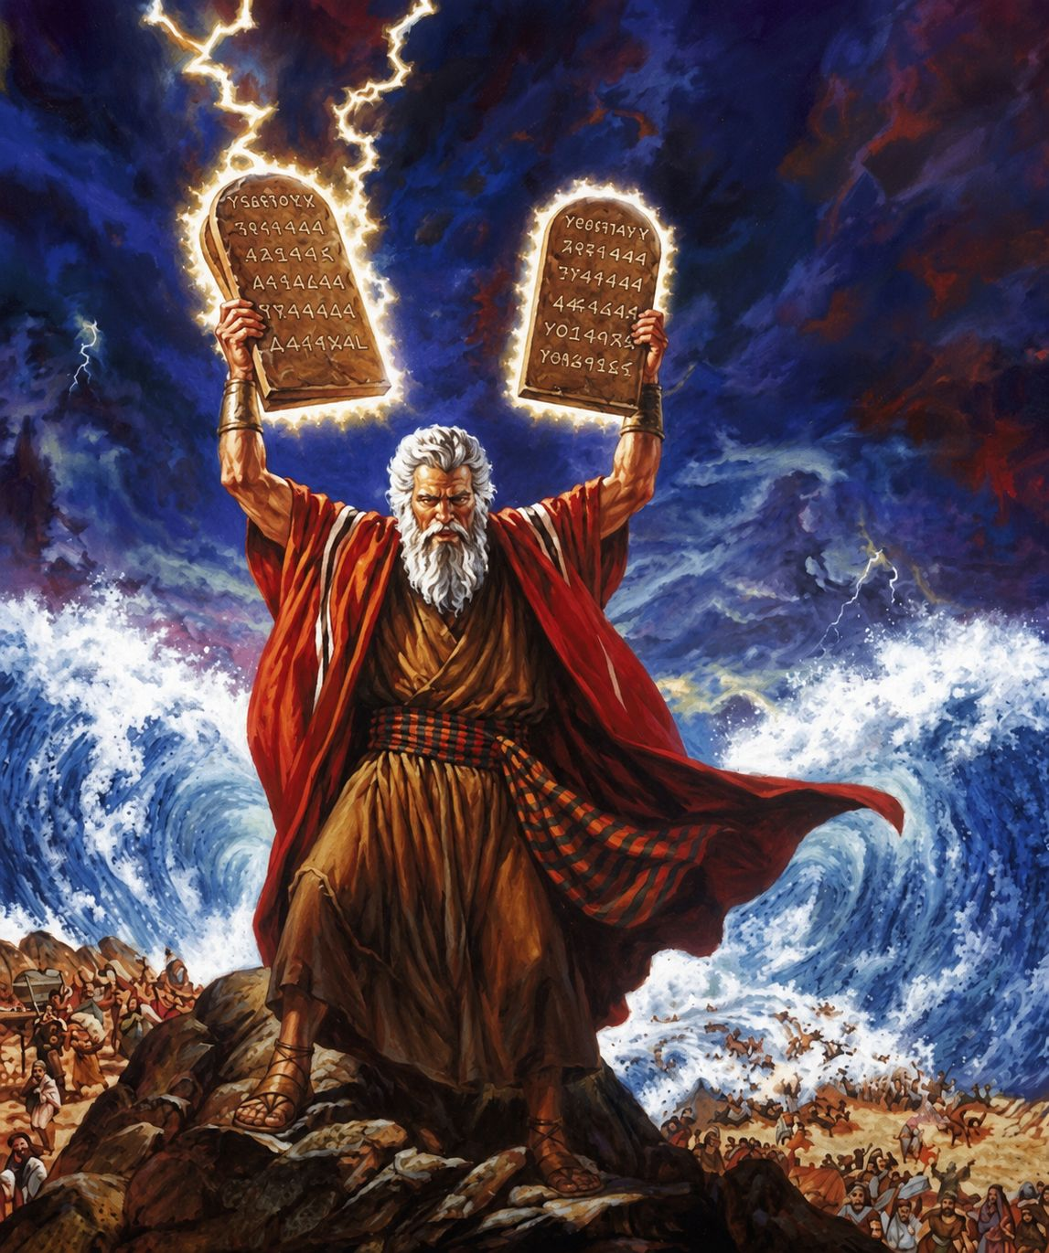
十诫
Ten Commandments
  十诫：关乎神的诫命 第二讲）
  出20章1至17
  The Ten Commandments: Commandments Concerning God (Part 2)

Slide 2
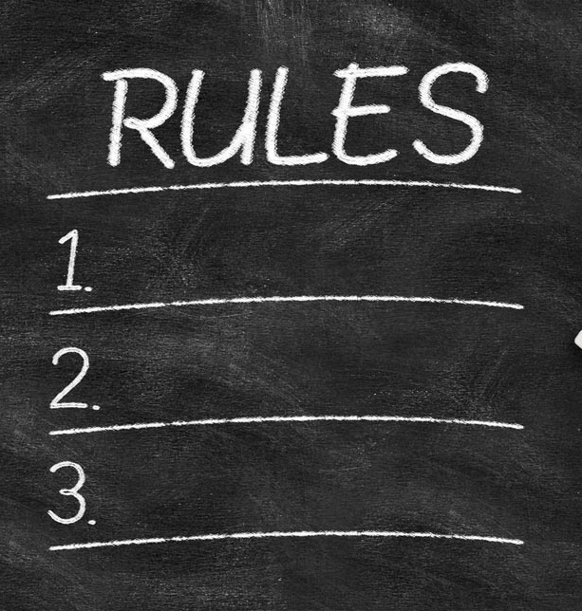
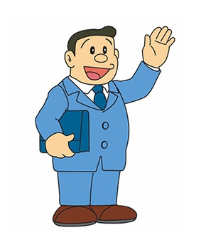


Slide 3
出20:1 神吩咐这一切的话说：2 「我是耶和华你的神，曾将你从埃及地为奴之家领出来。3 「除了我以外，你不可有别的神。4 「不可为自己雕刻偶像，也不可做什麽形像彷佛上天、下地，和地底下、水中的百物。5 不可跪拜那些像，也不可事奉他，因为我耶和华你的神是忌邪的神。恨我的，我必追讨他的罪，自父及子，直到三四代；6 爱我、守我诫命的，我必向他们发慈爱，直到千代。
Exo 20:1 And God spoke all these words, saying,2 “I am the LORD your God, who brought you out of the land of Egypt, out of the house of slavery.3 “You shall have no other gods before me.4 “You shall not make for yourself a carved image, or any likeness of anything that is in heaven above, or that is in the earth beneath, or that is in the water under the earth.5 You shall not bow down to them or serve them, for I the LORD your God am a jealous God, visiting the iniquity of the fathers on the children to the third and the fourth generation of those who hate me,6 but showing steadfast love to thousands of those who love me and keep my commandments.
1/3

Slide 4
7 「不可妄称耶和华你神的名；因为妄称耶和华名的，耶和华必不以他为无罪。8 「当记念安息日，守为圣日。9 六日要劳碌做你一切的工，10 但第七日是向耶和华你神当守的安息日。这一日你和你的儿女、仆婢、牲畜，并你城里寄居的客旅，无论何工都不可做；11 因为六日之内，耶和华造天、地、海，和其中的万物，第七日便安息，所以耶和华赐福与安息日，定为圣日。
7 “You shall not take the name of the LORD your God in vain, for the LORD will not hold him guiltless who takes his name in vain.8 “Remember the Sabbath day, to keep it holy.9 Six days you shall labor, and do all your work,10 but the seventh day is a Sabbath to the LORD your God. On it you shall not do any work, you, or your son, or your daughter, your male servant, or your female servant, or your livestock, or the sojourner who is within your gates.11 For in six days the LORD made heaven and earth, the sea, and all that is in them, and rested on the seventh day. Therefore the LORD blessed the Sabbath day and made it holy.
2/3

Slide 5
12 「当孝敬父母，使你的日子在耶和华你神所赐你的地上得以长久。13 「不可杀人。14 「不可奸淫。15 「不可偷盗。16 「不可作假见证陷害人。17 「不可贪恋人的房屋；也不可贪恋人的妻子、仆婢、牛驴，并他一切所有的。」
12 “Honor your father and your mother, that your days may be long in the land that the LORD your God is giving you.13 “You shall not murder.14 “You shall not commit adultery.15 “You shall not steal.16 “You shall not bear false witness against your neighbor.17 “You shall not covet your neighbor's house; you shall not covet your neighbor's wife, or his male servant, or his female servant, or his ox, or his donkey, or anything that is your neighbor's.”
3/3

Slide 6
(a)律法是有轻重
The Law Has Different Degrees of Importance
(b)被救赎后才赐诫命
The Commandments Were Given After Redemption

Slide 7
01
第一与第二诫命：
你不可有别的神，也不可造或拜偶像。
The First and Second Commandments:
You Shall Have No Other Gods, and You Shall Not Make or Worship Idols.

Slide 8
5 不可跪拜那些像，也不可事奉他，因为我耶和华你的神是忌邪的神。恨我的，我必追讨他的罪，自父及子，直到三四代；
5 You shall not bow down to them or serve them, for I the LORD your God am a jealous God, visiting the iniquity of the fathers on the children to the third and the fourth generation of those who hate me,

Slide 9
02
有另外一种的偶像是我们基督徒要谨慎的
There is another kind of idol that Christians must guard against.

Slide 10
西3:5...，和贪婪（贪婪就与拜偶像一样）。
Col 3:5 ...., and covetousness, which is idolatry.

Slide 11
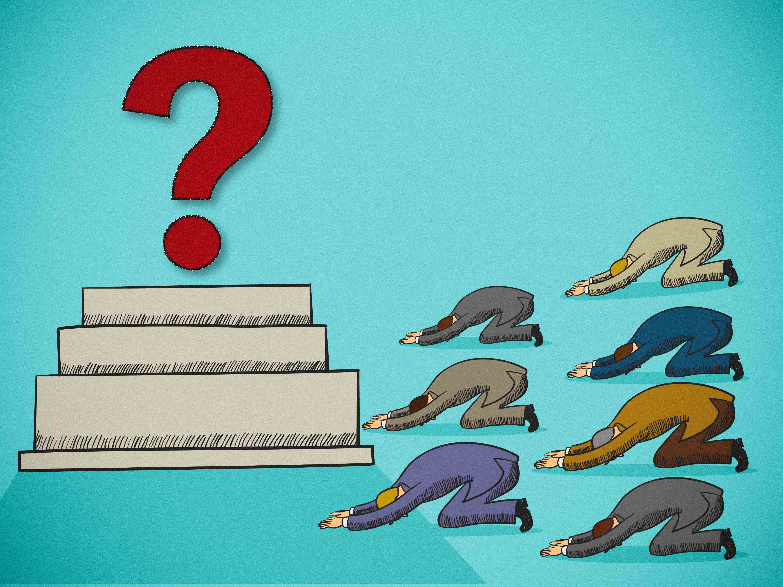
信念、哲理、Beliefs、Philosophies
传统、文化、Culture、Traditions
人、People
东西、事物、Possessions Things
享乐、Pleasures
梦想、Dreams、Ambitions
事业、金钱、Careers、Money
权利 等等 Power、Authority etc

Slide 12
6 爱我、守我诫命的，我必向他们发慈爱，直到千代。
6 but showing steadfast love to thousands of those who love me and keep my commandments.

Slide 13
03
第三诫：不可妄称耶和华你神的名
The Third Commandment:
You Shall Not Take the Name of the LORD Your God in Vain.

Slide 14
7 「不可妄称耶和华你神的名；因为妄称耶和华名的，耶和华必不以他为无罪。
7 “You shall not take the name of the LORD your God in vain, for the LORD will not hold him guiltless who takes his name in vain.

Slide 15
04
第四诫：安息日
The Fourth Commandment: The Sabbath

Slide 16
8 「当记念安息日，守为圣日。9 六日要劳碌做你一切的工，10 但第七日是向耶和华你神当守的安息日。这一日你和你的儿女、仆婢、牲畜，并你城里寄居的客旅，无论何工都不可做；11 因为六日之内，耶和华造天、地、海，和其中的万物，第七日便安息，所以耶和华赐福与安息日，定为圣日。
8 “Remember the Sabbath day, to keep it holy.9 Six days you shall labor, and do all your work,10 but the seventh day is a Sabbath to the LORD your God. On it you shall not do any work, you, or your son, or your daughter, your male servant, or your female servant, or your livestock, or the sojourner who is within your gates.11 For in six days the LORD made heaven and earth, the sea, and all that is in them, and rested on the seventh day. Therefore the LORD blessed the Sabbath day and made it holy.

Slide 17
出31:14 所以你们要守安息日，以为圣日。凡干犯这日的，必要把他治死；凡在这日做工的，必从民中剪除。15 六日要做工，但第七日是安息圣日，是向耶和华守为圣的。凡在安息日做工的，必要把他治死。』16 故此，以色列人要世世代代守安息日为永远的约。
Exo 31:14 You shall keep the Sabbath, because it is holy for you. Everyone who profanes it shall be put to death. Whoever does any work on it, that soul shall be cut off from among his people.15 Six days shall work be done, but the seventh day is a Sabbath of solemn rest, holy to the LORD. Whoever does any work on the Sabbath day shall be put to death.16 Therefore the people of Israel shall keep the Sabbath, observing the Sabbath throughout their generations, as a covenant forever.

Slide 18
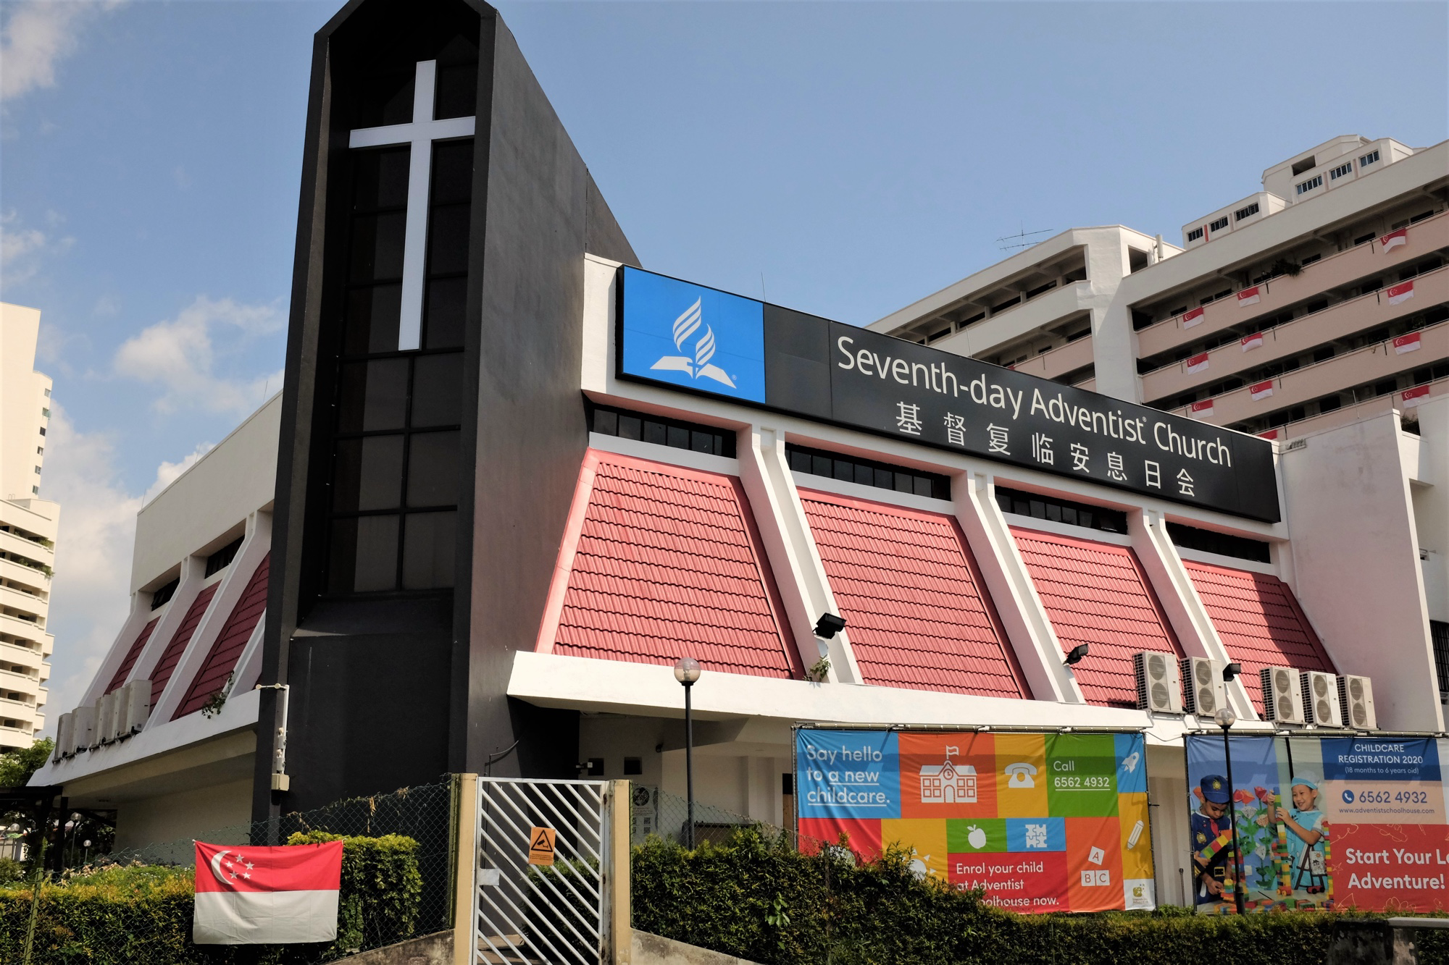

Slide 19
西2:16
所以，不拘在饮食上，或节期、月朔、安息日都不可让人论断你们。17 这些原是後事的影儿；那形体却是基督。
Col 2:16 Therefore let no one pass judgment on you in questions of food and drink, or with regard to a festival or a new moon or a Sabbath. 17 These are a shadow of the things to come, but the substance belongs to Christ.

Slide 20
来10:25
你们不可停止聚会，好像那些停止惯了的人，倒要彼此劝勉，既知道那日子临近，就更当如此。
Heb 10:25 not neglecting to meet together, as is the habit of some, but encouraging one another, and all the more as you see the Day drawing near.

