Slide 1
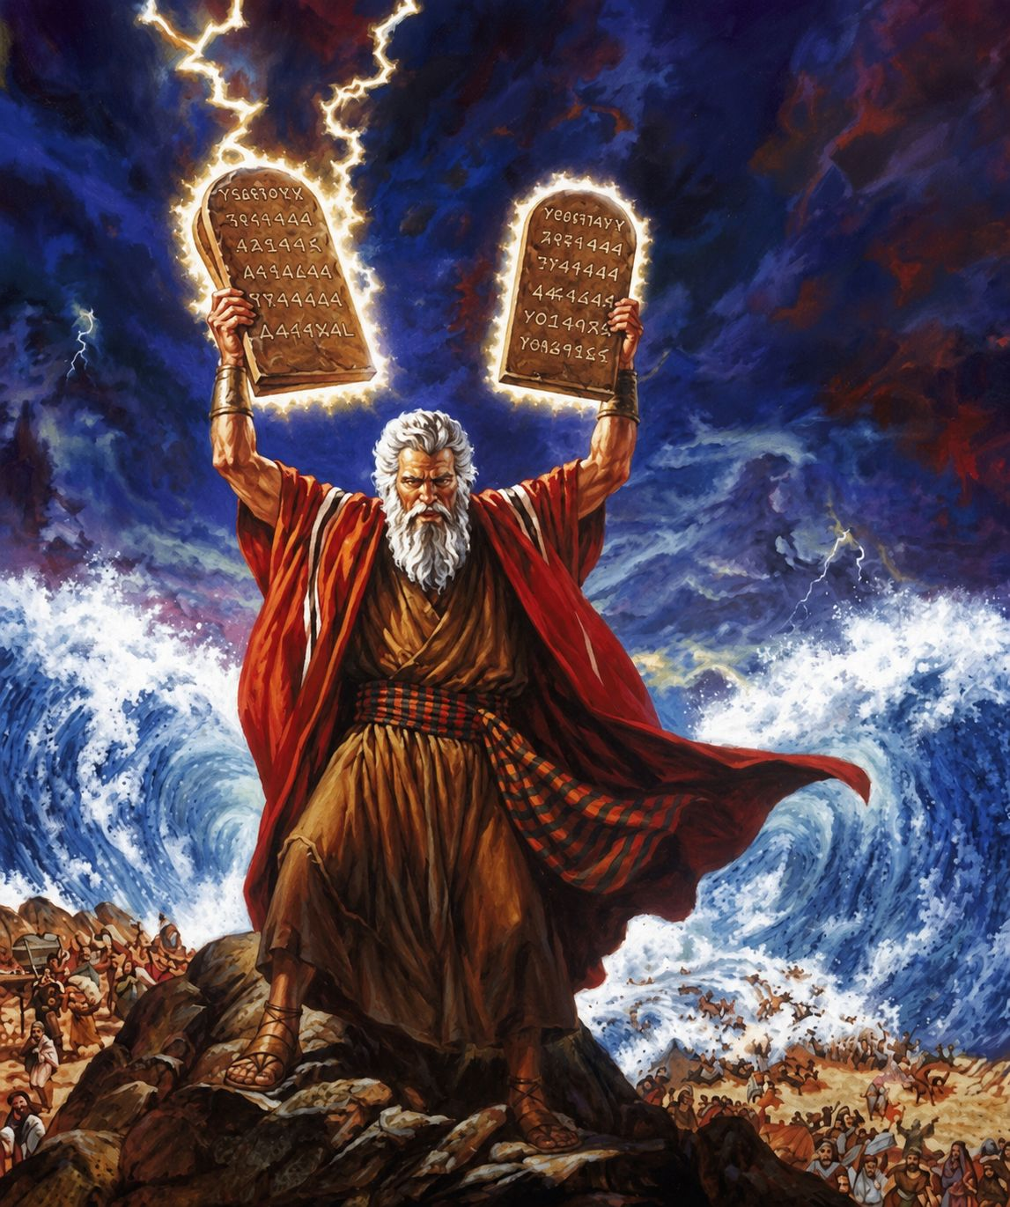
十诫
Ten Commandments
  十诫的五福（第一讲）
  出20章1至17
  The Five Blessings of the Ten Commandments (Part 1)

Slide 2

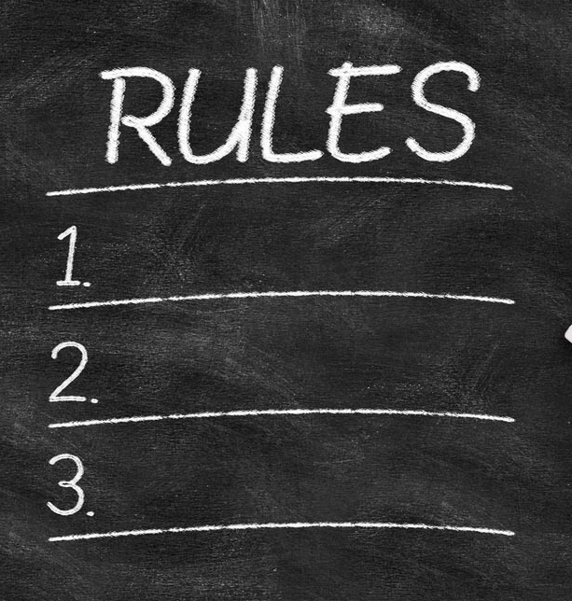


Slide 3
出20:1 神吩咐这一切的话说：2 「我是耶和华你的神，曾将你从埃及地为奴之家领出来。3 「除了我以外，你不可有别的神。4 「不可为自己雕刻偶像，也不可做什麽形像彷佛上天、下地，和地底下、水中的百物。5 不可跪拜那些像，也不可事奉他，因为我耶和华你的神是忌邪的神。恨我的，我必追讨他的罪，自父及子，直到三四代；6 爱我、守我诫命的，我必向他们发慈爱，直到千代。
Exo 20:1 And God spoke all these words, saying,2 “I am the LORD your God, who brought you out of the land of Egypt, out of the house of slavery.3 “You shall have no other gods before me.4 “You shall not make for yourself a carved image, or any likeness of anything that is in heaven above, or that is in the earth beneath, or that is in the water under the earth.5 You shall not bow down to them or serve them, for I the LORD your God am a jealous God, visiting the iniquity of the fathers on the children to the third and the fourth generation of those who hate me,6 but showing steadfast love to thousands of those who love me and keep my commandments.
1/3

Slide 4
7 「不可妄称耶和华你神的名；因为妄称耶和华名的，耶和华必不以他为无罪。8 「当记念安息日，守为圣日。9 六日要劳碌做你一切的工，10 但第七日是向耶和华你神当守的安息日。这一日你和你的儿女、仆婢、牲畜，并你城里寄居的客旅，无论何工都不可做；11 因为六日之内，耶和华造天、地、海，和其中的万物，第七日便安息，所以耶和华赐福与安息日，定为圣日。
7 “You shall not take the name of the LORD your God in vain, for the LORD will not hold him guiltless who takes his name in vain.8 “Remember the Sabbath day, to keep it holy.9 Six days you shall labor, and do all your work,10 but the seventh day is a Sabbath to the LORD your God. On it you shall not do any work, you, or your son, or your daughter, your male servant, or your female servant, or your livestock, or the sojourner who is within your gates.11 For in six days the LORD made heaven and earth, the sea, and all that is in them, and rested on the seventh day. Therefore the LORD blessed the Sabbath day and made it holy.
2/3

Slide 5
12 「当孝敬父母，使你的日子在耶和华你神所赐你的地上得以长久。13 「不可杀人。14 「不可奸淫。15 「不可偷盗。16 「不可作假见证陷害人。17 「不可贪恋人的房屋；也不可贪恋人的妻子、仆婢、牛驴，并他一切所有的。」
12 “Honor your father and your mother, that your days may be long in the land that the LORD your God is giving you.13 “You shall not murder.14 “You shall not commit adultery.15 “You shall not steal.16 “You shall not bear false witness against your neighbor.17 “You shall not covet your neighbor's house; you shall not covet your neighbor's wife, or his male servant, or his female servant, or his ox, or his donkey, or anything that is your neighbor's.”
3/3

Slide 6
申10:13
遵守他的诫命律例，就是我今日所吩咐你的，为要叫你得福。
Deuteronomy 10:13.
and to keep the commandments and statutes of the Lord , which I am commanding you today for your good?
3/3

Slide 7
01
十诫帮助我们认识神
The Ten Commandments help us to know God.

Slide 8
02
十诫让我们明白我们无法自救
The Ten Commandments show us that we are unable to save ourselves.

Slide 9
17 「不可贪恋人的房屋；也不可贪恋人的妻子、仆婢、牛驴，并他一切所有的。」
17 “You shall not covet your neighbor's house; you shall not covet your neighbor's wife, or his male servant, or his female servant, or his ox, or his donkey, or anything that is your neighbor's.”

Slide 10


Slide 11
罗3:20
所以凡有血气的，没有一个因行律法能在神面前称义，因为律法本是叫人知罪。
Rom 3:20 For by works of the law no human being will be justified in his sight, since through the law comes knowledge of sin.

Slide 12
03
十诫指引我们到耶稣寻求救恩
The Ten Commandments leads us to Jesus to seek salvation.

Slide 13
加 3:24
这样，律法是我们训蒙的师傅，引我们到基督那里，使我们因信称义。
Galatians 3
24.So then, the law was our guardian until Christ came, in order that we might be justified by faith.

Slide 14
04
十诫是我们生活的准则
The Ten Commandments are the rule for our lives.

Slide 15
不在律法之下（罗6:14）
No Longer Under the Law (Rom. 6:14)
与基督联合
Being United with Christ
不再被定罪
（罗8:1）
No more Condemnation
(Rom. 8:1)
脱离罪的捆绑
（罗6:6）
Freed from the Bondage of Sin (Rom. 6:6)

Slide 16
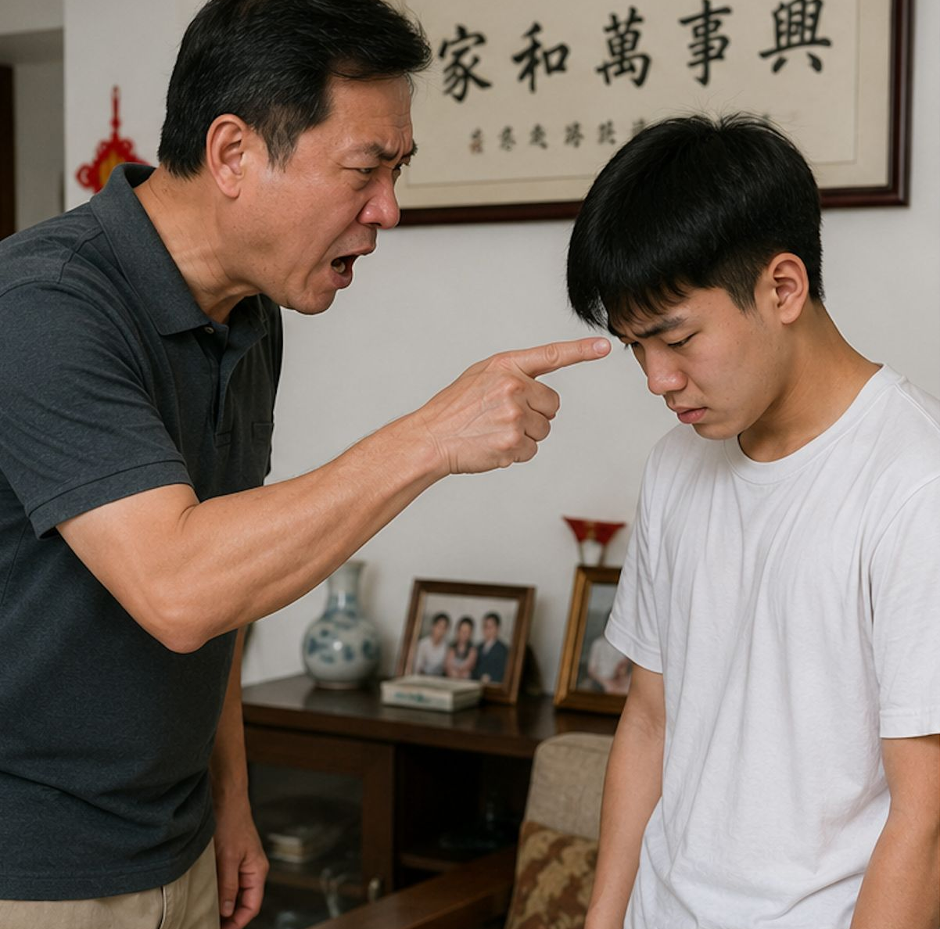
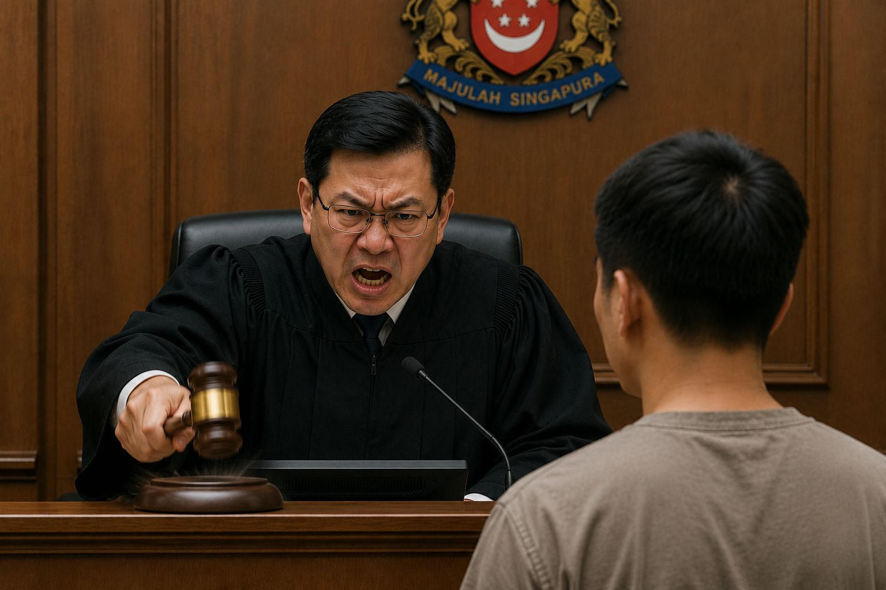
父亲发怒
Father's Anger
法官发怒
Judge's Anger

Slide 17
05
十诫与成功
The Ten Commandments and Success

Slide 18


Slide 19
十诫与成功
The Ten Commandments and Success
最大的成功就是耶稣基督为我们守住十诫
The greatest success is Christ's perfect obedience to the Ten Commandments on our behalf.
我们对主忠心也是成功
Our success is found in remaining faithful to the Lord.

