Slide 1
圣经的得财之道
箴言 8:21
The Biblical Way to Obtain Wealth – Proverbs 8:21

Slide 2
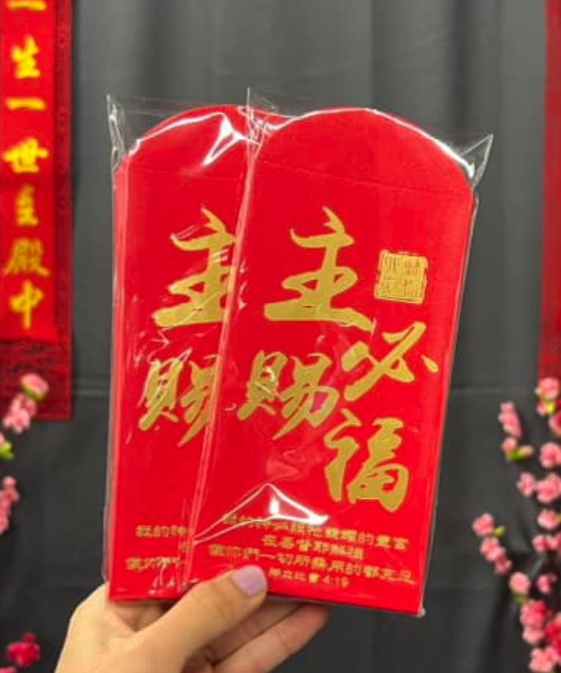
新年期间，你最喜欢什么？
During the New Year, what do you like the most?

Slide 3
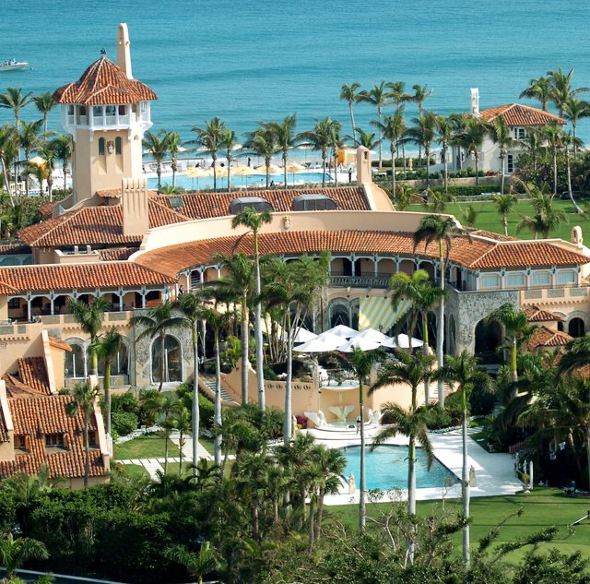
巴伦 特朗普
天赐 borned Silver-spoon
Barron Trump

Slide 4
扎克伯格
天才 prodigy
约 19岁 就开始了脸书 Facebook
Mark Zuckerberg
Started Facebook at around 19 years old.

Slide 5
神赐敬畏祂的人智慧
1
God grants wisdom to those who fear Him.

Slide 6
箴言 9:10
敬畏耶和华是智慧的开端；认识至圣者便是聪明。
Proverbs 9:10.
The fear of the Lord is the beginning of wisdom, and the knowledge of the Holy One is insight.

Slide 7
箴言 2:6
因为，耶和华赐人智慧；知识和聪明都由他口而出。
Proverbs 2:6.
For the Lord gives wisdom; from his mouth come knowledge and understanding;

Slide 8
智慧人获得富贵
The wise will gain wealth.

Slide 9
箴言 3:16.
她(智慧)右手有长寿，左手有富贵。
Proverbs 3:16.
Long life is in her (wisdom) right hand; in her left hand are riches and honor.

Slide 10
箴言8:21
使爱我【智慧】的，承受货财，并充满他们的府库。
Proverbs 8:21.
granting an inheritance to those who love me, and filling their treasuries.

Slide 11
智慧人不走捷径求财富
2
A wise person does not pursue quick and easy wealth

Slide 12
箴言 13:11
不劳而得之财必然消耗；勤劳积蓄的，必见加增。
Proverbs 13:11.
Wealth gained hastily will dwindle, but whoever gathers little by little will increase it.

Slide 13
箴言 28:20
...想要急速发财的，不免受罚。
Proverbs 28:20…, but whoever hastens to be rich will not go unpunished.

Slide 14
 | 投资Investing | 赌博Gambling
方式 Approach | 研究与策略Research & Strategy | 依靠运气 Luck
风险程度 Risk Level | 可控风险 Managed Risk | 高风险 High Risk
时间周期 Time Frame | 长期增长 Long-term Growth | 短线投机 Short-term Betting
决策依据 Decision Based On | 公司业绩 Company Performance | 热点炒作 Speculation
目标 End Goal | 资产增值 Wealth Building | 快速盈利或亏损Quick Profits or loses

Slide 16
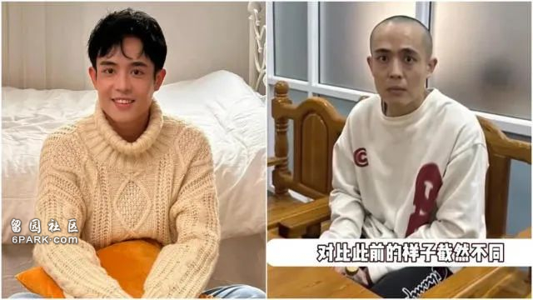
中国演员王星

Slide 17
智慧人不好宴乐,节约用钱
3
The wise do not indulge in feasting and are prudent with their money.

Slide 18
箴言 23:21
因为好酒贪食的，必致贫穷；...
Proverbs 23:21
.for the drunkard and the glutton will come to poverty, …

Slide 19
箴言21:20.
智慧人家中积蓄宝物膏油；愚昧人随得来随吞下。
Proverbs 21:20.
Precious treasure and oil are in a wise mans dwelling, but a foolish man devours it.

Slide 20
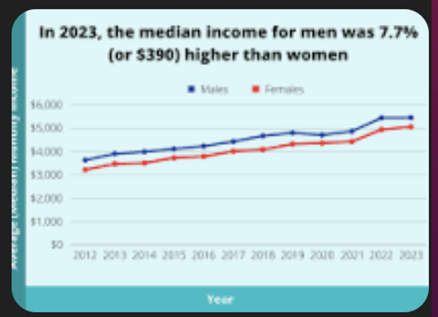
2024年 新加坡 中位数收入 median income 收入是每月 $5,197 新元

Slide 21
在2024年，新加坡的家庭月收入中位数为每月 $10,869 新元。

Slide 22
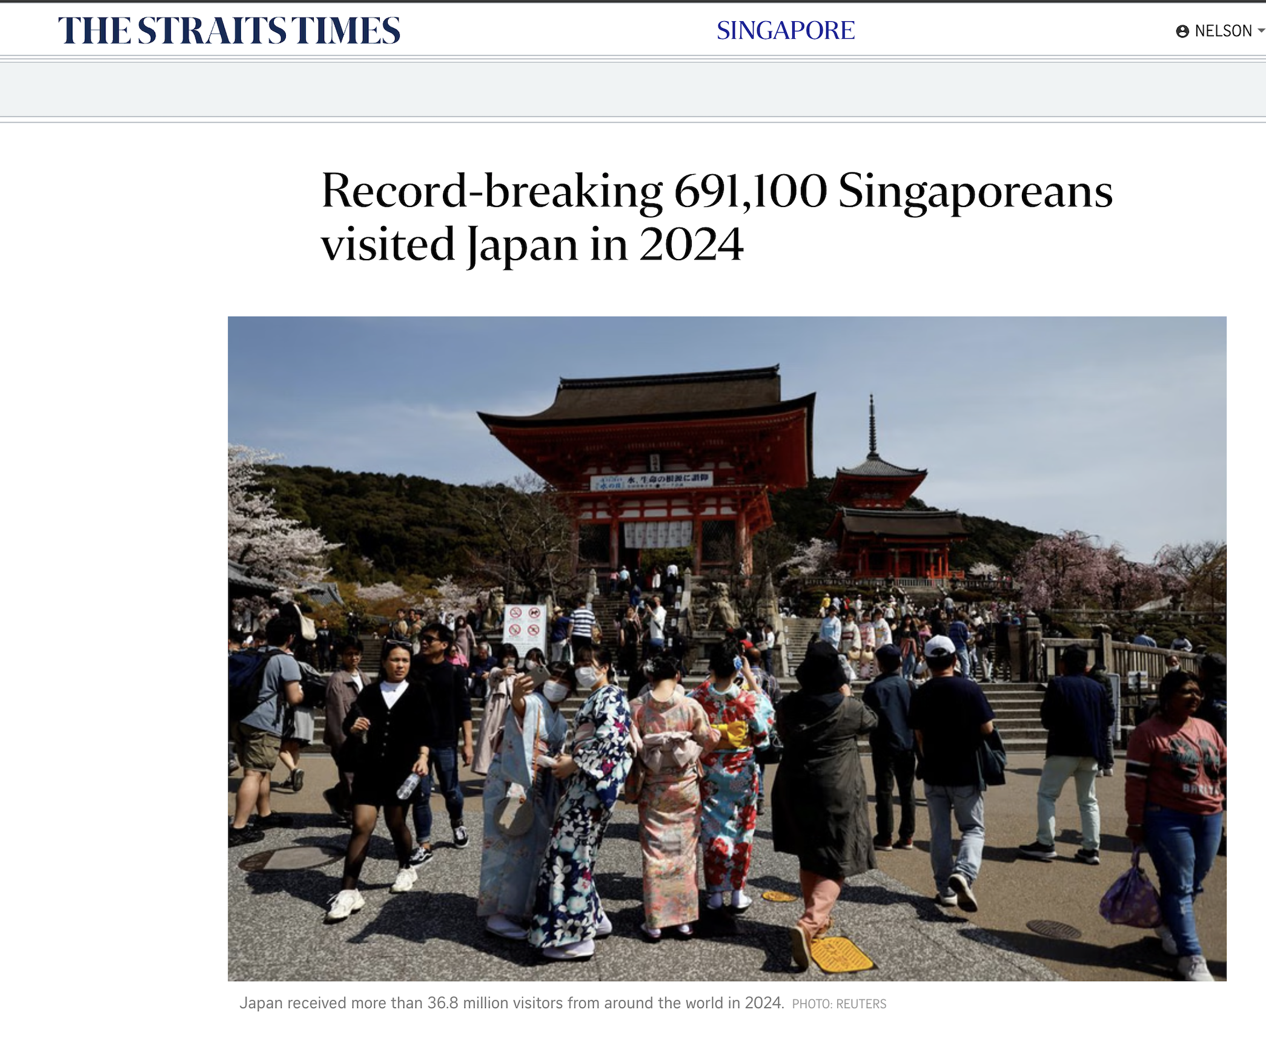
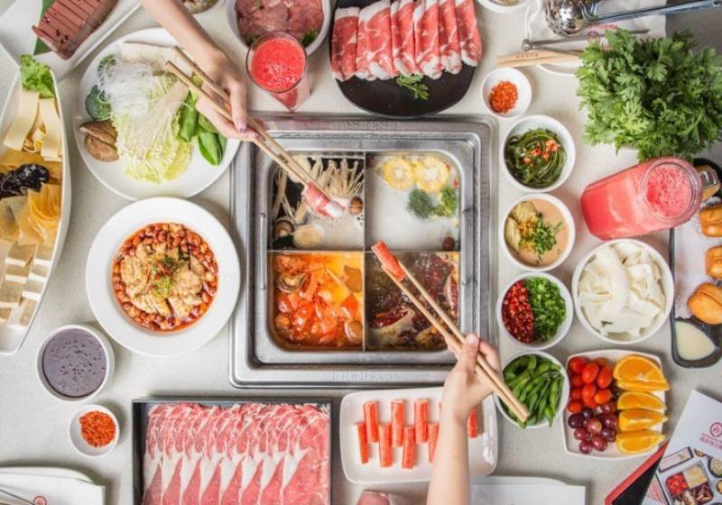
69万 新加坡人 在2024年访问了日本

Slide 23
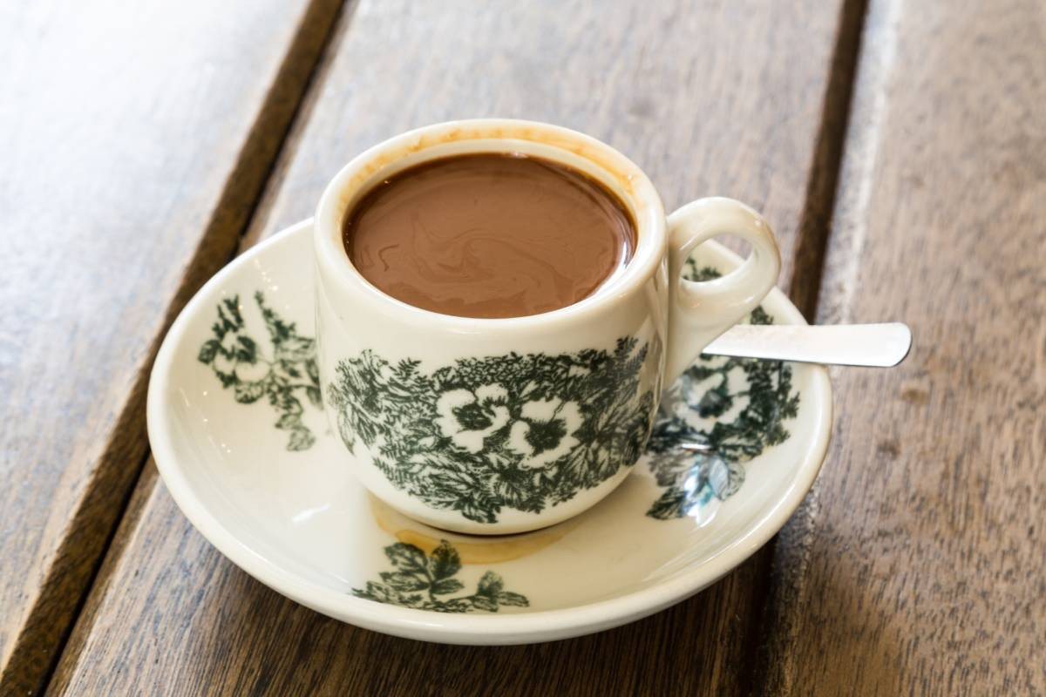
$8
$1.5

Slide 24
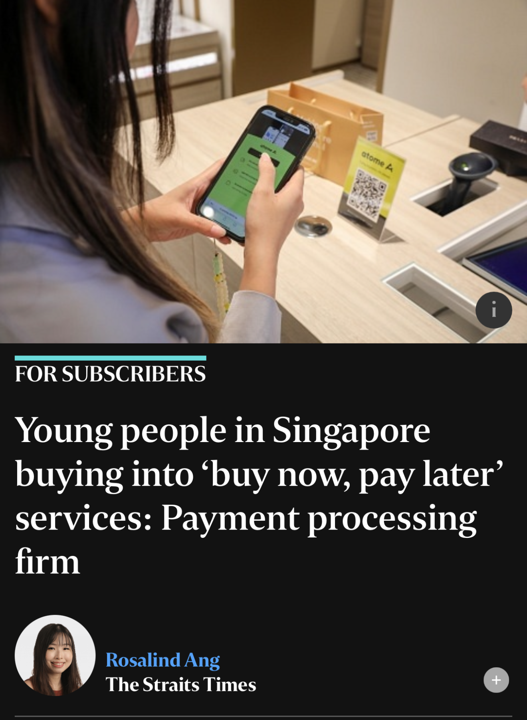
2024年报道
新加坡年轻人
热衷于 “先买后付” 模式

Slide 25
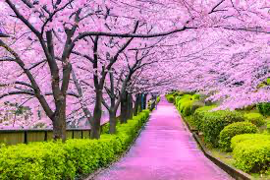
消费的前提是，
每月都有足够的积蓄
The prerequisite for spending is to have sufficient savings for each month

Slide 26
智慧人细心培育赚钱能力
4
The wise carefully cultivate their ability to make money.

Slide 27
箴言 27:18.
看守无花果树的，必吃树上的果子；...
Proverbs 27:18.
Whoever tends a fig tree will eat its fruit, …

Slide 28
AI人工智能

Slide 29
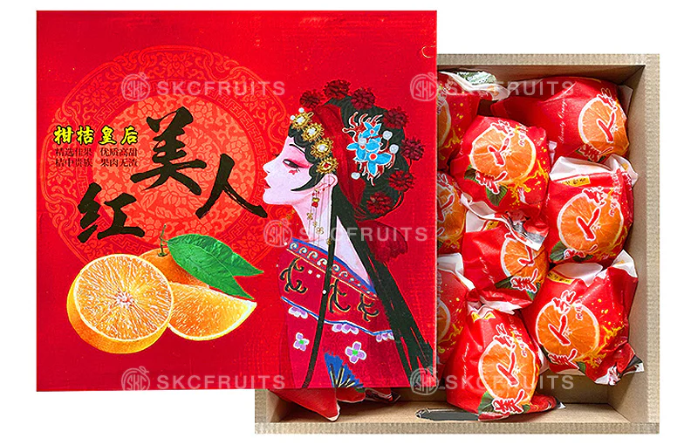
中国于2002年通过民间从日本引入，已被多个地区引种发展。

Slide 30
智慧人，殷勤不懒惰
5
The wise are diligent and not lazy..

Slide 31
箴言 23:21
...好睡觉的，必穿破烂衣服。
Proverbs 23:21…
and slumber will clothe them with rags.

Slide 32
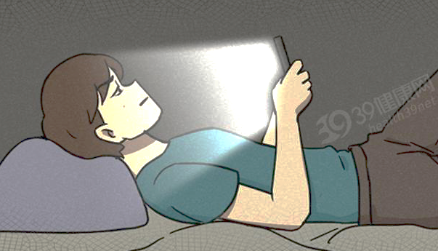
箴言 10:4
手懒的，要受贫穷；手勤的，却要富足。
Proverbs 10:4.
A slack hand causes poverty, but the hand of the diligent makes rich.

Slide 33
如果你是老板你有三个员工你必须裁掉一人， 聪明但懒惰，不聪明但勤奋，不聪明又懒惰。你裁哪一位？
If you were a boss with three employees and had to lay off one, who would you choose: the smart but lazy one, the not-so-smart but diligent one, or the not-so-smart and lazy one?

Slide 34
如果我是老板，我会优先裁掉不聪明又懒惰的员工。

Slide 35
留下不聪明但勤奋的员工。

Slide 36
智慧人为冬天积蓄
6
A wise man stores up provisions for the winter

Slide 37
箴言 6:8
(蚂蚁)尚且在夏天预备食物，在收割时聚敛粮食。
Proverbs 6:8.
(Ant).she prepares her bread in summer and gathers her food in harvest.

Slide 38
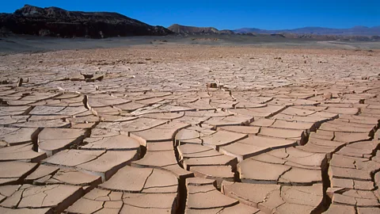
遇见饥荒
亚伯拉罕（创12）
以撒Isaac(创26)
雅各（创41-42）
Encountering famine,
e.g., Abraham (Genesis 12), Isaac (Genesis 26), Jacob (Genesis 41-42)

Slide 39
智慧人购置田地，牛羊
7
The wise acquire land, cattle, and sheep.

Slide 40
箴言 27:23.你要详细知道你羊群的景况，留心料理你的牛群；...26.羊羔之毛是为你作衣服；山羊是为作田地的价值，27.并有母山羊奶够你吃，也够你的家眷吃，且够养你的婢女。
Proverbs 27:23.Know well the condition of your flocks, and give attention to your herds,…..26.the lambs will provide your clothing, and the goats the price of a field.

Slide 41
强力建议：国家不允许倒闭的公司
recommendation: Companies that the state does not allow to go bankrupt.

Slide 42
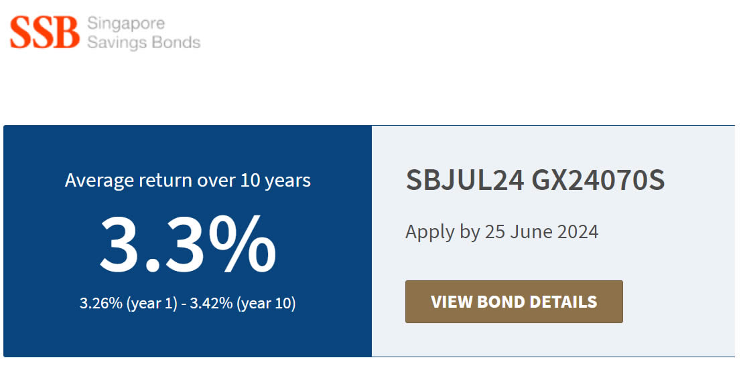
新加坡国家政府储蓄债券

Slide 43
智慧人脚踏实地
8
The wise are down-to-earth.( realistic and practical)

Slide 44
箴言 28:19
耕种自己田地的，必得饱食；追随虚浮的，足受穷乏。
Proverbs 28:19
Whoever works his land will have plenty of bread, but he who follows worthless pursuits will have plenty of poverty.

Slide 45
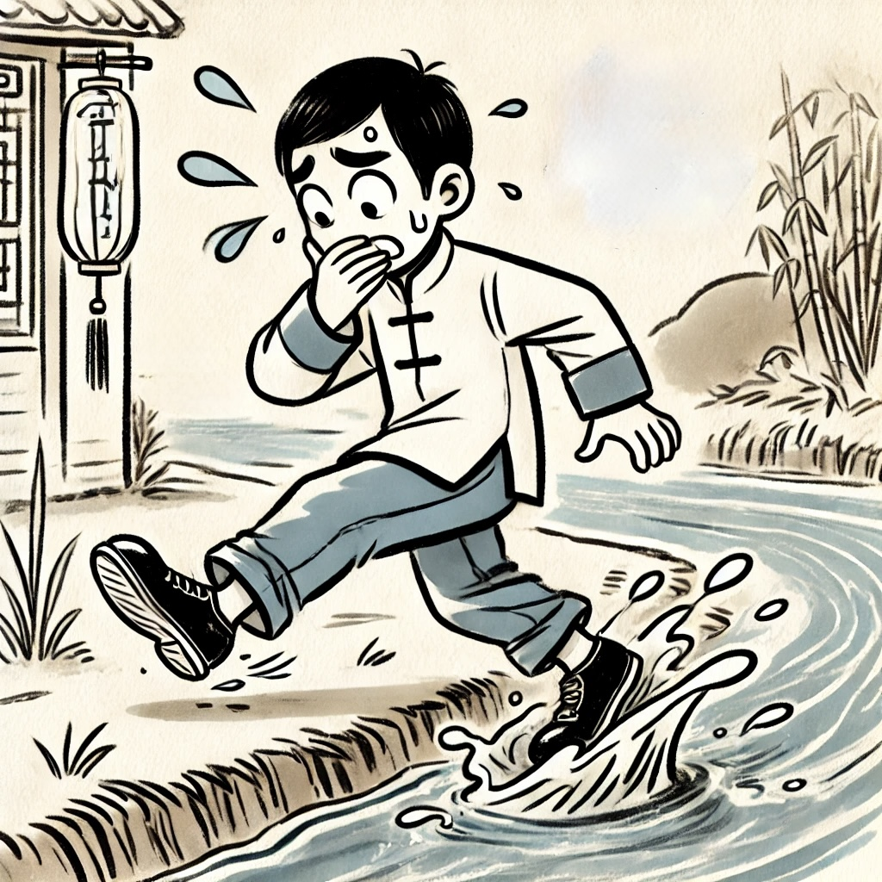
俗语：
常在河边走，哪有不湿鞋
A common saying: "If you walk by the river often, how can you not get your shoes wet?

Slide 46
智慧人娶贤妻，贤妻使家富裕。
9
The wise marry a virtuous wife, and a virtuous wife brings prosperity to the family.

Slide 47
箴言 14:1
智慧妇人建立家室；愚妄妇人亲手拆毁。
Proverbs 14:1.
The wisest of women builds her house, but folly with her own hands tears it down.

Slide 48
箴言 31:16
她想得田地就买来；用手所得之利栽种葡萄园。17.她以能力束腰，使膀臂有力。18.她觉得所经营的有利；她的灯终夜不灭。
Proverbs 31
16.She considers a field and buys it; with the fruit of her hands she plants a vineyard.17.She dresses herself with strength and makes her arms strong.18.She perceives that her merchandise is profitable. Her lamp does not go out at night.

Slide 49
以神为首，以财物尊荣神 。
10
Put God first and honor Him with your wealth.

Slide 50
（1）敬畏主，为主的国奉献。
（2）敬畏主，周济贫困的人 (箴言 11:25、28:27)
1 Honor the Lord and offer to His kingdom.
2 Honor the Lord and give to the poor (Proverbs 11:25, 28:27).

Slide 51
财宝在天上
定期存款
Treasures
in Heaven

Slide 52
箴言 3:9.你要以财物和一切初熟的土产尊荣耶和华。10 这样，你的仓房必充满有余；你的酒榨有新酒盈溢。
Proverbs 3
9.Honor the Lord with your wealth and with the firstfruits of all your produce;10.then your barns will be filled with plenty, and your vats will be bursting with wine.

Slide 53
箴言11:25
好施舍的，必得丰裕；滋润人的，必得滋润。
Proverbs 11:25.
Whoever brings blessing will be enriched, and one who waters will himself be watered.

