Slide 1
基督徒在职场中
Christians in the workplace

Slide 2
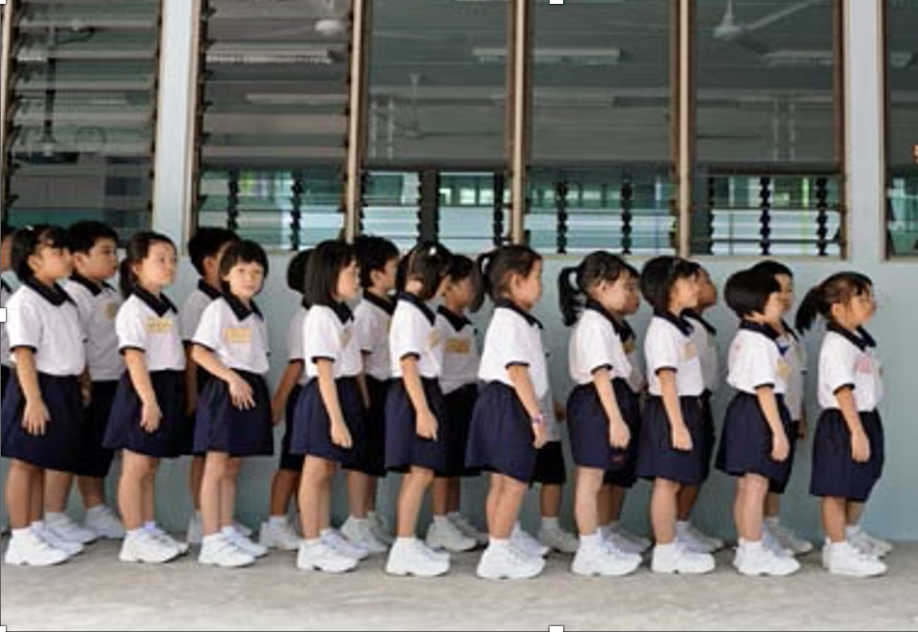
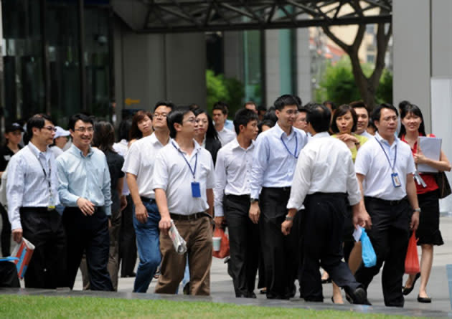

Slide 3
I
职场中甘心事奉
Serving willingly in the workplace

Slide 4
弗 6:5.你们作仆人的，要惧怕战兢，用诚实的心听从你们肉身的主人，好像听从基督一般。6.不要只在眼前事奉，像是讨人喜欢的，要像基督的仆人，从心里遵行神的旨意。7.甘心事奉，好像服事主，不像服事人。8.因为晓得各人所行的善事，不论是为奴的，是自主的，都必按所行的得主的赏赐。
Ephesians 6:5. Bondservants, obey your earthly masters with fear and trembling, with a sincere heart, as you would Christ,6.not by the way of eye-service, as people-pleasers, but as bondservants of Christ, doing the will of God from the heart,7.rendering service with a good will as to the Lord and not to man,8.knowing that whatever good anyone does, this he will receive back from the Lord, whether he is a bondservant or is free.9.Masters, do the same to them, and stop your threatening, knowing that he who is both their Master and yours is in heaven, and that there is no partiality with him.

Slide 5
II
思想神的话
Meditating on God’s Word

Slide 6
诗篇 1:2.
惟喜爱耶和华的律法，昼夜思想，这人便为有福！3.他要像一棵树栽在溪水旁，按时候结果子，叶子也不枯干。凡他所做的尽都顺利。
Psalms 1:1. Blessed is the man who walks not in the counsel of the wicked, nor stands in the way of sinners, nor sits in the seat of scoffers; 2.but his delight is in the law of the Lord , and on his law he meditates day and night. 3.He is like a tree planted by streams of water that yields its fruit in its season, and its leaf does not wither. In all that he does, he prospers.

Slide 7
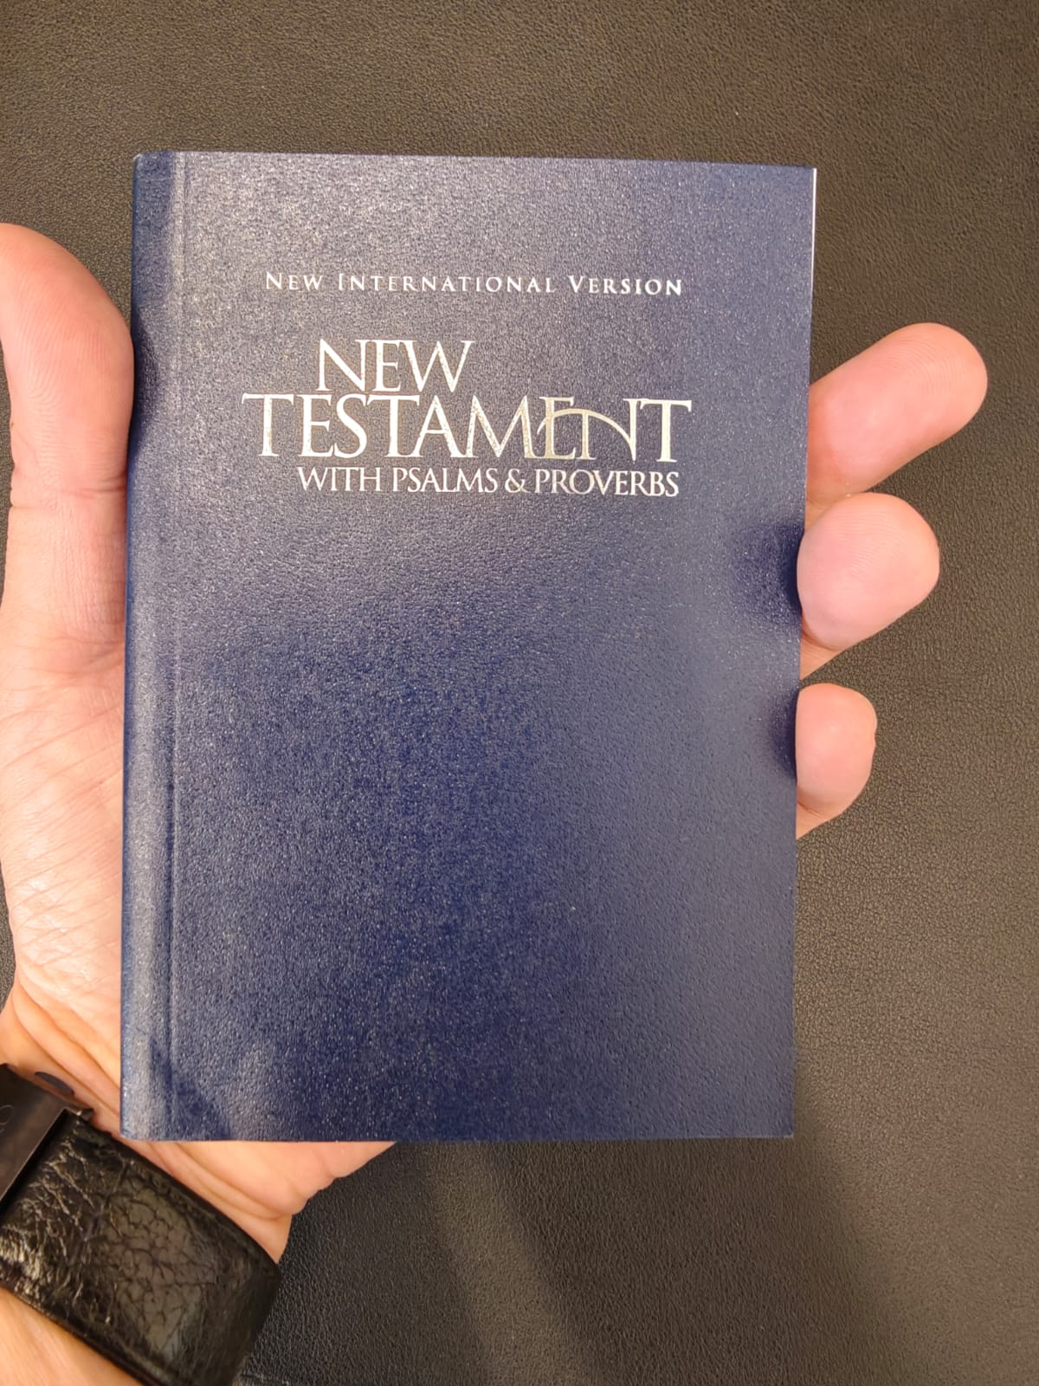

Slide 8
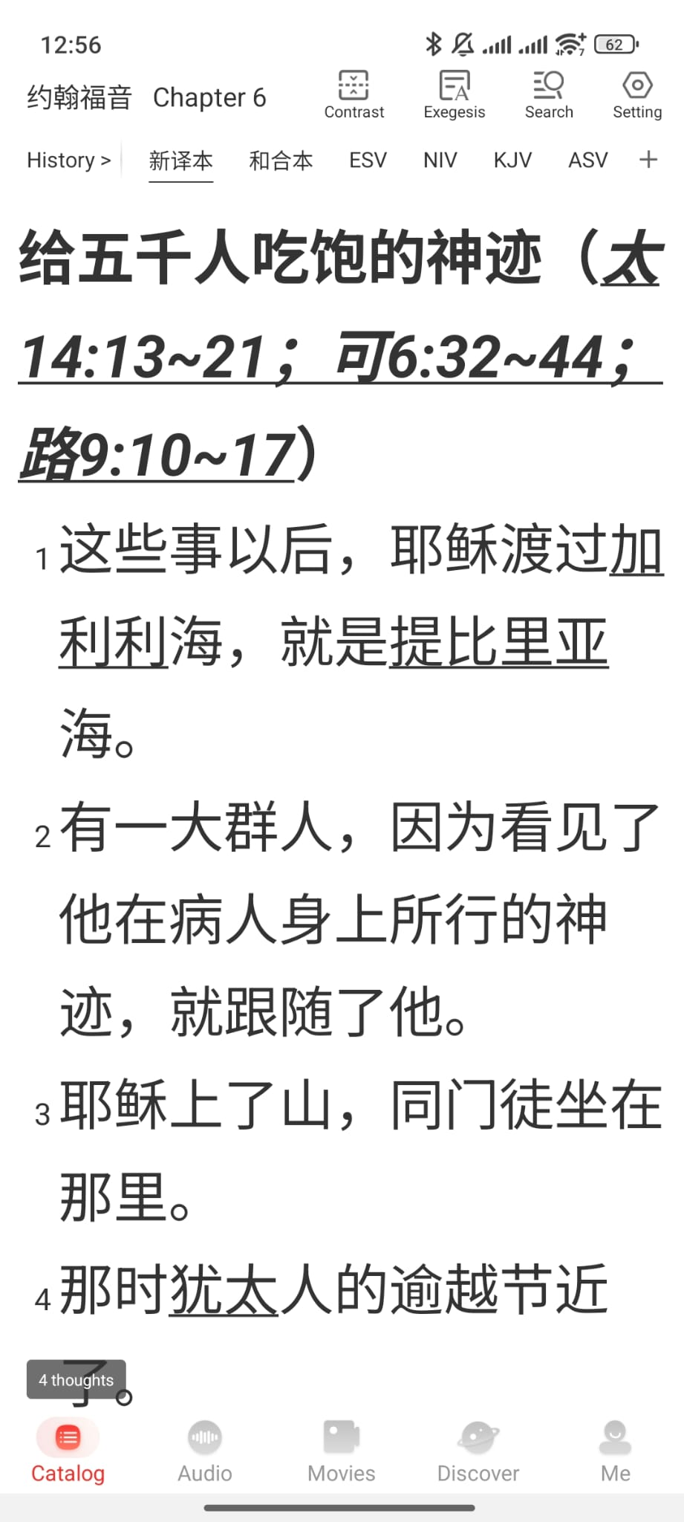
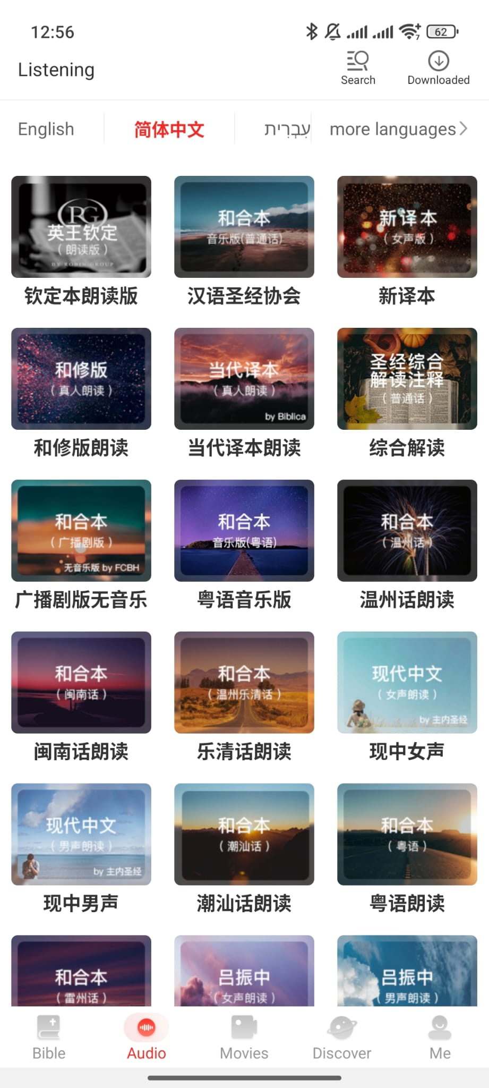


Slide 9
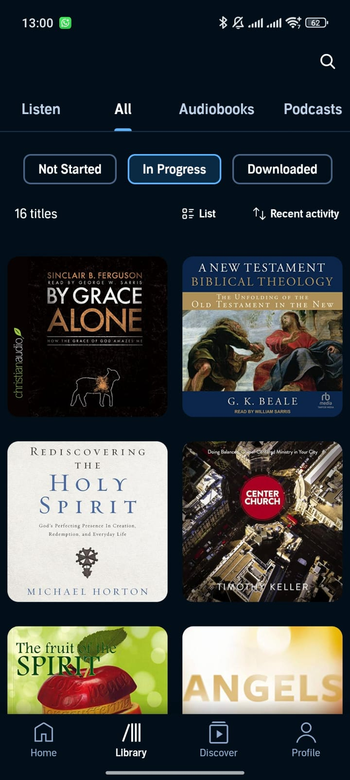


Slide 10
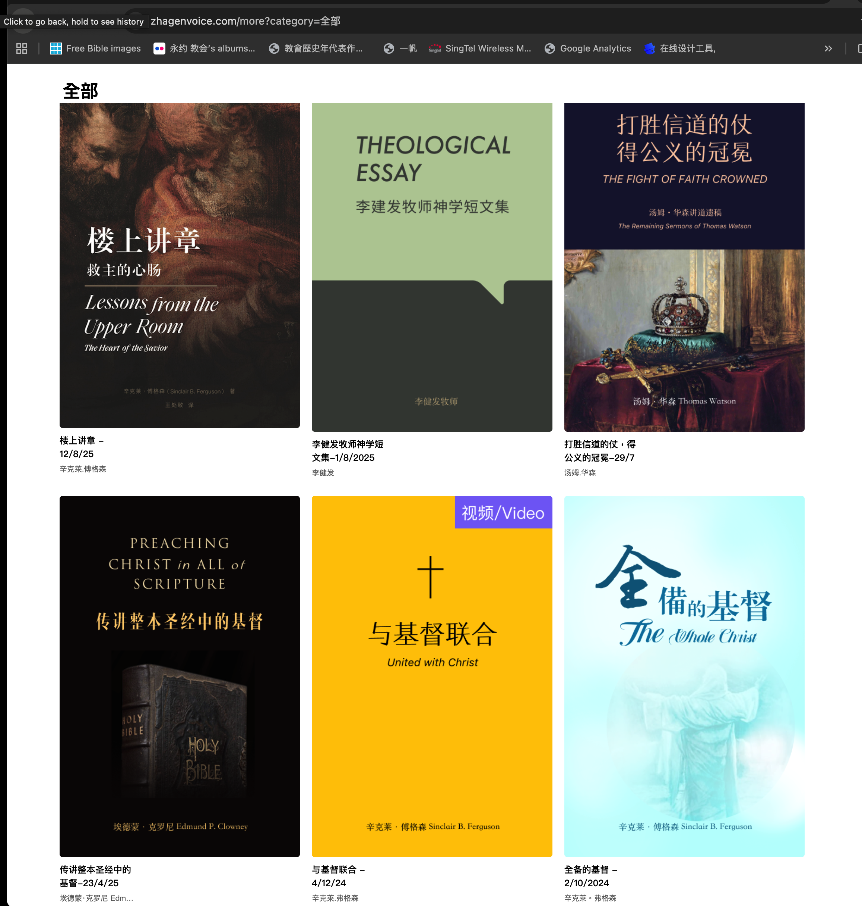


Slide 11
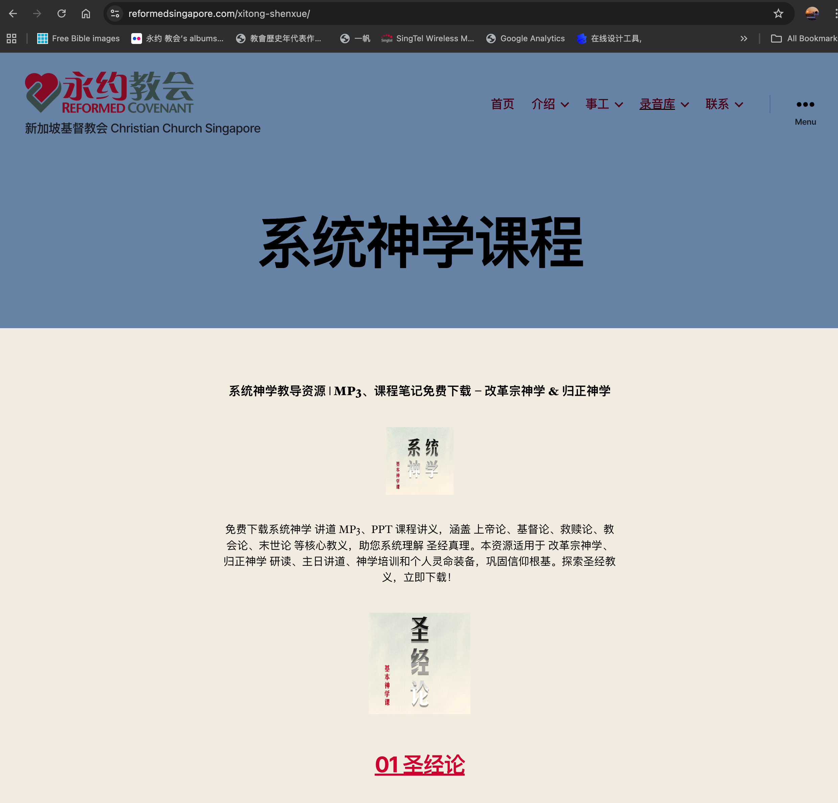

Slide 12

我岂没有吩咐你吗？你当刚强壮胆！不要惧怕，也不要惊惶；因为你无论往哪里去，耶和华—你的神必与你同在。约书亚记 1:9.

Slide 13



Slide 14
书 1:8
这律法书不可离开你的口，总要昼夜思想，好使你谨守遵行这书上所写的一切话。如此，你的道路就可以亨通，凡事顺利。
Joshua 1:8.
This Book of the Law shall not depart from your mouth, but you shall meditate on it day and night, so that you may be careful to do according to all that is written in it. For then you will make your way prosperous, and then you will have good success.

Slide 15
III
边工作，边祷告
Praying as you work

Slide 16
书 1:8
这律法书不可离开你的口，总要昼夜思想，好使你谨守遵行这书上所写的一切话。如此，你的道路就可以亨通，凡事顺利。
Joshua 1:8.
This Book of the Law shall not depart from your mouth, but you shall meditate on it day and night, so that you may be careful to do according to all that is written in it. For then you will make your way prosperous, and then you will have good success.

Slide 17
箴 16:3.
你所做的，要交托耶和华，你所谋的，就必成立。
Proverbs 16:3.
Commit your work to the Lord , and your plans will be established.

Slide 18
诗 37:5.
当将你的事交托耶和华，并倚靠他，他就必成全。
Psalms 37:5.
Commit your way to the Lord ; trust in him, and he will act.

Slide 19
IV
不要害怕人
Do not fear man

Slide 20
箴29:25.
惧怕人的，陷入网罗；惟有倚靠耶和华的，必得安稳。
Proverbs 29:25.
The fear of man lays a snare, but whoever trusts in the Lord is safe.

Slide 21
.
诗 56:2
...攻击我的人甚多。3.我惧怕的时候要倚靠你。
Psalms 56: 2 ...., for many attack me proudly. 3. When I am afraid, I put my trust in you.

Slide 22
诗118:6.
有耶和华帮助我，我必不惧怕，人能把我怎么样呢？7.在那帮助我的人中，有耶和华帮助我，所以我要看见那恨我的人遭报。
Psalms 118:6. The Lord is on my side; I will not fear. What can man do to me? 7.The Lord is on my side as my helper; I shall look in triumph on those who hate me.

Slide 23
约1:9.
我岂没有吩咐你吗？你当刚强壮胆！不要惧怕，也不要惊惶；因为你无论往哪里去，耶和华—你的神必与你同在。
Joshua 1:9.
Have I not commanded you? Be strong and courageous. Do not be frightened, and do not be dismayed, for the Lord your God is with you wherever you go."

Slide 24
V
遇良心不安的事
facing matters that trouble the conscience

Slide 25
约壹 1:9.
我们若认自己的罪，神是信实的，是公义的，必要赦免我们的罪，洗净我们一切的不义。
1 John 1:9
If we confess our sins, he is faithful and just to forgive us our sins and to cleanse us from all unrighteousness.

Slide 26
VI
灰心时想起过去，并凡事谢恩
facing matters that trouble the conscience

Slide 27
申4:9.你只要谨慎，殷勤保守你的心灵，免得忘记你亲眼所看见的事，又免得你一生、这事离开你的心；总要传给你的子子孙孙。
申7:18. 你不要惧怕他们，要牢牢记念耶和华—你神向法老和埃及全地所行的事，
Deuteronomy 4:9.” Only take care, and keep your soul diligently, lest you forget the things that your eyes have seen, and lest they depart from your heart all the days of your life. Make them known to your children and your childrens children—
Deuteronomy 7:18. you shall not be afraid of them but you shall remember what the Lord your God did to Pharaoh and to all Egypt,

Slide 28
帖前 5:17.
不住地祷告，18.凡事谢恩；因为这是神在基督耶稣里向你们所定的旨意。
1 Thessalonians 5:17.
pray without ceasing, 18. give thanks in all circumstances; for this is the will of God in Christ Jesus for you.

Slide 29
VII
天天求主加添智慧
Daily asking the Lord for more wisdom

Slide 30
雅 1:5.
你们中间若有缺少智慧的，应当求那厚赐与众人、也不斥责人的神，主就必赐给他。6.只要凭着信心求，一点不疑惑；因为那疑惑的人，就像海中的波浪，被风吹动翻腾。7.这样的人不要想从主那里得什么。
James 1:5
.If any of you lacks wisdom, let him ask God, who gives generously to all without reproach, and it will be given him. 6.But let him ask in faith, with no doubting, for the one who doubts is like a wave of the sea that is driven and tossed by the wind. 7.For that person must not suppose that he will receive anything from the Lord;

Slide 31
诗篇 145:19
敬畏他的人，他必成就他们的心愿，也必听他们的呼求，拯救他们。20. 耶和华保护一切爱他的人，却要灭绝一切的恶人。
Psalms 145:19.
He fulfills the desire of those who fear him; he also hears their cry and saves them.20. The Lord preserves all who love him, but all the wicked he will destroy.

