Slide 1
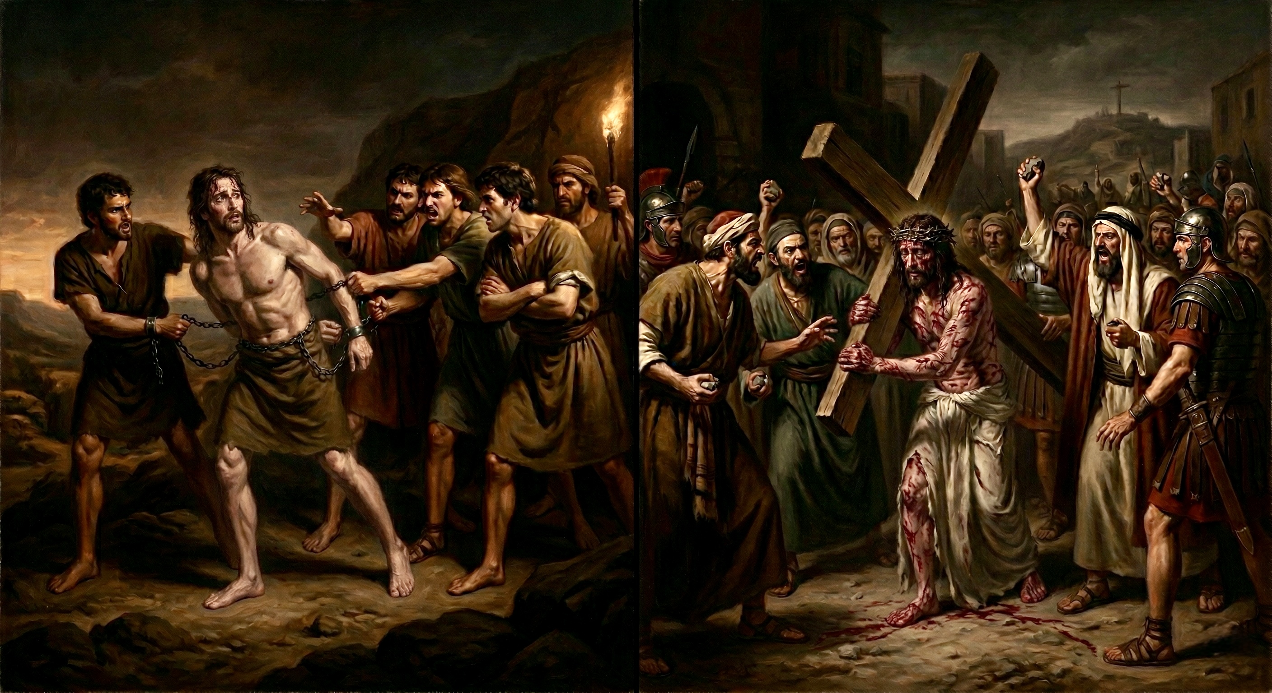
嫉妒、出卖、苦待
创世纪看约瑟与基督（上）
envied, betrayed, suffered
Looking at Joseph and Christ in Genesis

Slide 2


Slide 3
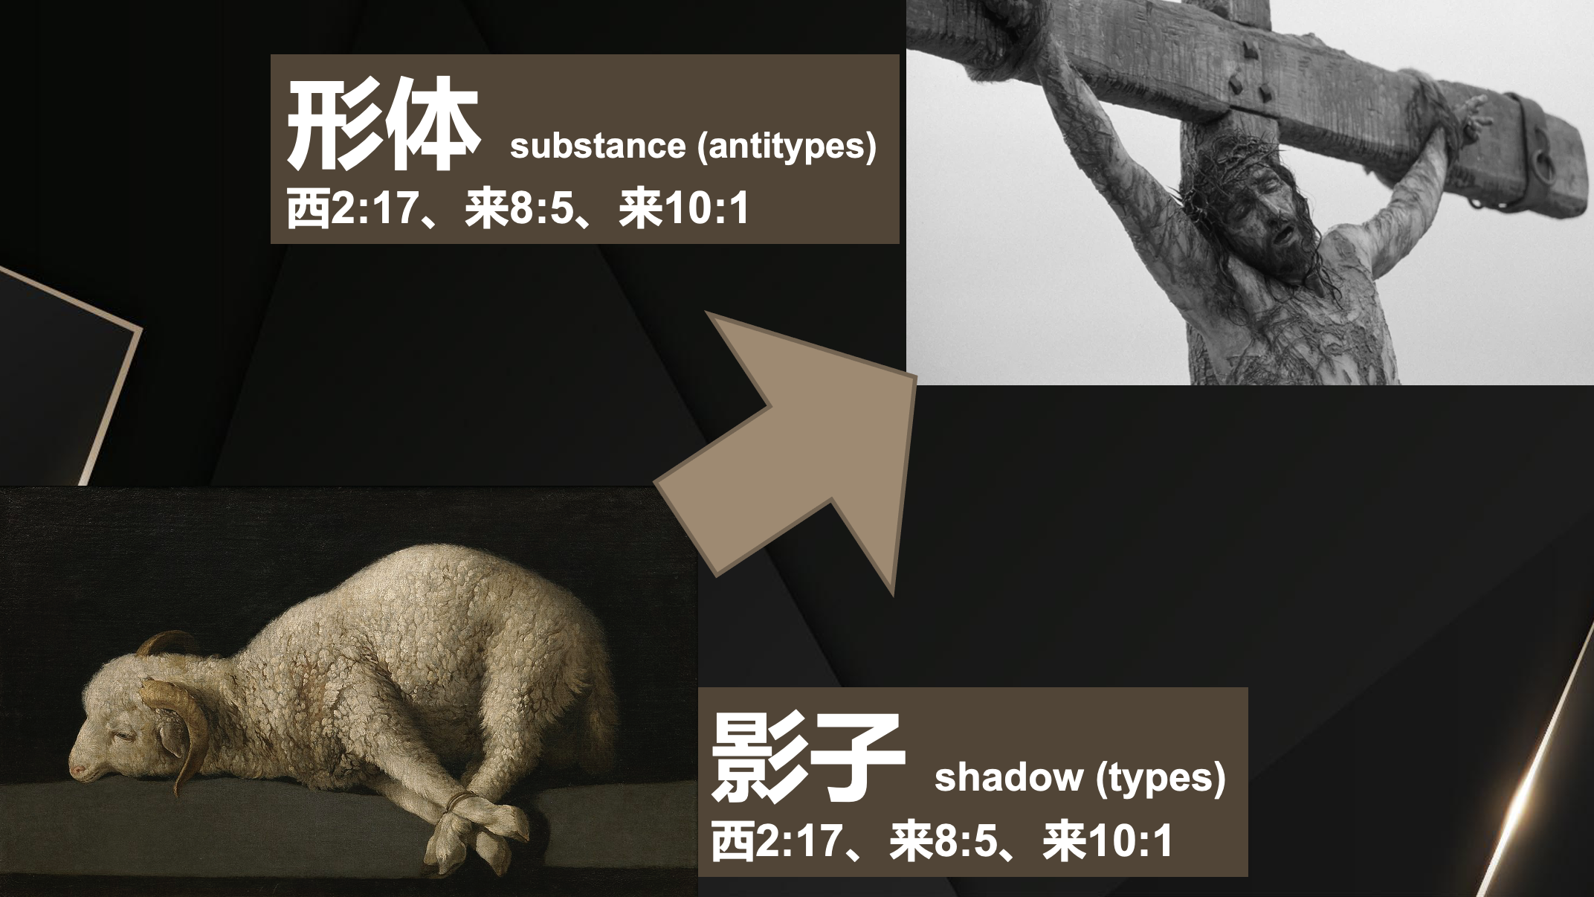

Slide 4
创世记 37:1.雅各住在迦南地，就是他父亲寄居的地。2.雅各的记略如下。约瑟十七岁与他哥哥们一同牧羊。他是个童子，与他父亲的妾辟拉、悉帕pà的儿子们常在一处。约瑟将他哥哥们的恶行报给他们的父亲。3.以色列原来爱约瑟过于爱他的众子，因为约瑟是他年老生的；他给约瑟做了一件彩衣。4.约瑟的哥哥们见父亲爱约瑟过于爱他们，就恨约瑟，不与他说和睦的话。
Genesis 37:1.Jacob lived in the land of his father's sojournings, in the land of Canaan. 2.These are the generations of Jacob. Joseph, being seventeen years old, was pasturing the flock with his brothers. He was a boy with the sons of Bilhah and Zilpah, his father's wives. And Joseph brought a bad report of them to their father.3.Now Israel loved Joseph more than any other of his sons, because he was the son of his old age. And he made him a robe of many colors.4.But when his brothers saw that their father loved him more than all his brothers, they hated him and could not speak peacefully to him.

Slide 5
5.约瑟做了一梦，告诉他哥哥们，他们就越发恨他。 6.约瑟对他们说：「请听我所做的梦：7.我们在田里捆禾hé稼jià，我的捆kǔn起来站着，你们的捆来围着我的捆下拜。」8.他的哥哥们回答说：「难道你真要作我们的王吗？难道你真要管辖我们吗？」他们就因为他的梦和他的话越发恨他。9.后来他又做了一梦，也告诉他的哥哥们说:「看哪，我又做了一梦，梦见太阳、月亮，与十一个星向我下拜。
5.Now Joseph had a dream, and when he told it to his brothers they hated him even more.6.He said to them, "Hear this dream that I have dreamed:7.Behold, we were binding sheaves in the field, and behold, my sheaf arose and stood upright. And behold, your sheaves gathered around it and bowed down to my sheaf."8.His brothers said to him, "Are you indeed to reign over us? Or are you indeed to rule over us?" So they hated him even more for his dreams and for his words.9.Then he dreamed another dream and told it to his brothers and said, "Behold, I have dreamed another dream. Behold, the sun, the moon, and eleven stars were bowing down to me."

Slide 6
10.约瑟将这梦告诉他父亲和他哥哥们，他父亲就责备他说：「你做的这是什么梦！难道我和你母亲、你弟兄果然要来俯伏在地，向你下拜吗？」11.他哥哥们都嫉妒他，他父亲却把这话存在心里。
10.But when he told it to his father and to his brothers, his father rebuked him and said to him, "What is this dream that you have dreamed? Shall I and your mother and your brothers indeed come to bow ourselves to the ground before you?"11.And his brothers were jealous of him, but his father kept the saying in mind.

Slide 7
【1】
神所爱的人遭人嫉妒
The one loved by God is envied by others.

Slide 8
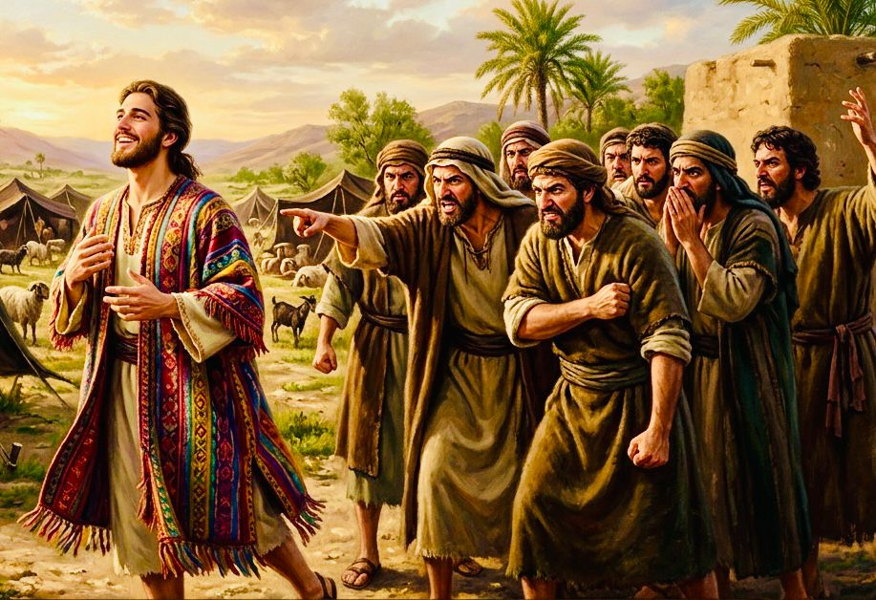
【A】
遭人嫉恨：
因他与别人不一样
Hated by others: because he is different from others.

Slide 9
【B】
遭人嫉妒：
他拥有别人所没有的
Envied by others: he has what others do not.

Slide 10
3....他给约瑟做了一件彩衣。4.约瑟的哥哥们见父亲爱约瑟过于爱他们，就恨约瑟，不与他说和睦的话。
3..... And he made him a robe of many colors.4.But when his brothers saw that their father loved him more than all his brothers, they hated him and could not speak peacefully to him.

Slide 11
【C】
遭人嫉妒：
上帝唯独启示他，要使他高升
Envied by others: God reveals to him alone and intends to exalt him.

Slide 12
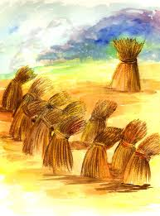
8.他的哥哥们回答说：「难道你真要作我们的王吗？难道你真要管辖我们吗？」他们就因为他的梦和他的话越发恨他。
8.His brothers said to him, "Are you indeed to reign over us? Or are you indeed to rule over us?" So they hated him even more for his dreams and for his words.
我捆的禾hé稼jià起来站着，你们的捆来围着我的捆下拜
your sheaves gathered around it and bowed down to my sheaf

Slide 13
被人嫉妒
to be envied
嫉妒人
to envy others

Slide 14
路12:48
...因为多给谁，就向谁多取；多托谁，就向谁多要。
Luk 12:48 。。。Everyone to whom much was given, of him much will be required, and from him to whom they entrusted much, they will demand the more.

Slide 15
罗8:17
...如果我们和他一同受苦，也必和他一同得荣耀。
Rom 8:17 ... provided we suffer with him in order that we may also be glorified with him.

Slide 16
【2】
被自己人出卖
betrayed by his own people.

Slide 17
37:25.他们坐下吃饭，举目观看，见有一伙米甸的以实玛利人从基列来，用骆驼驮tuó着香料、乳香、没药，要带下埃及去。26.犹大对众弟兄说：「我们杀我们的兄弟，藏了他的血有什么益处呢？27.我们不如将他卖给以实玛利人，不可下手害他；因为他是我们的兄弟，我们的骨肉。」众弟兄就听从了他。28.有些米甸的商人从那里经过，哥哥们就把约瑟从坑里拉上来，讲定二十舍客勒银子，把约瑟卖给以实玛利人。他们就把约瑟带到埃及去了。
25.Then they sat down to eat. And looking up they saw a caravan of Ishmaelites coming from Gilead, with their camels bearing gum, balm, and myrrh, on their way to carry it down to Egypt.26.Then Judah said to his brothers, "What profit is it if we kill our brother and conceal his blood?27.Come, let us sell him to the Ishmaelites, and let not our hand be upon him, for he is our brother, our own flesh." And his brothers listened to him.28.Then Midianite traders passed by. And they drew Joseph up and lifted him out of the pit, and sold him to the Ishmaelites for twenty shekels of silver. They took Joseph to Egypt.

Slide 18
诗篇 55:12 原来不是仇敌辱骂我，若是仇敌，还可忍耐；也不是恨我的人向我狂大，若是恨我的人就必躲避他。13 不料是你；你原与我平等，是我的同伴，是我知己的朋友！14 我们素常彼此谈论，以为甘甜；我们与群众在神的殿中同行。15 愿死亡忽然临到他们！愿他们活活的下入阴间！因为他们的住处，他们的心中，都是邪恶。16 至於我，我要求告神；耶和华必拯救我。
Psalms 55:12.For it is not an enemy who taunts me— then I could bear it; it is not an adversary who deals insolently with me— then I could hide from him.13.But it is you, a man, my equal, my companion, my familiar friend.14.We used to take sweet counsel together; within God's house we walked in the throng.15.Let death steal over them; let them go down to Sheol alive; for evil is in their dwelling place and in their heart.16.But I call to God, and the Lord will save me.

Slide 19
【3】
义人被苦待时依然敬畏神
When the righteous suffer, they still fear and honor God.

Slide 20
39:1.约瑟被带下埃及去。有一个埃及人，是法老的内臣 护卫长波提乏，从那些带下他来的以实玛利人手下买了他去。2.约瑟住在他主人埃及人的家中，耶和华与他同在，他就百事顺利。3.他主人见耶和华与他同在，又见耶和华使他手里所办的尽都顺利，4.约瑟就在主人眼前蒙恩，伺候他主人，并且主人派他管理家务，把一切所有的都交在他手里。5.自从主人派约瑟管理家务和他一切所有的，耶和华就因约瑟的缘故赐福与那埃及人的家；凡家里和田间一切所有的都蒙耶和华赐福
1.Now Joseph had been brought down to Egypt, and Potiphar, an officer of Pharaoh, the captain of the guard, an Egyptian, had bought him from the Ishmaelites who had brought him down there. 2.The Lord was with Joseph, and he became a successful man, and he was in the house of his Egyptian master.3.His master saw that the Lord was with him and that the Lord caused all that he did to succeed in his hands.4.So Joseph found favor in his sight and attended him, and he made him overseer of his house and put him in charge of all that he had.5.From the time that he made him overseer in his house and over all that he had, the Lord blessed the Egyptian's house for Joseph's sake; the blessing of the Lord was on all that he had, in house and field.

Slide 21
6.波提乏将一切所有的都交在约瑟的手中，除了自己所吃的饭，别的事一概不知。约瑟原来秀雅俊美。7.这事以后，约瑟主人的妻以目送情给约瑟,说:「你与我同寝吧！」8.约瑟不从，对他主人的妻说：「看哪，一切家务，我主人都不知道；他把所有的都交在我手里。9在这家里没有比我大的；并且他没有留下一样不交给我，只留下了你，因为你是他的妻子。我怎能作这大恶，得罪神呢？
6.So he left all that he had in Joseph's charge, and because of him he had no concern about anything but the food he ate. Now Joseph was handsome in form and appearance.7.And after a time his master's wife cast her eyes on Joseph and said, "Lie with me."8.But he refused and said to his master's wife, "Behold, because of me my master has no concern about anything in the house, and he has put everything that he has in my charge.9.He is not greater in this house than I am, nor has he kept back anything from me except you, because you are his wife. How then can I do this great wickedness and sin against God?"

Slide 22
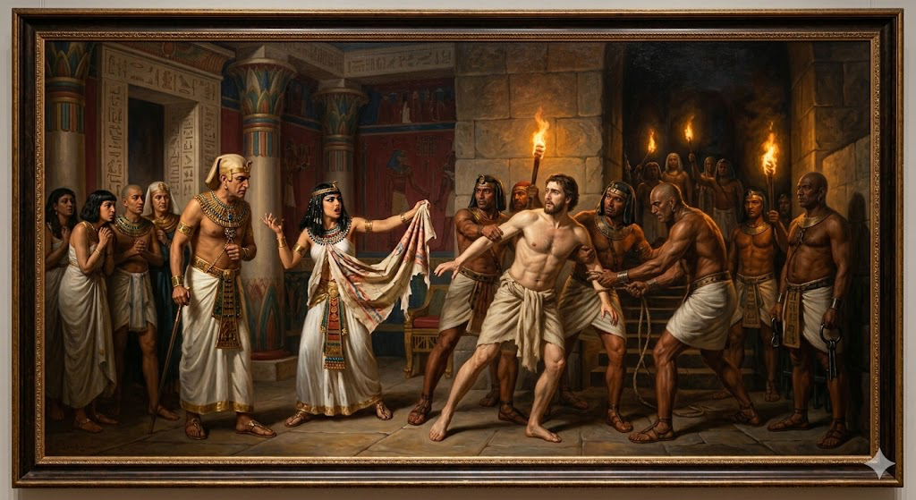
创世记 39:20.
把约瑟下在监里，就是王的囚犯被囚的地方。于是约瑟在那里坐监。
Genesis 39:20.And Joseph's master took him and put him into the prison, the place where the king's prisoners were confined, and he was there in prison.

Slide 23
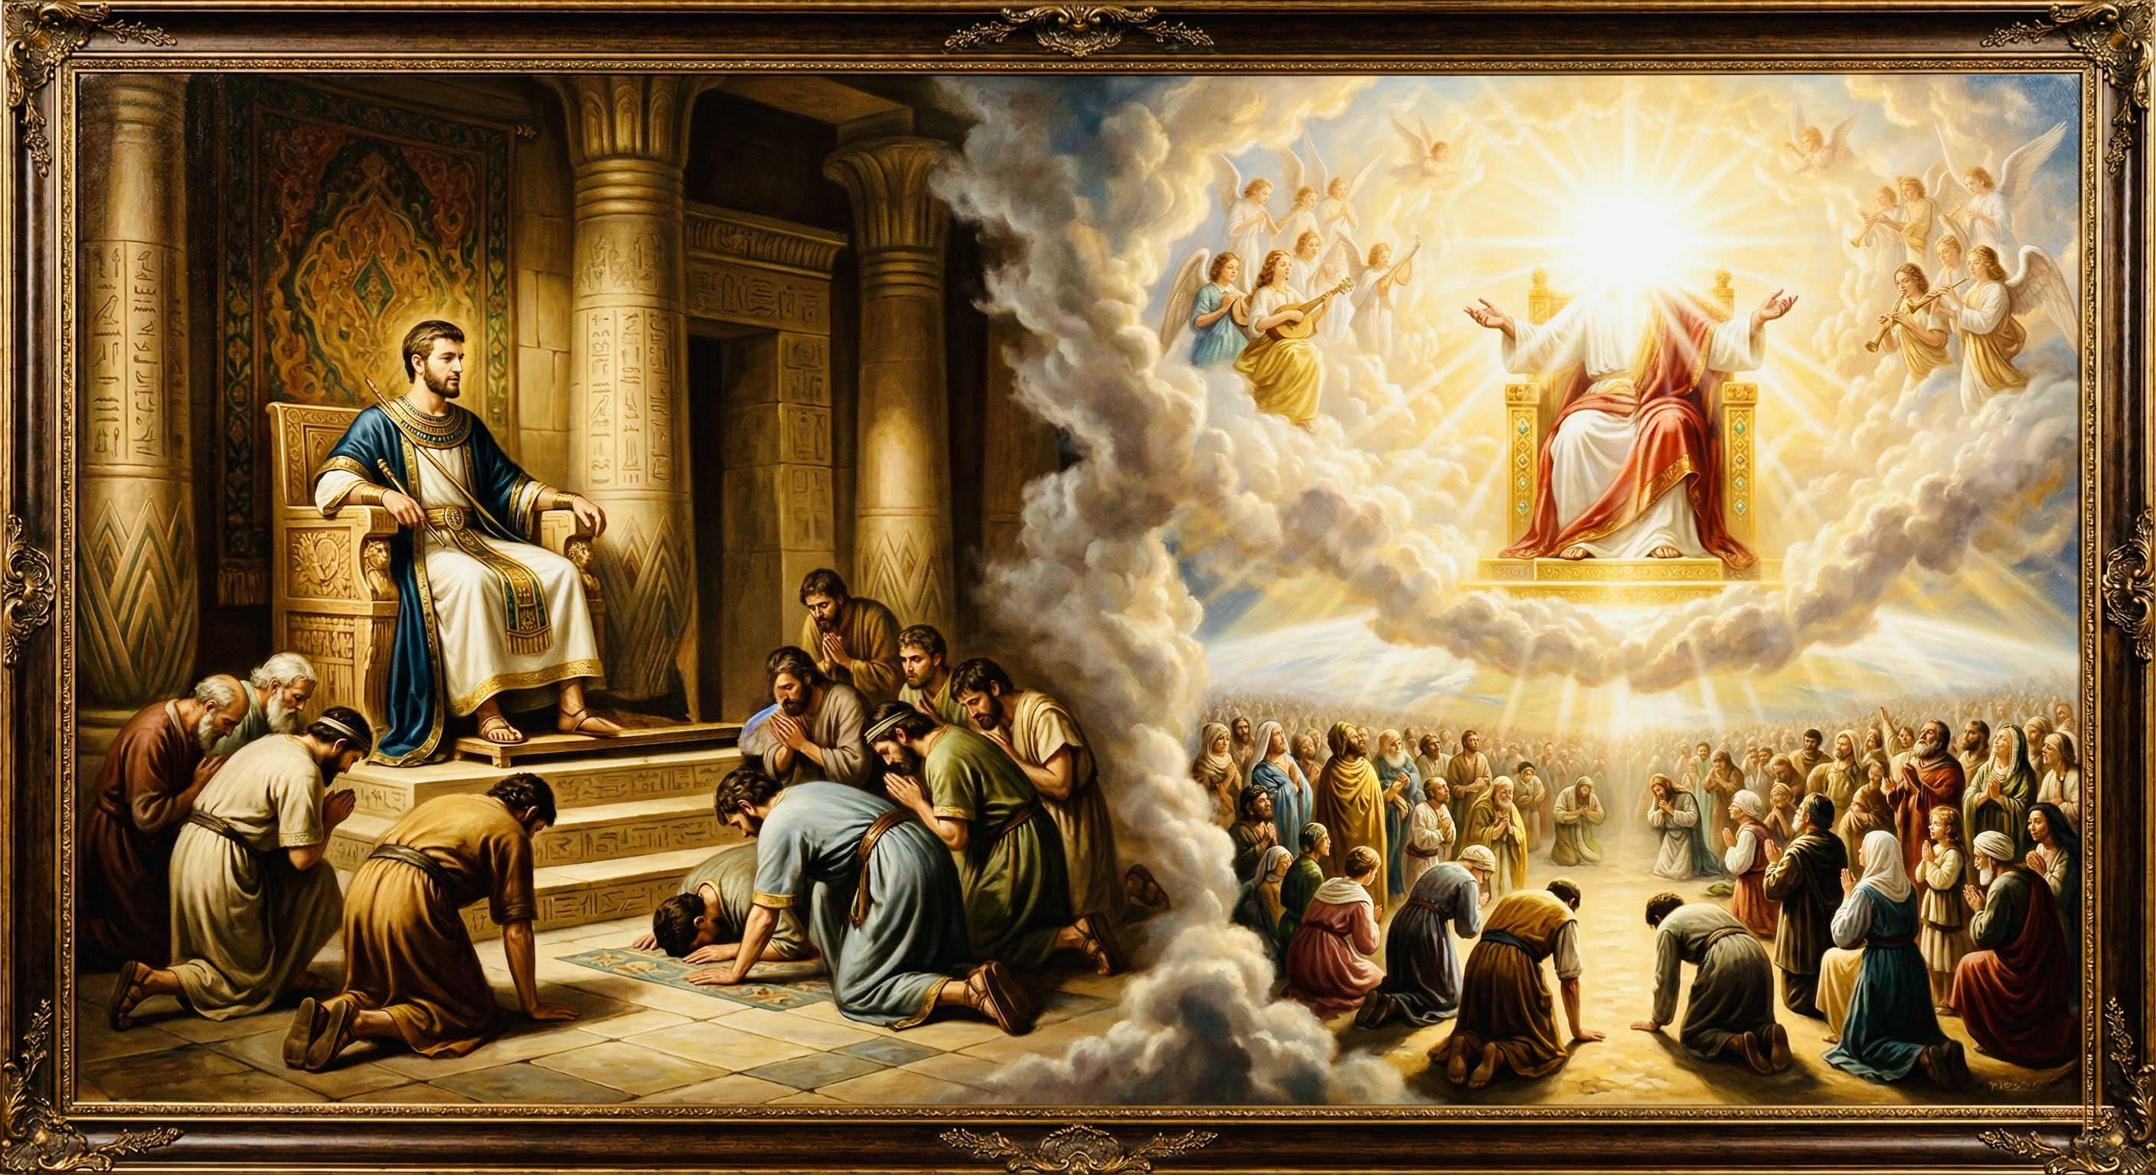
高升、救赎、饶恕
创世纪看约瑟与基督
exaltation; redemption; forgiveness
Looking at Joseph and Christ in Genesis

