Slide 1
对神失望,向神生气
Feeling disappointed with God and being angry at God.

Slide 2
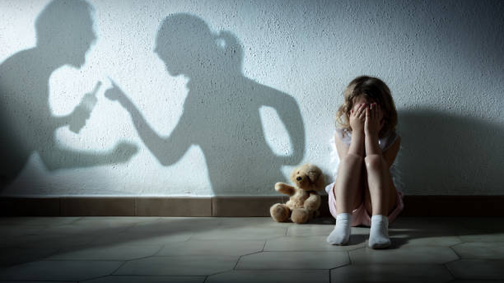

Slide 3
【1】 圣经中先知对神失望或生气的例子
Examples in the Bible where prophets felt disappointed or angry with God.

Slide 4
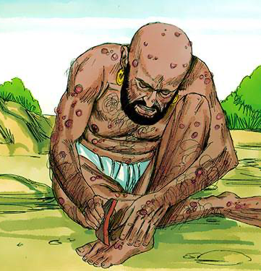
（失去十个孩子、破产、生病）
伯10:18
你为何使我出母胎呢？不如我当时气绝，无人得见我；
Job 10:18. Why did you bring me out from the womb? Would that I had died before any eye had seen me
(Losing ten children, going bankrupt, falling ill)

Slide 5
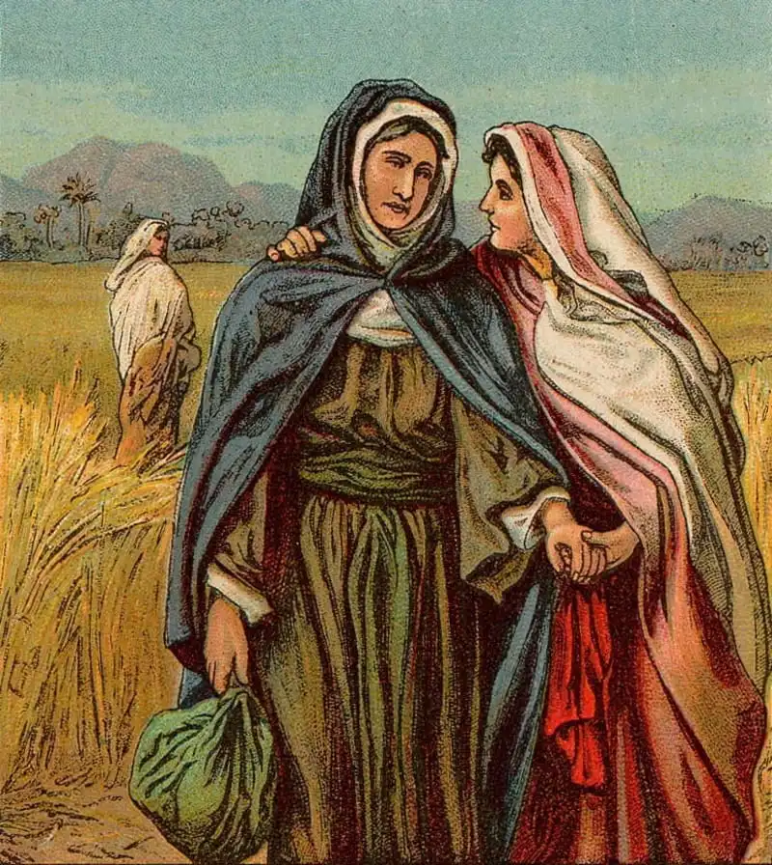
（失去丈夫与两个儿子，贫困）
得 1:20 拿俄米对他们说：「不要叫我拿俄米（就是甜的意思），要叫我玛拉（就是苦的意思），因为全能者使我受了大苦。
Ruth 1:20. She said to them, "Do not call me Naomi; call me Mara, for the Almighty has dealt very bitterly with me.
Losing her husband and two sons, and poverty

Slide 6
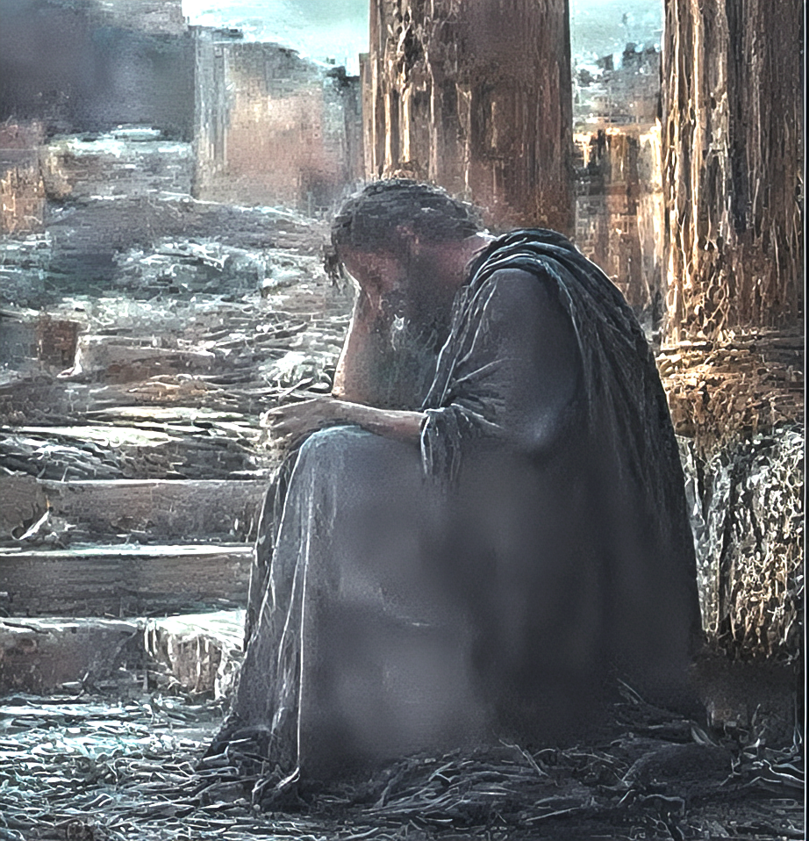
受到逼迫伤害
（新译本）耶20:7 耶和华啊！你愚弄了我 ，我受了愚弄；你比我强大，你胜了我。我整天成了别人讥笑的对象，人人都嘲弄我。
Jeremiah 20:7. O Lord , you have deceived me, and I was deceived; you are stronger than I, and you have prevailed. I have become a laughingstock all the day; everyone mocks me.
facing persecution and harm

Slide 7
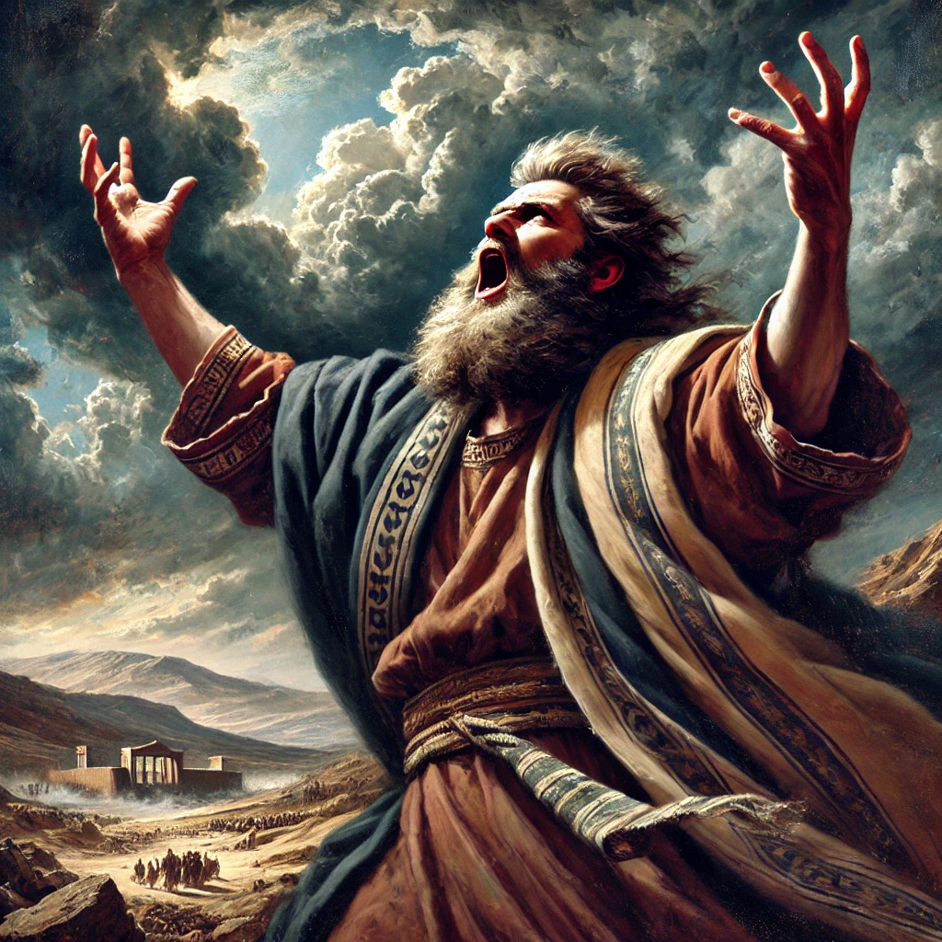
受到逼迫伤害
哈1:2 他说：耶和华啊！我呼求你，你不应允，要到几时呢？我因强暴哀求你，你还不拯救。
Habakkuk 1:2. O Lord , how long shall I cry for help, and you will not hear? Or cry to you "Violence!" and you will not save?
facing persecution and harm

Slide 8
当基督徒对神失望，
会有什么可能的反应？
What possible response might Christians have when they feel disappointed with God?

Slide 9
1）一些遇困难对神失望，遇见试炼就跌倒了（路8:13）
Some, when facing difficulties, feel disappointed with God and fall away during trials (Luke 8:13).
2）与神疏远，不再寄望神会帮助他们
distance themselves from God and no longer hope that He will help them.
3）怀疑神的爱，认为神一点都不爱他们
Doubting God's love, they feel that God does not love them at all.
4）像先知们与神吵架，质问神
Quarrel with God and questioning Him, like the prophets did.
5）像基督一样依然爱神，顺服神的主权
Continuing to love God and submit to His sovereignty, just like Christ did.

Slide 10
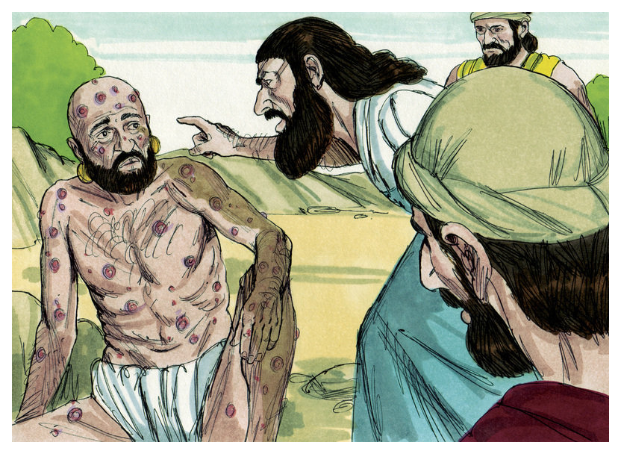
约伯的三位好朋友
Job's three good friends

Slide 11
【2】 信徒对神感到失望的一部分原因
Some of the reasons believers feel disappointed with God

Slide 12
1）神没有应允祷告，像小孩一样生气或失望
When God does not answer prayers, becomes angry or disappointed like a child.
2）认为神更赐福其他弟兄姐妹。
distance themselves from God and no longer hope that He will help them.
3）不赞同神的安排。比如约拿（拿4:1）
disagrees with God‘s ways and methods
4）因苦难感到失望或愤怒，如约伯，或 因顺服受苦如耶利米。
Feeling disappointed or angry due to suffering, like Job, or suffering for obedience, like Jeremiah.
5）因被父母、牧者、领袖伤害，对神感到失望。
Disappointed with God due to being hurt by parents, pastors, or leaders.

Slide 13
【3】 造成我们受苦的一部分原因
Part of the reasons for our suffering

Slide 14
1）有些苦难是我们自身的愚昧所导致的
Some suffering is caused by our own foolishness.
2）堕落的世界中的不合理性
The irrationality in a fallen world
3）因罪恶义人也会受苦
Because of sin, the righteous also suffer.
4）撒旦影响世界，抵挡上帝的旨意 (约壹 5:19)
Satan influences the world and opposes God‘s will. (1 John 5:19)
5）还有许多原因，因时间关系未能列出
There are many reasons, but not all are listed due to time constraints.

Slide 15
【4】 对神感到生气或失望时， 我们应该如何回应？
How should we respond when we feel angry or disappointed with God?

Slide 16
对神感到生气或失望时，我们应该如何回应？ How should we respond when we feel angry or disappointed with God?
1）不要离开神。e.g.约伯、拿俄米
Do not distance yourself from God; keep waiting on Him. For example, Job and Naomi.
2）借鉴先知们的经历。e.g.阅读诗篇、耶利米哀歌、约伯记、先知书
Learn from the experiences of the prophets, e.g., by reading Psalms, Lamentations, Job, and the Prophets.
3）以眼泪向神哭泣（e.g.耶利米哀歌）
Cry out to God with tears (e.g., Lamentations).

Slide 17
对神感到生气或失望时，我们应该如何回应？ How should we respond when we feel angry or disappointed with God?
4）求神的灵开我们的眼睛。
Ask God's Spirit to open our eyes
5）定睛在主耶稣与十字架
Fix your eyes on the Lord Jesus and the cross..
6）祈求神开恩给你有生之年看见好的结局
Pray for God's mercy to let you see a good ending in your lifetime

Slide 18
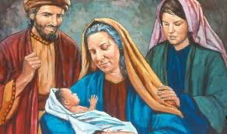
得 4:14
妇人们对拿俄米说：「耶和华是应当称颂的！因为今日没有撇下你，使你无至近的亲属。愿这孩子在以色列中得名声。
Ruth 4:14. Then the women said to Naomi, "Blessed be the Lord , who has not left you this day without a redeemer, and may his name be renowned in Israel!
波阿斯与路得为拿俄米生下俄备得
Boaz and Ruth bore Obed for Naomi.

Slide 19
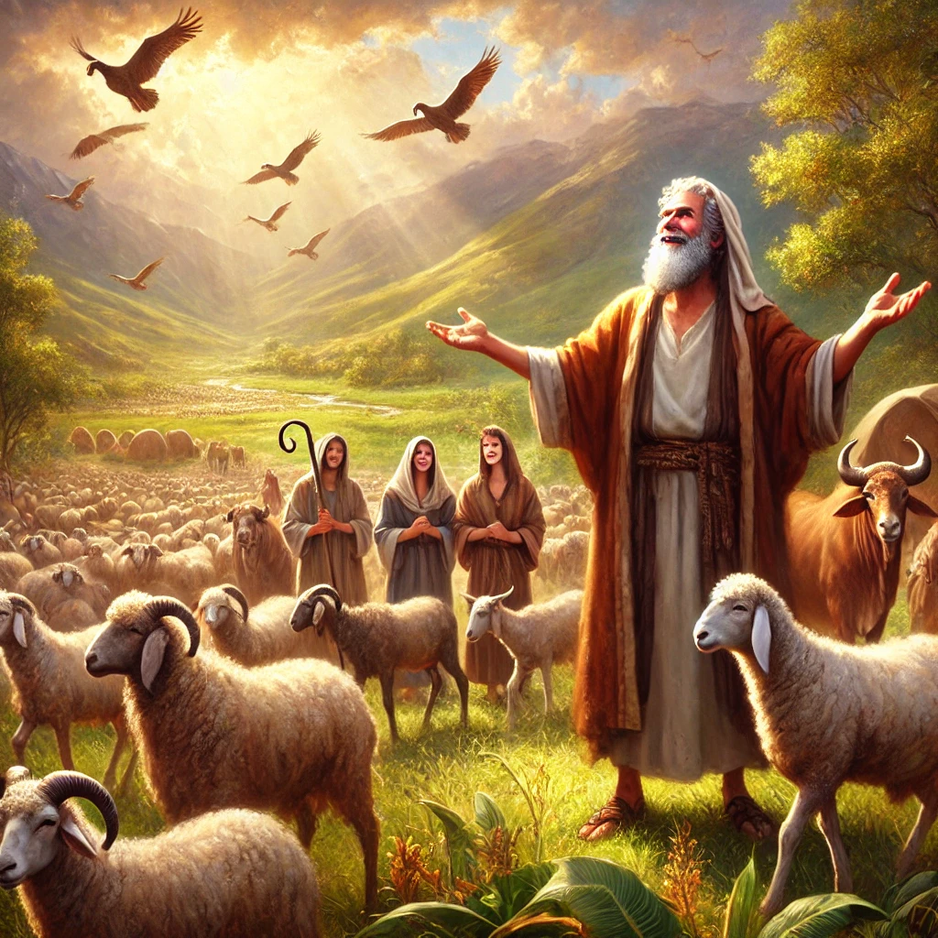
伯42:12
这样，耶和华後来赐福给约伯比先前更多。...
Job 42:12 .And the Lord blessed the latter days of Job more than his beginning. …

Slide 20
雅 5:11 那先前忍耐的人，我们称他们是有福的。你们听见过约伯的忍耐，也知道主给他的结局，明显主是满心怜悯，大有慈悲。
James 5:11. Behold, we consider those blessed who remained steadfast. You have heard of the steadfastness of Job, and you have seen the purpose of the Lord, how the Lord is compassionate and merciful.

Slide 21
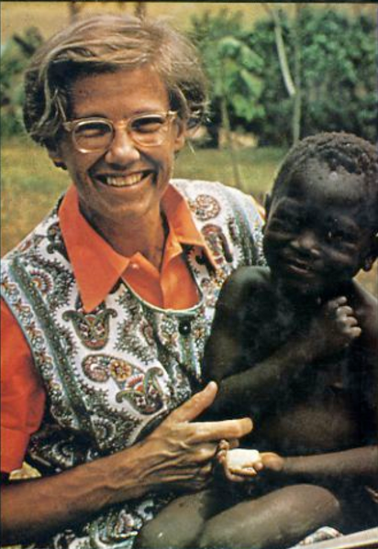
海伦·罗斯维尔医生 (出生1925）
Dr Helen Roseveare born 1925
在一次宣教聚会中公开宣告：“无论代价如何，我愿意去任何神要我去的地方。”
in a missionary meeting in England in 1945, she publicly declared: 'No matter the cost, I am willing to go wherever God wants me to go.'

Slide 22
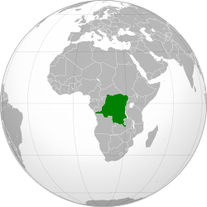
在1953年，28岁抵达
刚果 Congo（后来称为扎伊尔 Zaire）
In 1953, at the age of 28, she arrived in Congo (later known as Zaire).

Slide 23
她被囚禁长达五个月
She was imprisoned for up to five months.
“遍体鳞伤、恐惧痛苦、孤立无援的我，感到神似乎辜负了我。祂本可以早些介入，事情不至于发展到如此地步。我感到自己跌入绝望与空虚的深渊。”
beaten and bruised, terrified and tormented, unutterably alone, I had felt at last God had failed me. Surely He could have stepped in earlier, surely things need not have gone that far. I had reached what seemed to be the ultimate depth of despairing nothingness.

Slide 24
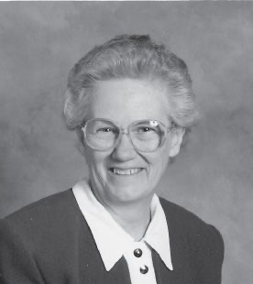
海伦·罗斯维尔医生
Dr Helen Roseveare
享年91岁
1925 - 2016
Lived to the age of 91
(1925–2016).

Slide 25
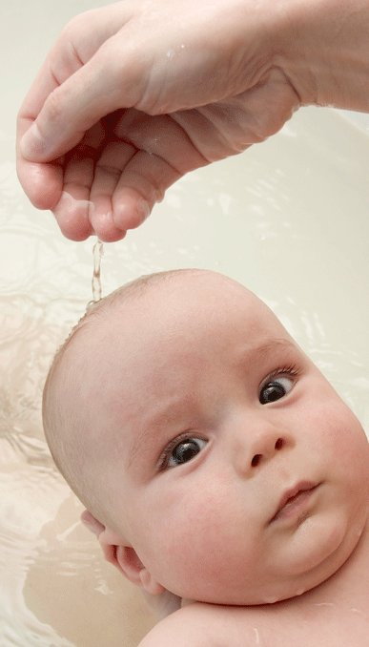
洗礼

Slide 26
马太福音 16:24
於是耶稣对门徒说：
若有人要跟从我，就当舍己，背起他的十字架来跟从我。
Mat 16:24
Then Jesus told his disciples,
“If anyone would come after me, let him deny himself
and take up his cross and follow me.

Slide 27
问：你是否接受耶稣基督是上帝的独生爱子，祂就是上帝？
问：你是否承认自己是罪人，并接受耶稣基督为你的罪钉在十字架上 ？
问：你是否相信耶稣基督赦免你的罪并赐你永生？

Slide 28
问：你是否愿意背起十字架来跟随主耶稣，作主耶稣的门徒？
问：你是否愿意坚守神与你所立的约？一生信主、爱主、顺服主。

