Slide 1

慧言所结的福果
《箴言16:24》
The Blessed Fruit Produced by Words of Wisdom
(Proverbs 16:24)

Slide 2

有什么事情不需要花钱就能祝福人？
What things can bless others without spending money?

Slide 3
【1】
言语拥有强大的能力
Speech possesses great power.

Slide 4

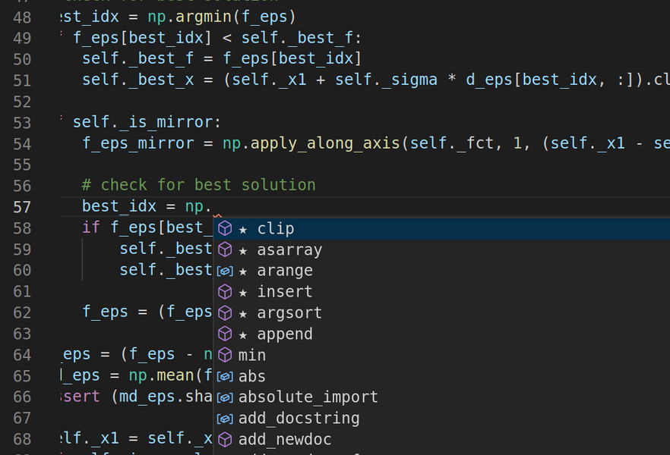



Slide 5
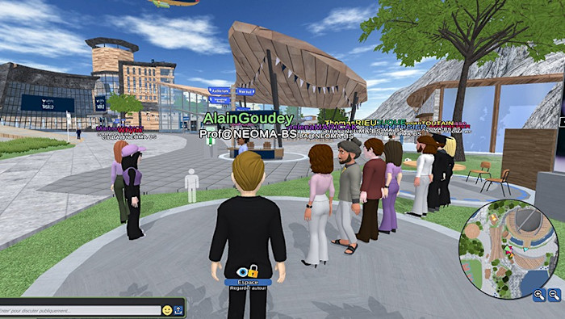

Slide 6
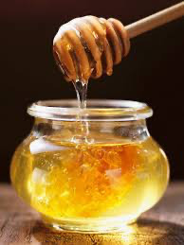
箴言 16:24
良言如同蜂房，使心觉甘甜，使骨得医治。
Pro 16:24 Gracious words are like a honeycomb, sweetness to the soul and health to the body.

Slide 7
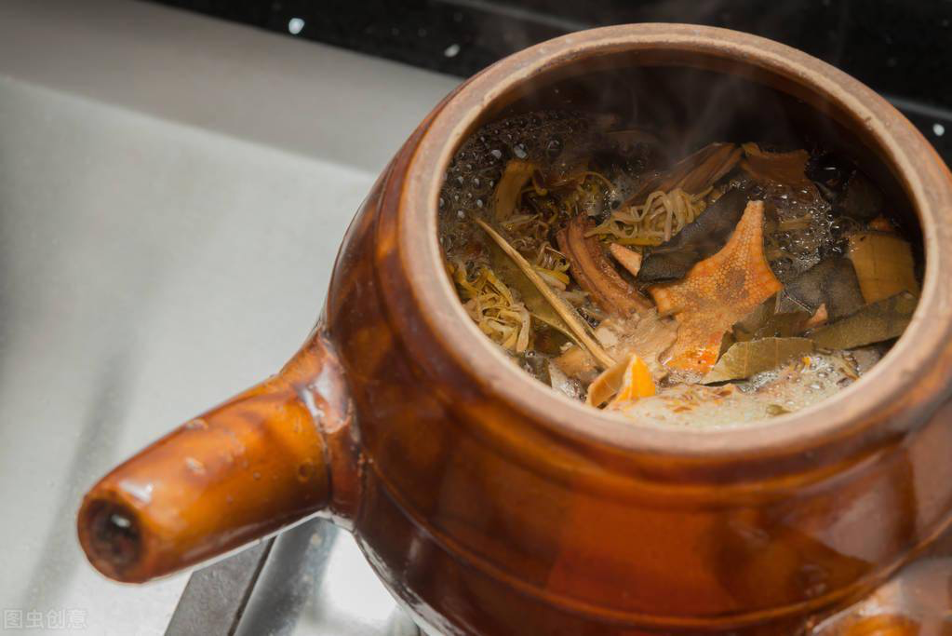
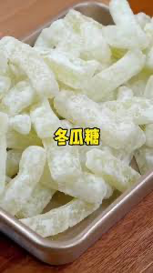

Slide 8

箴言 16:24
良言如同蜂房，使心觉甘甜，使骨得医治。
Pro 16:24 Gracious words are like a honeycomb, sweetness to the soul and health to the body.
良言如同苦药，使心觉甘苦，使骨被折断。
Gracious words are like a bitter gourd , bitterness to the soul and inflicting the body.

Slide 9
【2】
人能完全控制口舌吗？
Can a person completely control the tongue?

Slide 10
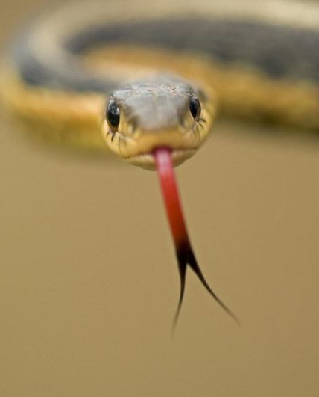
雅 3:8
惟独舌头没有人能制伏，是不止息的恶物，满了害死人的毒气。
Jas 3:8 but no human being can tame the tongue. It is a restless evil, full of deadly poison.

Slide 11
常说谎 Frequently lies
不守秘密 Cannot keep secrets
说话愚昧 Speaks foolishly
说话鲁莽 Speaks rashly
尖酸刻薄 sarcastic
爱讲人 Gossips
骂粗话 Vulgar language
辱骂父母 Insults parents

Slide 12
【3】
尽力谨守口舌的人有福
Blessed is the one who diligently guards his tongue.

Slide 13
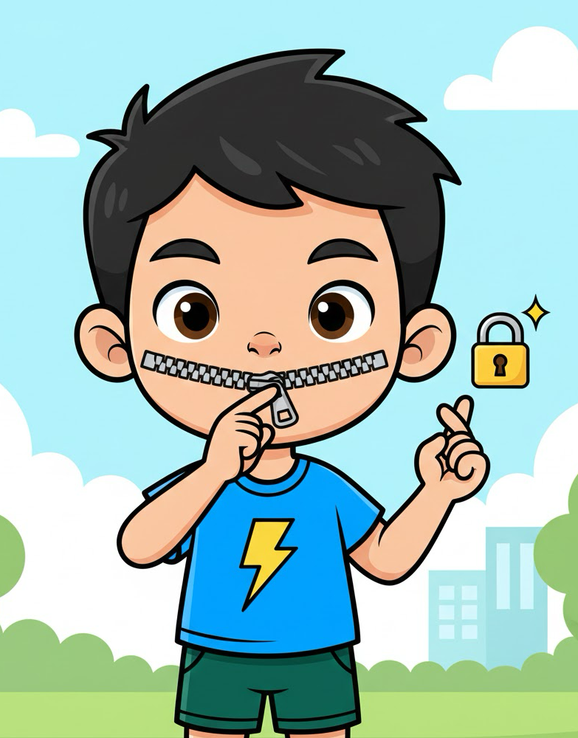
箴 13:3 谨守口的，得保生命；大张嘴的，必致败亡。
Pro 13:3 Whoever guards his mouth preserves his life; he who opens wide his lips comes to ruin.

Slide 14
一起聊天时 In Group conversation
不要随意给人意见 Avoid unsolicited advice
不要随意评价 Avoid opinions.
不要好奇问私事 Don’t probe into privacy
不要心直口快 Do not be bluntly straight forward
少说话 Speak less

Slide 15
箴17:28 愚昧人若静默不言也可算为智慧；闭口不说也可算为聪明。
Pro 17:28 Even a fool who keeps silent is considered wise; when he closes his lips, he is deemed intelligent.

Slide 16
【4】
纠正亵慢人使自己受害
Correcting a scoffer brings harm upon oneself.

Slide 17
箴言 9:7 指斥亵慢人的，必受辱骂；责备恶人的，必被玷污。8 不要责备亵慢人，恐怕他恨你；要责备智慧人，他必爱你 。
Pro 9:7 Whoever corrects a scoffer gets himself abuse, and he who reproves a wicked man incurs injury.
8 Do not reprove a scoffer, or he will hate you; reprove a wise man, and he will love you.

Slide 18
【5】
求主赐我们能扶助疲乏人的话语。
May the Lord grant us words that can sustain the weary.

Slide 19
赛50:4 主耶和华赐我受教者的舌头，使我知道怎样用言语扶助疲乏的人。主每早晨提醒，提醒我的耳朵，使我能听，像受教者一样。
Isa 50:4 The Lord GOD has given me the tongue of those who are taught, that I may know how to sustain with a word him who is weary. Morning by morning he awakens; he awakens my ear to hear as those who are taught.

