Slide 1
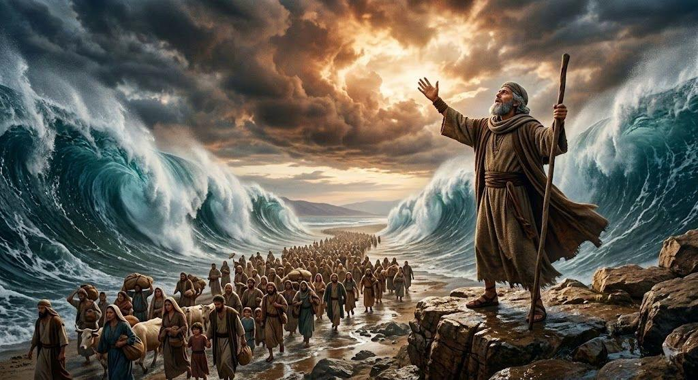
摩西开红海
出14章1至31
Moses parts the Red Sea, Exodus 14:1–31

Slide 2
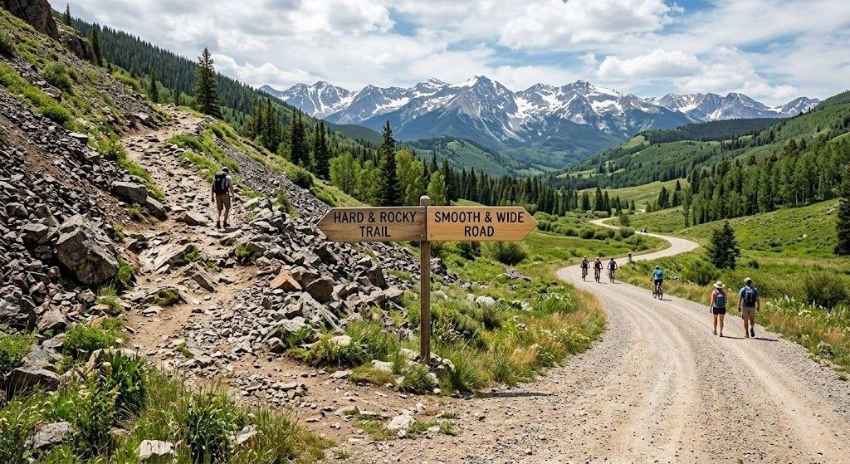

Slide 3

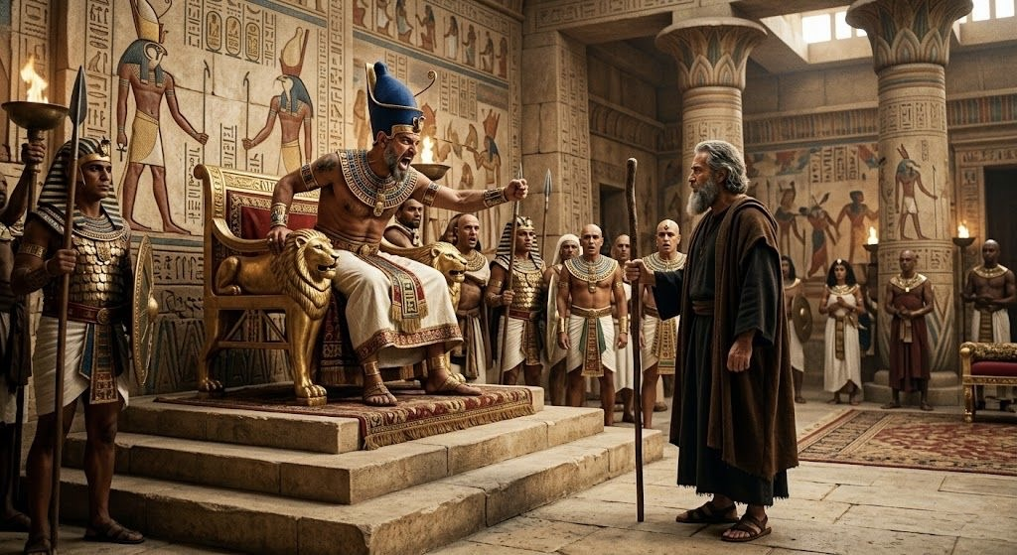

Slide 4
01
上帝神圣的安排
The Divine Setup .

Slide 5
出14:1.耶和华告诉摩西说：2.“你要吩咐以色列人转回过来，在比.哈希录前，密夺和海之间安营；你们要在巴力.洗分前，对着巴力.洗分，靠近海边的地方安营。3.法老必论到以色列人的事，说:‘他们在这地走迷了路，旷野把他们困住了。’4.我要使法老的心刚硬，他就必追赶他们；这样，我就可以在法老身上和他的全军身上得到荣耀，埃及人就必知道我是耶和华。”于是以色列人就这样行了。
Exodus 14:1.Then the Lord said to Moses, 2."Tell the people of Israel to turn back and encamp in front of Pi-hahiroth, between Migdol and the sea, in front of Baal-zephon; you shall encamp facing it, by the sea.3.For Pharaoh will say of the people of Israel, 'They are wandering in the land; the wilderness has shut them in.'4.And I will harden Pharaoh's heart, and he will pursue them, and I will get glory over Pharaoh and all his host, and the Egyptians shall know that I am the Lord ." And they did so.
1/2

Slide 6
5.有人告诉埃及王说：“以色列人逃走了。”法老和他的臣仆对以色列人的心就改变了，他们说：“我们让以色列人离开，不再服事我们，我们作了什么事呢？”6.法老就预备他的马车，带着他的人民一同去，7.并且带着六百辆特选的马车和埃及所有的马车，每辆马车上都有马车长。8.耶和华使埃及王法老的心刚硬，法老就追赶以色列人；因为以色列是靠着耶和华高举的手出来的。9.埃及人追赶他们，法老所有的马匹、战车和他的马兵与军队，就在海边，靠近比.哈希录，对着巴力.洗分他们安营的地方追上了他们。
Exodus 14:5.When the king of Egypt was told that the people had fled, the mind of Pharaoh and his servants was changed toward the people, and they said, "What is this we have done, that we have let Israel go from serving us?"6.So he made ready his chariot and took his army with him,7.and took six hundred chosen chariots and all the other chariots of Egypt with officers over all of them.8.And the Lord hardened the heart of Pharaoh king of Egypt, and he pursued the people of Israel while the people of Israel were going out defiantly.9.The Egyptians pursued them, all Pharaoh's horses and chariots and his horsemen and his army, and overtook them encamped at the sea, by Pi-hahiroth, in front of Baal-zephon.
2/2

Slide 7
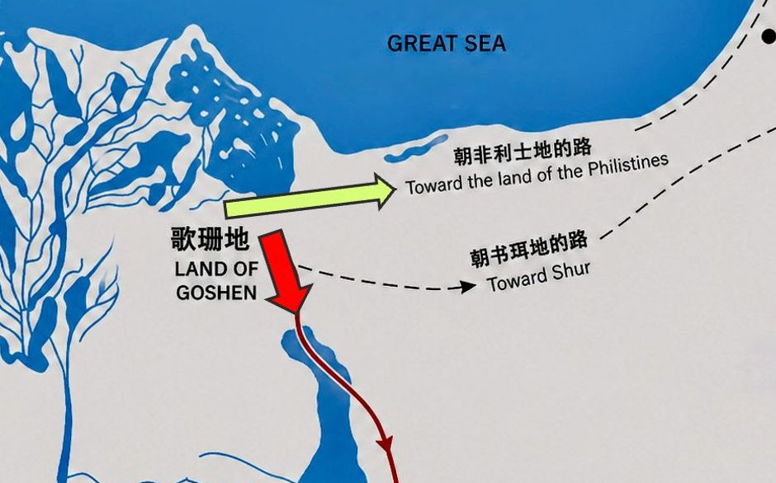

Slide 8
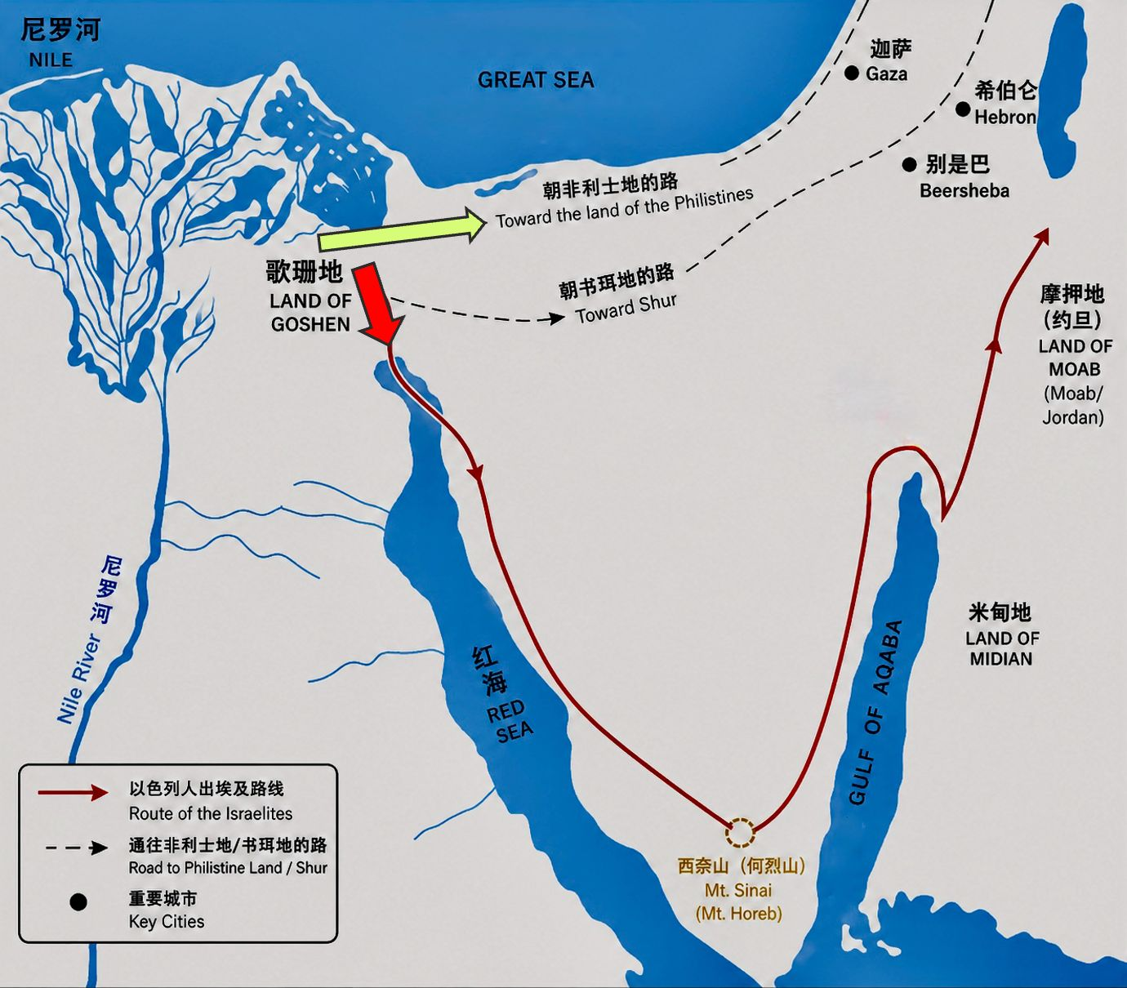

Slide 9
出埃及记 13:17.
法老让人民离开的时候，虽然非利士的路很近，神却不领他们从那里走，因为神说：“恐怕百姓看见战争而后悔，就回埃及去。”
Exodus 13:17.When Pharaoh let the people go, God did not lead them by way of the land of the Philistines, although that was near. For God said, "Lest the people change their minds when they see war and return to Egypt."

Slide 10
出 14:4. 我要使法老的心刚硬，他就必追赶他们； ..... 8.耶和华使埃及王法老的心刚硬，法老就追赶以色列人
'4 .And I will harden Pharaoh's heart, and he will pursue them, ...... 8.And the Lord hardened the heart of Pharaoh king of Egypt,

Slide 11
02
疑惑、怀疑、焦虑、害怕、埋怨。
Doubt, suspicion, anxiety, fear, grumbling.

Slide 12
10.法老走近的时候，以色列人举目观看，看见埃及人正追赶过来，就非常惧怕，向耶和华呼求。11.他们对摩西说：“难道埃及没有坟墓，你要把我们带来死在旷野吗？你为什么这样待我们，把我们从埃及领出来呢？12.我们在埃及的时候，不是对你说过：‘不要管我们，我们要服事埃及人’这话吗？因为服事埃及人比死在旷野还好。”13.摩西对人民说：“不要惧怕，要站着，观看耶和华今天为你们施行的拯救；因为你们今天看见的埃及人，必永远不再看见了。14.耶和华必为你们争战，你们必须安静，不要作声。”
10.You shall therefore keep this statute at its appointed time from year to year.11."When the Lord brings you into the land of the Canaanites, as he swore to you and your fathers, and shall give it to you,12.you shall set apart to the Lord all that first opens the womb. All the firstborn of your animals that are males shall be the Lord 's.13.Every firstborn of a donkey you shall redeem with a lamb, or if you will not redeem it you shall break its neck. Every firstborn of man among your sons you shall redeem.14.And when in time to come your son asks you, 'What does this mean?' you shall say to him, 'By a strong hand the Lord brought us out of Egypt, from the house of slavery.

Slide 13
疑惑
Doubt
怀疑
suspicion
焦虑
anxiety
害怕
fear
埋怨
grumbling

Slide 14
13.摩西对人民说：“不要惧怕，要站着，观看耶和华今天为你们施行的拯救；因为你们今天看见的埃及人，必永远不再看见了。14.耶和华必为你们争战，你们必须安静，不要作声。”
13.And Moses said to the people, "Fear not, stand firm, and see the salvation of the Lord , which he will work for you today. For the Egyptians whom you see today, you shall never see again. 14.The Lord will fight for you, and you have only to be silent."

Slide 15
03
上帝吩咐勇往直前
God commands to press forward bravely.

Slide 16
15.耶和华对摩西说：“你为什么向我呼求呢？吩咐以色列人往前走。16.你要把你的杖举起来，向海伸手，把海分开，叫以色列人下到海中走干地。17.看哪，我要使埃及人的心刚硬，他们就必跟着以色列人下去；这样，我必在法老和他的全军身上，以及他的马车和马兵身上得到荣耀。18.我在法老身上，以及他的马车和马兵身上得到荣耀的时候，埃及人就知道我是耶和华。”
15.The Lord said to Moses, "Why do you cry to me? Tell the people of Israel to go forward.16.Lift up your staff, and stretch out your hand over the sea and divide it, that the people of Israel may go through the sea on dry ground.17.And I will harden the hearts of the Egyptians so that they shall go in after them, and I will get glory over Pharaoh and all his host, his chariots, and his horsemen.18.And the Egyptians shall know that I am the Lord , when I have gotten glory over Pharaoh, his chariots, and his horsemen."

Slide 17
15.耶和华对摩西说：“你为什么向我呼求呢？吩咐以色列人往前走。
15.The Lord said to Moses, "Why do you cry to me? Tell the people of Israel to go forward.

Slide 18
04
上帝使不可能的变为可能
God makes the impossible possible.

Slide 19
19.在以色列营前行走的 神的使者，转到他们后面去；云柱也从他们前面转过去，立在他们后面。20.云柱来到埃及营和以色列营中间；云柱一边是黑暗的，一边却光照着黑夜。这样整夜彼此都不能接近。21.摩西向海伸手，耶和华就用极强的东风，一夜之间使海水退去；他使海变成干地，海水也分开了。22.以色列人下到海中走干地，水在他们的左右作了墙垣。23.埃及人追赶过来，法老所有的马匹、马车和马兵，都跟着以色列人下到海中去。24.到了晨更的时候，耶和华透过云柱火柱向下观看埃及人的军兵，并且使埃及人的军兵大起混乱。25.又使他们的车轮脱落，行驶困难，因此埃及人说：“我们从以色列人面前逃跑吧，因为耶和华为他们争战，攻击埃及人了。”
19.Then the angel of God who was going before the host of Israel moved and went behind them, and the pillar of cloud moved from before them and stood behind them,20.coming between the host of Egypt and the host of Israel. And there was the cloud and the darkness. And it lit up the night without one coming near the other all night.21.Then Moses stretched out his hand over the sea, and the Lord drove the sea back by a strong east wind all night and made the sea dry land, and the waters were divided.22.And the people of Israel went into the midst of the sea on dry ground, the waters being a wall to them on their right hand and on their left.23.The Egyptians pursued and went in after them into the midst of the sea, all Pharaoh's horses, his chariots, and his horsemen.24.And in the morning watch the Lord in the pillar of fire and of cloud looked down on the Egyptian forces and threw the Egyptian forces into a panic,25.clogging their chariot wheels so that they drove heavily. And the Egyptians said, "Let us flee from before Israel, for the Lord fights for them against the Egyptians."

Slide 20
诫命、律法、原则、精神 Commandments, laws, principles, spirit.
引导Guidance
是否唯一选择？，后果是否荣耀神 Is it the only way?, whether the outcome glorifies God.
内心的引导，
内心的平安?、
动机是否正确 Inner guidance, peace of heart?, whether the motive is correct.

Slide 21
05
上帝透过中保救赎
God redeems through a mediator.

Slide 22
26.耶和华对摩西说：“你要向海伸手，使水回流到埃及人身上，流到他们的战车和马兵身上。”27.摩西就向海伸手，到了天亮的时候，海水流回原处；埃及人逆流逃跑的时候，耶和华就把他们投在海中。28.海水一回流，就淹没了马车、马兵和那些跟着以色列人下海去的法老的全军，连一个也没有余下。29.以色列人却在海中走干地，水在他们的左右作了墙垣。30.这样，耶和华就在那一天把以色列人从埃及人的手里拯救了出来；以色列人看见埃及人都死在海边。31.以色列人看见耶和华向埃及人所显大能的手，就敬畏耶和华，又信服耶和华和他的仆人摩西。
26.Then the Lord said to Moses, "Stretch out your hand over the sea, that the water may come back upon the Egyptians, upon their chariots, and upon their horsemen."27.So Moses stretched out his hand over the sea, and the sea returned to its normal course when the morning appeared. And as the Egyptians fled into it, the Lord threw the Egyptians into the midst of the sea.28.The waters returned and covered the chariots and the horsemen; of all the host of Pharaoh that had followed them into the sea, not one of them remained.29.But the people of Israel walked on dry ground through the sea, the waters being a wall to them on their right hand and on their left.30.Thus the Lord saved Israel that day from the hand of the Egyptians, and Israel saw the Egyptians dead on the seashore.31.Israel saw the great power that the Lord used against the Egyptians, so the people feared the Lord , and they believed in the Lord and in his servant Moses.

Slide 23
31.以色列人看见耶和华向埃及人所显大能的手，就敬畏耶和华，又信服耶和华和他的仆人摩西。
.31.Israel saw the great power that the Lord used against the Egyptians, so the people feared the Lord , and they believed in the Lord and in his servant Moses.

Slide 24
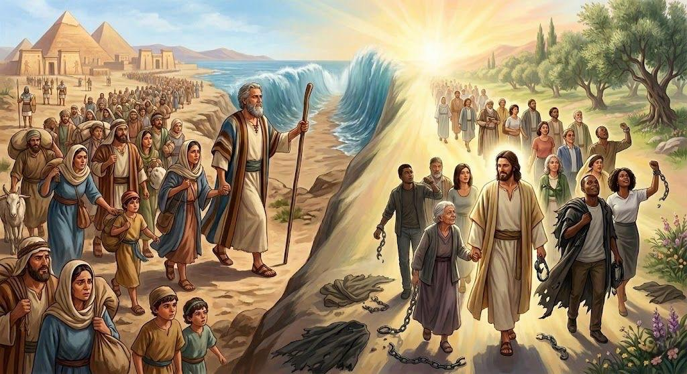
旧约的中保摩西 Moses mediator of old covenant
新约的中保耶稣 Jesus mediator of new covenant

Slide 25
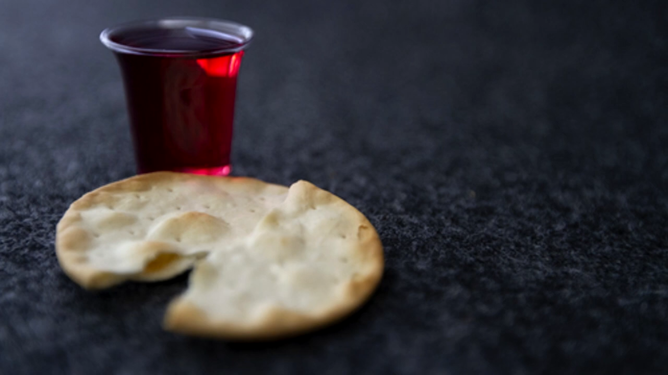
奇异恩典
圣餐

Slide 26
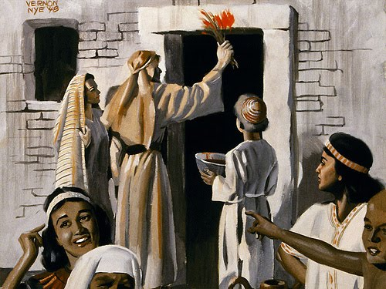
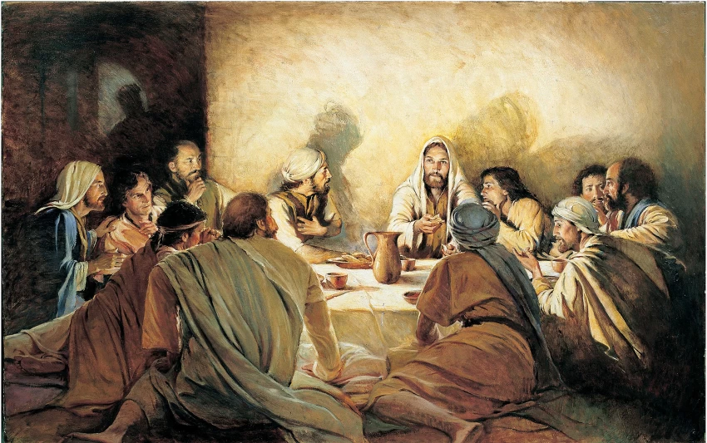
新约的圣餐取代了旧约的逾越节 Holy Communion replaces the passover meal

Slide 27
出12:21 于是，摩西把以色列的众长老召了来，对他们说：“你们要按着家族自己选取羊羔，把这逾越节的羊羔宰杀了。22要拿一把牛膝草，蘸在盆中的血里，然后把盆里的血涂在门楣上和两边的门柱上；你们谁也不可出自己的房门，直到早晨。23因为耶和华要走遍各处击打埃及人；他一看见门楣和两边的门柱上有血，就越过那门，不让那毁灭者进入你们的房屋来击杀你们。
Exo 12:21 Then Moses called all the elders of Israel and said to them, "Go and select lambs for yourselves according to your clans, and kill the Passover lamb. 22 Take a bunch of hyssop and dip it in the blood that is in the basin, and touch the lintel and the two doorposts with the blood that is in the basin. None of you shall go out of the door of his house until the morning. 23 For the LORD will pass through to strike the Egyptians, and when he sees the blood on the lintel and on the two doorposts, the LORD will pass over the door and will not allow the destroyer to enter your houses to strike you.

Slide 28
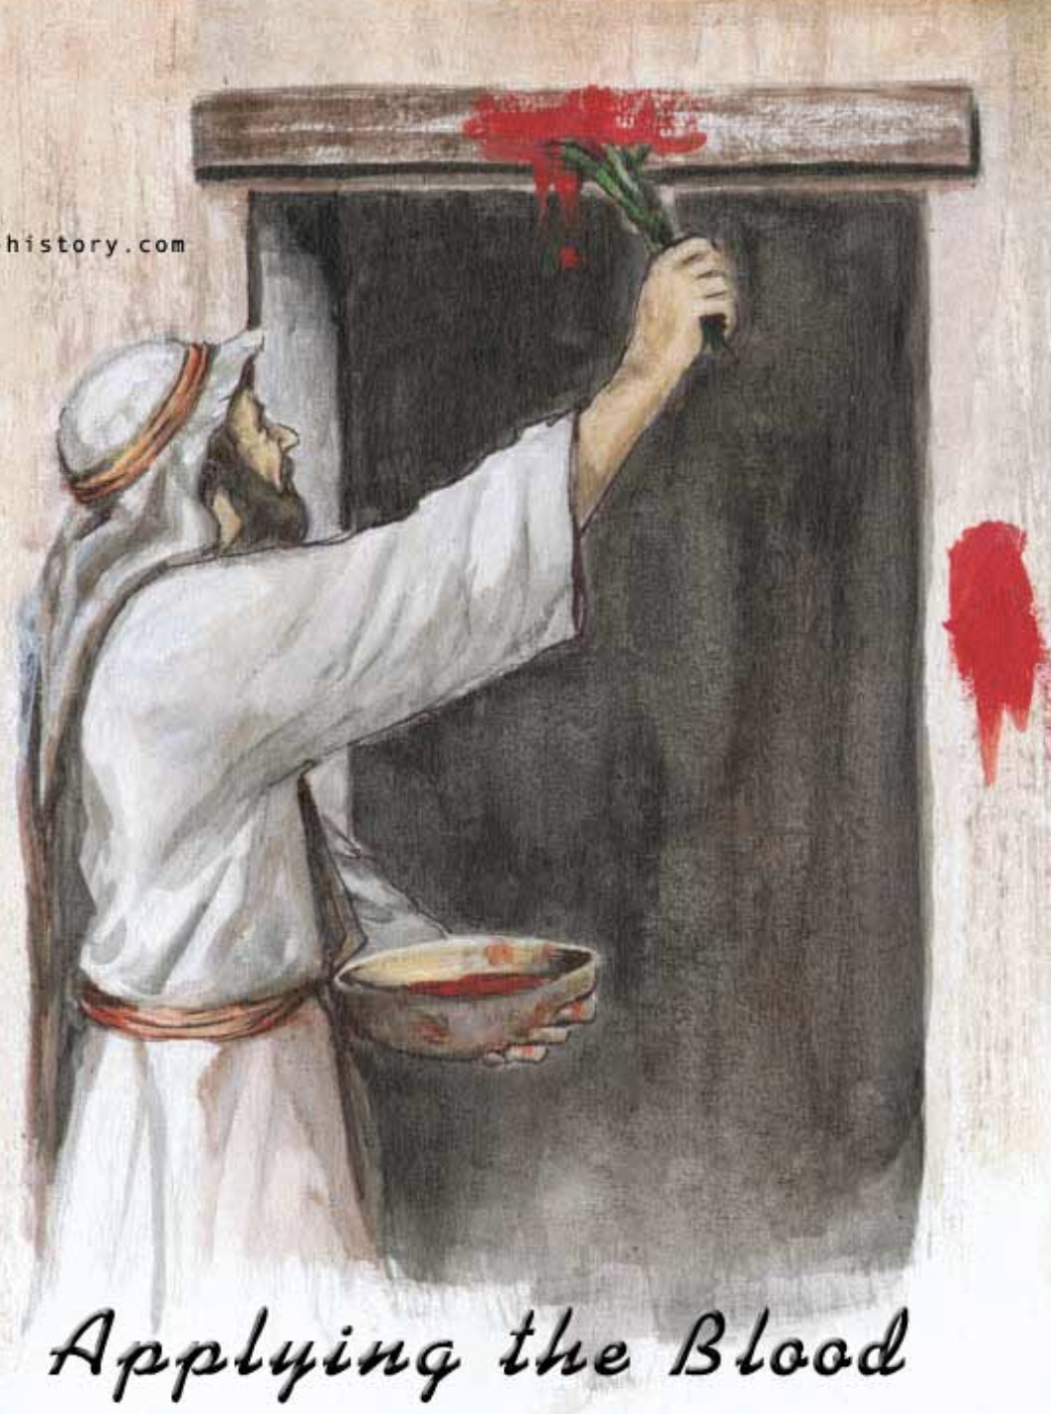
林前5:7 ...
我们逾越节的羊羔基督已经被杀献祭了。
1 Corinthians 5:7...our Passover lamb, has been sacrificed.

Slide 29
因为主耶稣，上帝的审判越过我们
Because of what Lord Jesus has done for us , God’s judgment has pass over us

