Slide 1
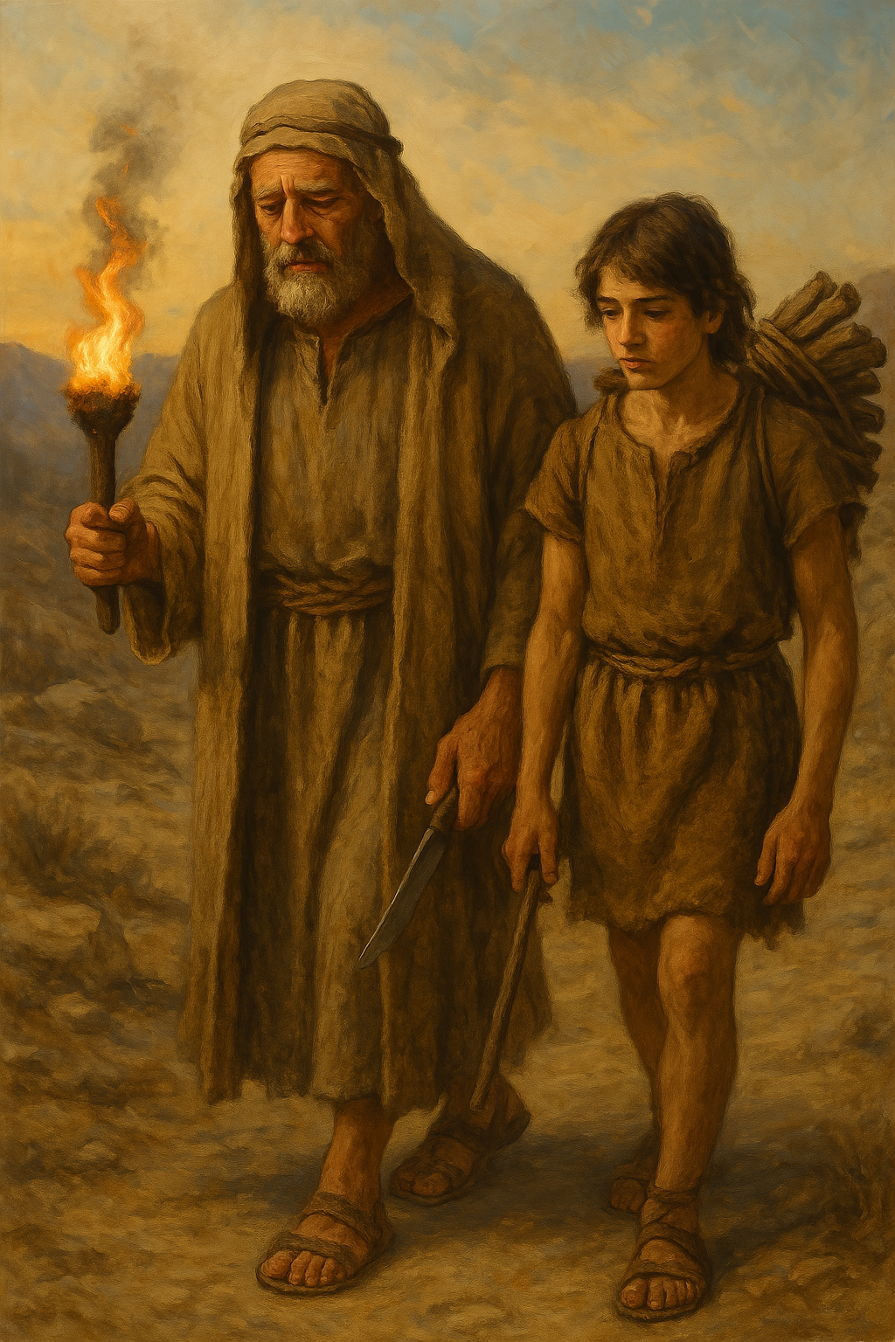
父献上独生爱子
创22章1至14
Father sacrifice beloved only son.

Slide 2
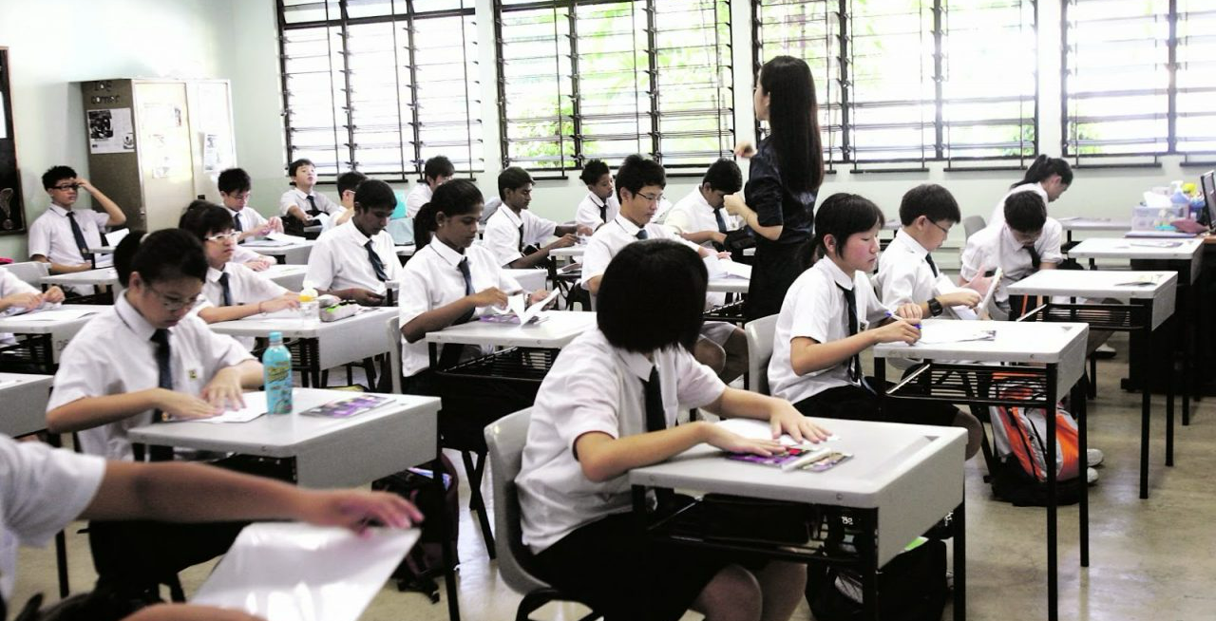

Slide 3
创22:1这些事以后，神要试验亚伯拉罕，就呼叫他说：「亚伯拉罕！」他说：「我在这里。」2神说：「你带着你的儿子，就是你独生的儿子，你所爱的以撒，往摩利亚地去，在我所要指示你的山上，把他献为燔祭。」3亚伯拉罕清早起来，备上驴，带着两个仆人和他儿子以撒，也劈好了燔祭的柴，就起身往神所指示他的地方去了。4到了第三日，亚伯拉罕举目远远地看见那地方。5亚伯拉罕对他的仆人说：「你们和驴在此等候，我与童子往那里去拜一拜，就回到你们这里来。」
Gen22:1After these things God tested Abraham and said to him, "Abraham!" And he said, "Here I am.” 2He said, "Take your son, your only son Isaac, whom you love, and go to the land of Moriah, and offer him there as a burnt offering on one of the mountains of which I shall tell you.” 3So Abraham rose early in the morning, saddled his donkey, and took two of his young men with him, and his son Isaac. And he cut the wood for the burnt offering and arose and went to the place of which God had told him. 4On the third day Abraham lifted up his eyes and saw the place from afar.5Then Abraham said to his young men, "Stay here with the donkey; I and the boy will go over there and worship and come again to you."
1/3

Slide 4
6亚伯拉罕把燔祭的柴放在他儿子以撒身上，自己手里拿着火与刀；于是二人同行。7以撒对他父亲亚伯拉罕说：「父亲哪！」亚伯拉罕说：「我儿，我在这里。」以撒说：「请看，火与柴都有了，但燔祭的羊羔在哪里呢？」8亚伯拉罕说：「我儿，神必自己预备作燔祭的羊羔。」于是二人同行。9他们到了神所指示的地方，亚伯拉罕在那里筑坛，把柴摆好，捆绑他的儿子以撒，放在坛的柴上。10亚伯拉罕就伸手拿刀，要杀他的儿子。
6And Abraham took the wood of the burnt offering and laid it on Isaac his son. And he took in his hand the fire and the knife. So they went both of them together.7And Isaac said to his father Abraham, "My father!" And he said, "Here I am, my son." He said, "Behold, the fire and the wood, but where is the lamb for a burnt offering?"8Abraham said, "God will provide for himself the lamb for a burnt offering, my son." So they went both of them together.9When they came to the place of which God had told him, Abraham built the altar there and laid the wood in order and bound Isaac his son and laid him on the altar, on top of the wood.10Then Abraham reached out his hand and took the knife to slaughter his son.
2/3

Slide 5
11耶和华的使者从天上呼叫他说：「亚伯拉罕！亚伯拉罕！」他说：「我在这里。」12天使说：「你不可在这童子身上下手。一点不可害他！现在我知道你是敬畏神的了；因为你没有将你的儿子，就是你独生的儿子，留下不给我。」13亚伯拉罕举目观看，不料，有一只公羊，两角扣在稠密的小树中，亚伯拉罕就取了那只公羊来，献为燔祭，代替他的儿子。14亚伯拉罕给那地方起名叫「耶和华以勒」，直到今日人还说：「在耶和华的山上必有预备。」
11But the angel of the Lord called to him from heaven and said, "Abraham, Abraham!" And he said, "Here I am."12He said, "Do not lay your hand on the boy or do anything to him, for now I know that you fear God, seeing you have not withheld your son, your only son, from me."13And Abraham lifted up his eyes and looked, and behold, behind him was a ram, caught in a thicket by his horns. And Abraham went and took the ram and offered it up as a burnt offering instead of his son.14So Abraham called the name of that place, "The Lord will provide"; as it is said to this day, "On the mount of the Lord it shall be provided."
3/3

Slide 6
01
背景：亚伯拉罕与以撒
Background: Abraham and Isaac

Slide 7
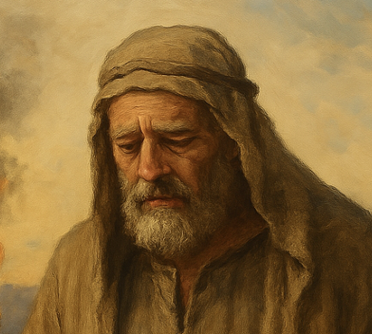
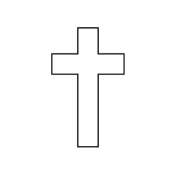
2025年
约2000年
约2000年
3/3

Slide 8
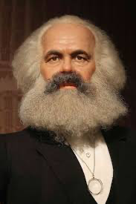
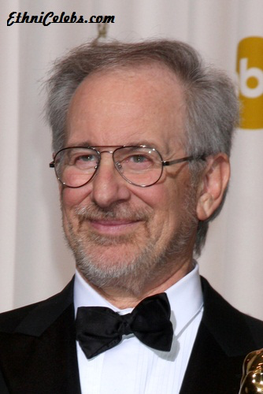
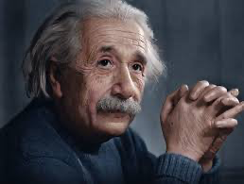
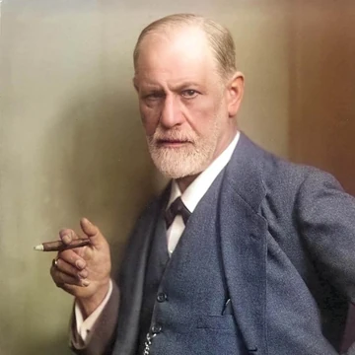
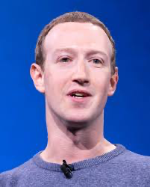
史蒂文·
斯皮尔伯格
马克思
爱因斯坦
Karl Marx (1818–1883)
Steven Spielberg
Albert Einstein (1879–1955)
弗洛伊德
马克·扎克伯格（脸书）
Sigmund Freud (1856–1939)
Mark Zuckerberg（Facebook）

Slide 9
加 3:7
所以，你们要知道：那以信为本的人，就是亚伯拉罕的子孙。
Gal 3:7 Know then that it is those of faith who are the sons of Abraham.

Slide 10
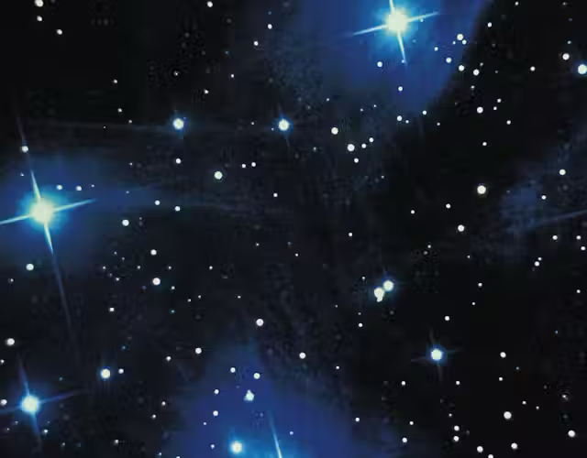
创 15:5.
于是领他走到外边，说：「你向天观看，数算众星，能数得过来吗？」又对他说：「你的后裔将要如此。」6.亚伯兰信耶和华，耶和华就以此为他的义。
Gen 15:5 And he brought him outside and said, “Look toward heaven, and number the stars, if you are able to number them.” Then he said to him, “So shall your offspring be.”6 And he believed the LORD, and he counted it to him as righteousness.

Slide 11
02
献独生儿子为燔祭
To offer his only son as a burnt offering

Slide 12
创22:1这些事以后，神要试验亚伯拉罕，就呼叫他说：「亚伯拉罕！」他说：「我在这里。」2神说：「你带着你的儿子，就是你独生的儿子，你所爱的以撒，往摩利亚地去，在我所要指示你的山上，把他献为燔祭。」
Gen22:1After these things God tested Abraham and said to him, "Abraham!" And he said, "Here I am.” 2He said, "Take your son, your only son Isaac, whom you love, and go to the land of Moriah, and offer him there as a burnt offering on one of the mountains of which I shall tell you.”

Slide 13
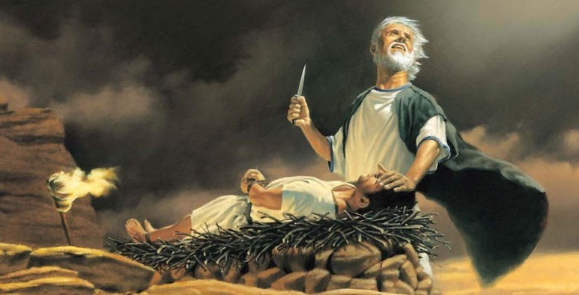

Slide 14
03
三日的行程
Three Days Journey

Slide 15
4到了第三日，亚伯拉罕举目远远地看见那地方。5亚伯拉罕对他的仆人说：「你们和驴在此等候，我与童子往那里去拜一拜，就回到你们这里来。」 6亚伯拉罕把燔祭的柴放在他儿子以撒身上，自己手里拿着火与刀；于是二人同行。7以撒对他父亲亚伯拉罕说：「父亲哪！」亚伯拉罕说：「我儿，我在这里。」以撒说：「请看，火与柴都有了，但燔祭的羊羔在哪里呢？」8亚伯拉罕说：「我儿，神必自己预备作燔祭的羊羔。」于是二人同行。
4 On the third day Abraham lifted up his eyes and saw the place from afar.5Then Abraham said to his young men, "Stay here with the donkey; I and the boy will go over there and worship and come again to you." 6And Abraham took the wood of the burnt offering and laid it on Isaac his son. And he took in his hand the fire and the knife. So they went both of them together.7And Isaac said to his father Abraham, "My father!" And he said, "Here I am, my son." He said, "Behold, the fire and the wood, but where is the lamb for a burnt offering?"8Abraham said, "God will provide for himself the lamb for a burnt offering, my son." So they went both of them together.

Slide 16
7..「父亲哪！」亚伯拉罕说：「我儿，我在这里。」以撒说：「请看，火与柴都有了，但燔祭的羊羔在哪里呢？」8亚伯拉罕说：「我儿，神必自己预备作燔祭的羊羔。」于是二人同行。
7..."My father!" And he said, "Here I am, my son." He said, "Behold, the fire and the wood, but where is the lamb for a burnt offering?"8 Abraham said, "God will provide for himself the lamb for a burnt offering, my son." So they went both of them together.

Slide 17
04
父亲捆绑爱子
The Father Binds His Beloved Son

Slide 18
9 他们到了神所指示的地方，亚伯拉罕在那里筑坛，把柴摆好，捆绑他的儿子以撒，放在坛的柴上。10亚伯拉罕就伸手拿刀，要杀他的儿子。 11耶和华的使者从天上呼叫他说：「亚伯拉罕！亚伯拉罕！」他说：「我在这里。」12天使说：「你不可在这童子身上下手。一点不可害他！现在我知道你是敬畏神的了；因为你没有将你的儿子，就是你独生的儿子，留下不给我。」
9When they came to the place of which God had told him, Abraham built the altar there and laid the wood in order and bound Isaac his son and laid him on the altar, on top of the wood.10Then Abraham reached out his hand and took the knife to slaughter his son. 11 But the angel of the LORD called to him from heaven and said, “Abraham, Abraham!” And he said, “Here I am.”12 He said, “Do not lay your hand on the boy or do anything to him, for now I know that you fear God, seeing you have not withheld your son, your only son, from me.”

Slide 19
05
预表耶稣基督
A type of Christ

Slide 20
13亚伯拉罕举目观看，不料，有一只公羊，两角扣在稠密的小树中，亚伯拉罕就取了那只公羊来，献为燔祭，代替他的儿子。14亚伯拉罕给那地方起名叫「耶和华以勒」，直到今日人还说：「在耶和华的山上必有预备。」
13And Abraham lifted up his eyes and looked, and behold, behind him was a ram, caught in a thicket by his horns. And Abraham went and took the ram and offered it up as a burnt offering instead of his son.14So Abraham called the name of that place,(KJV Jehovahjireh) "The Lord will provide"; as it is said to this day, "On the mount of the Lord it shall be provided."

Slide 24
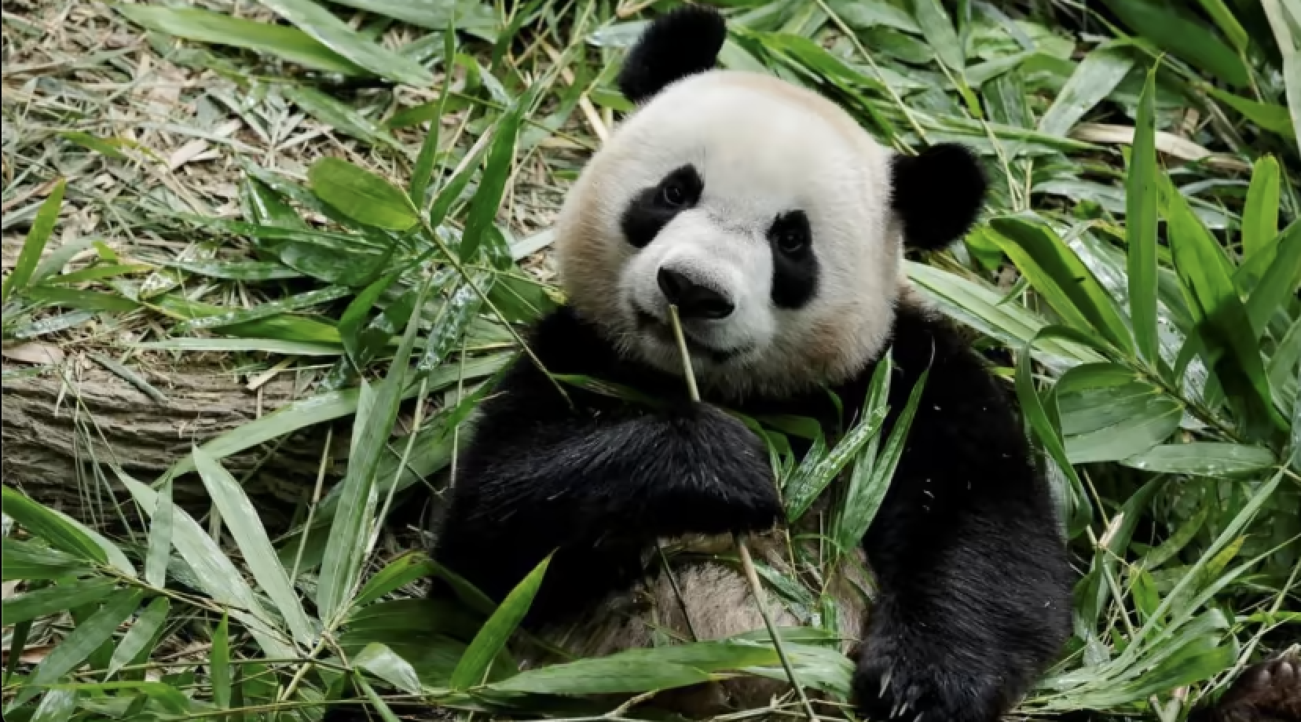
乐乐于2021年8月14日出生，是首只在新加坡诞生的熊猫。
Le Le came into the world on Aug 14, 2021, was the first panda to be born in Singapore.

Slide 25
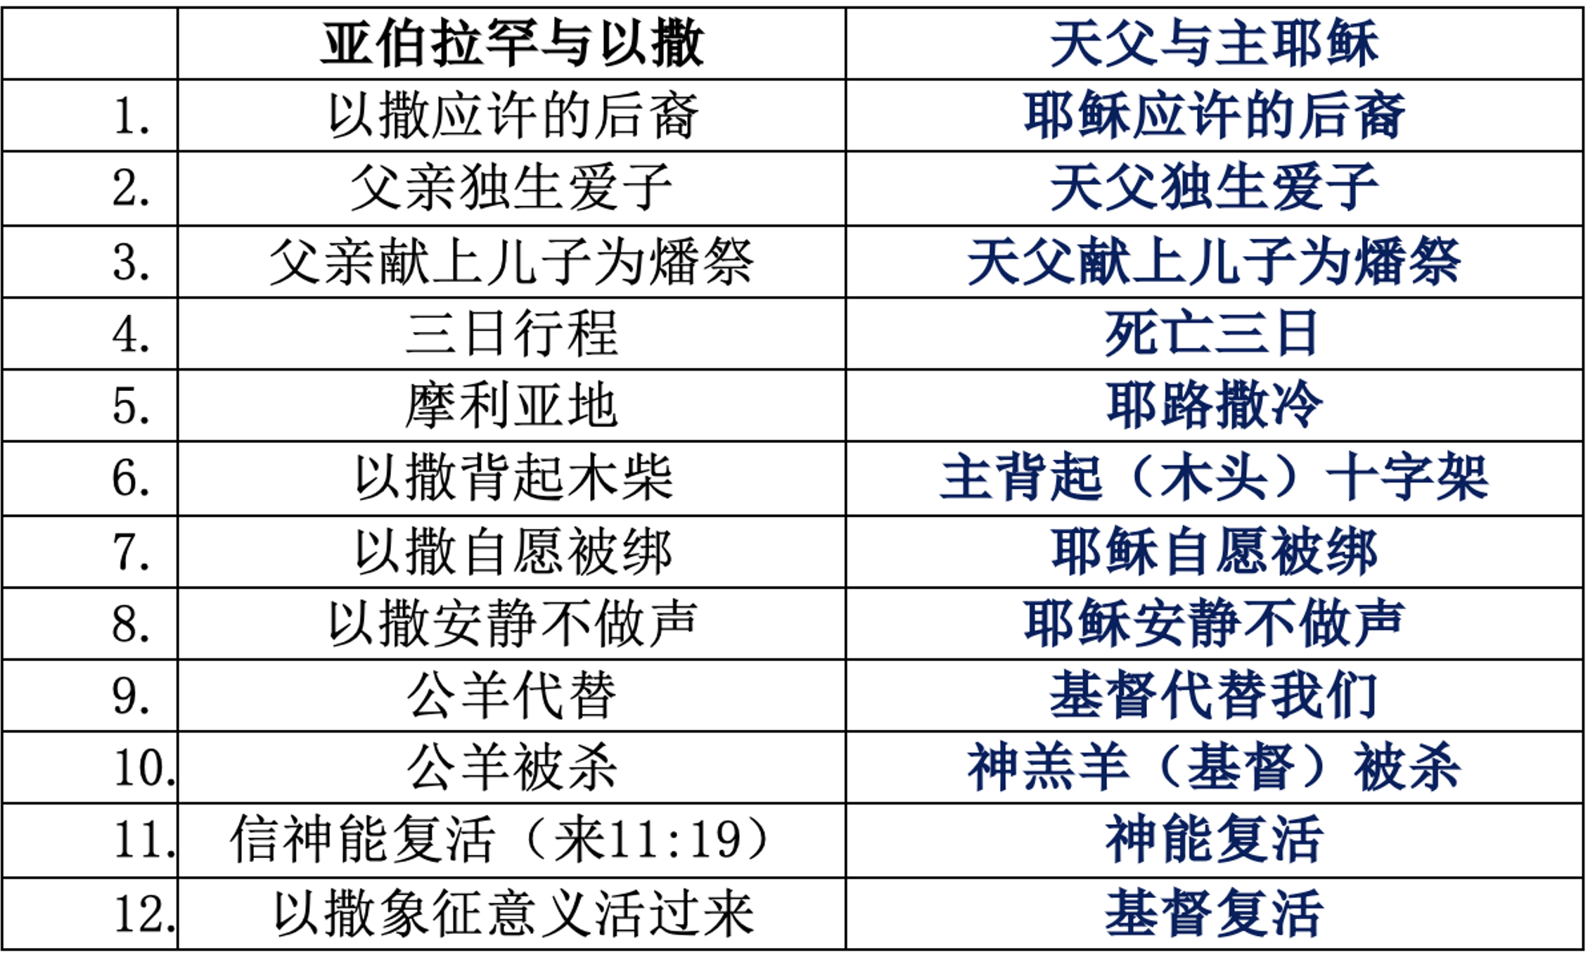

Slide 29
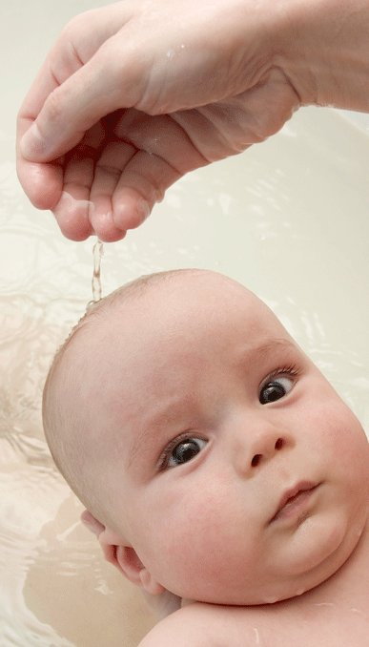
洗礼
Baptism

Slide 30
1.⁠Do you believe in the one true and living God, eternally existent in three persons: the Father, the Son, and the Holy Spirit?
2.⁠ ⁠Do you believe that Jesus Christ is the son of God, fully God and fully man. He lived a sinless life, was crucified, died, and rose again on the third day for the salvation of all who believe in him?
3.⁠ ⁠Do you believe that you are a sinner and in need of his salvation?
4.⁠ ⁠Do you trust and obey in Jesus Christ as your only Lord and savior?
5.⁠ ⁠Do you believe that the Bible is the inspired, infallible, and authoritative word of God, the final standard for faith and practice?
6.⁠ ⁠Do you promise, with God's help, to daily seek to know the bible and to practice the truths you have learned in his word?

Slide 31
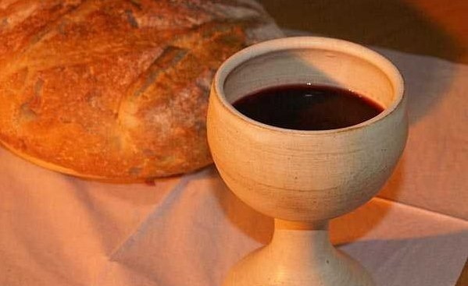
圣餐

Slide 32
约壹 4:10 不是我们爱神，乃是神爱我们，差他的儿子为我们的罪作了挽回祭，这就是爱了。11 亲爱的弟兄啊，神既是这样爱我们，我们也当彼此相爱。
1Jn 4:10 In this is love, not that we have loved God but that he loved us and sent his Son to be the propitiation for our sins.11 Beloved, if God so loved us, we also ought to love one another.

