Slide 1
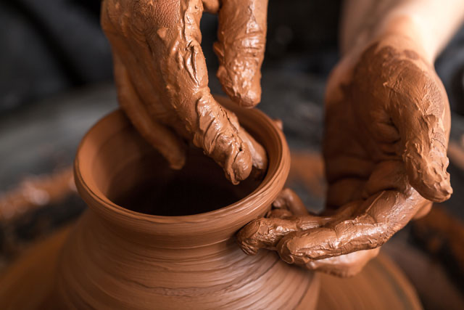

神的拣选与人的责任（上）
The Predestination of God and the Responsibility of Man (Part 1)

Slide 2


Slide 3
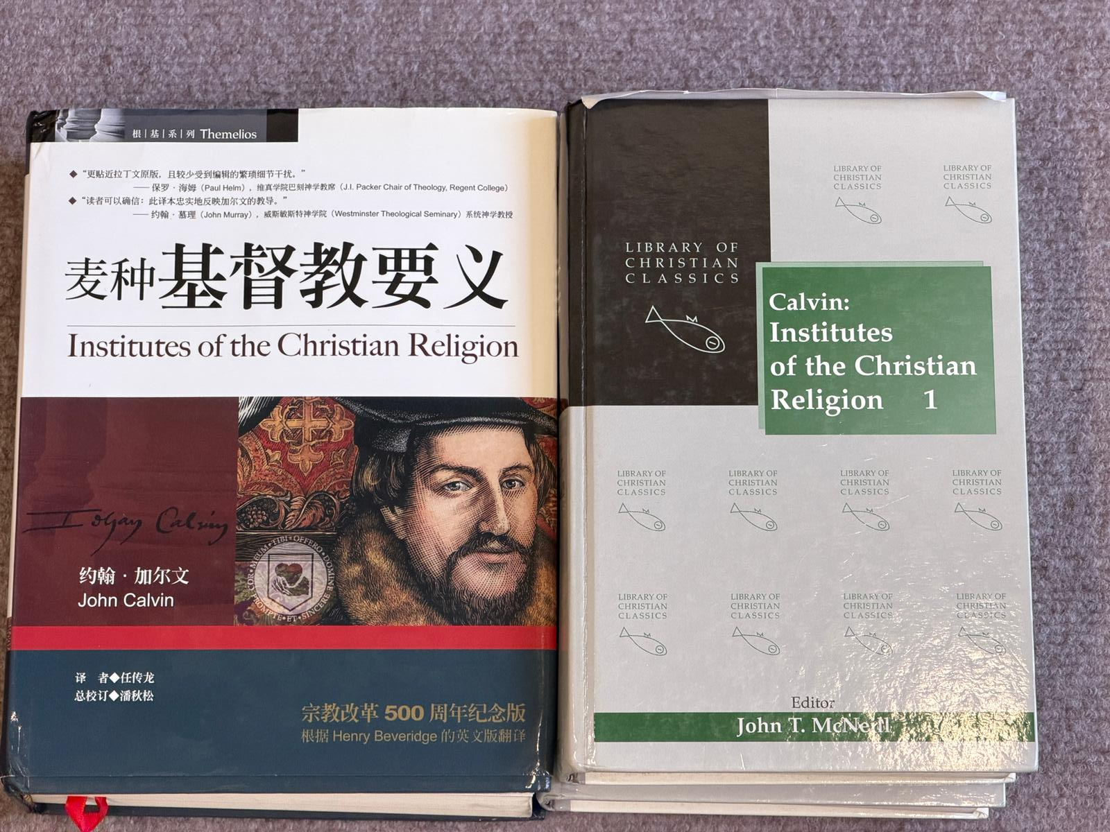

Slide 4
一些有关预定论的问题
Some questions concerning predestination
（1）若有些人不得救，神岂不是不公义吗？
If some people are not saved, does that mean God is unjust?
（2）如果神有绝对主权，那人岂不是成了木偶？
If God has absolute sovereignty, does that make man a puppet?
（3）如果神早已拣选谁得救，那人的努力还有意义吗？
If God has already chosen who will be saved, does human effort still have any meaning?

Slide 5
一些有关预定论的问题
Some questions concerning predestination
（1）若有些人不得救，神岂不是不公义吗？
If some people are not saved, does that mean God is unjust?

Slide 6
神的拣选有任何不公义吗？ Is there any injustice in God’s election?
【1】

Slide 7

罗马书 9:13
正如经上所记：雅各是我所爱的；以扫是我所恶的。14.这样，我们可说什么呢？难道神有什么不公平injustice/ unrighteousness 吗？断乎没有！
Romans 9:13.As it is written, "Jacob I loved, but Esau I hated."14.What shall we say then? Is there injustice on Gods part? By no means!

Slide 8
罗马书 9:13
正如经上所记：雅各是我所爱的；以扫是我所恶的。14.这样，我们可说什么呢？难道神有什么不公平injustice/ unrighteousness 吗？断乎没有！15.因他对摩西说：我要怜悯谁就怜悯谁，要恩待谁就恩待谁。
Romans 9:15.For he says to Moses, "I will have mercy on whom I have mercy, and I will have compassion on whom I have compassion."

Slide 9
罗马书 9：21.
窑匠难道没有权柄从一团泥里拿一块做成贵重的器皿，又拿一块做成卑贱的器皿吗？
Romans 9:21.Has the potter no right over the clay, to make out of the same lump one vessel for honorable use and another for dishonorable use?

Slide 10
制造者
Maker
窑匠
Potter
制造器皿
权柄塑造并决定 Authority to shape and to decide
作者自己的目的
The author’s own purpose

Slide 11
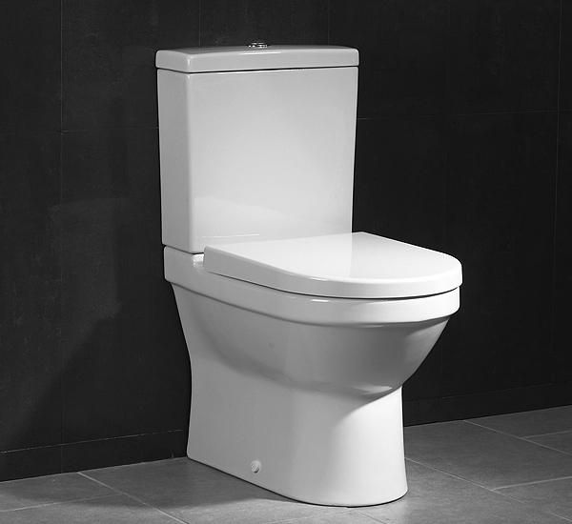
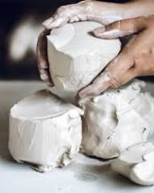
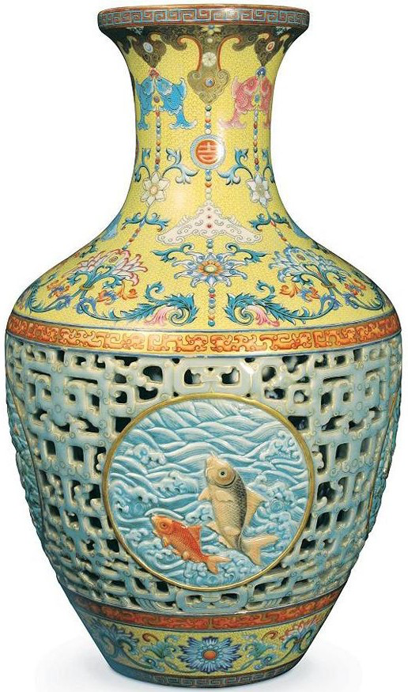
一块做成
卑贱的器皿
and another for dishonorable use
一块做成
贵重的器皿
same lump one vessel for honorable use
同一团泥
same lump of clay

Slide 12
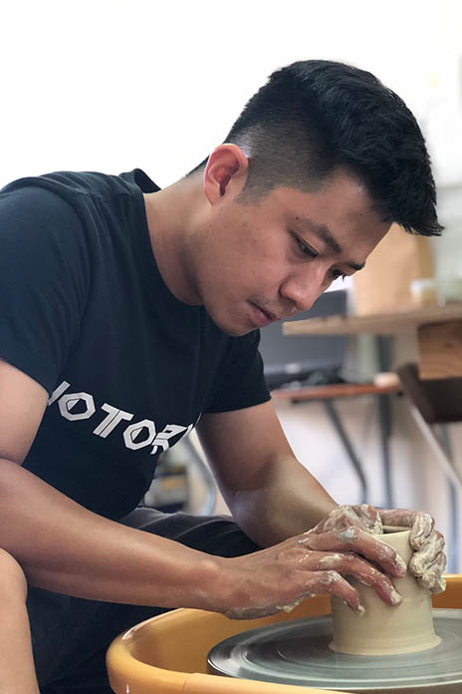
窑匠
窑匠你为何这样塑造我？
“Potter, why did you make me like this?”

Slide 13

杨康
黄蓉
郭靖
金庸作者《射雕英雄传 》

Slide 14
创作者
author
金庸
《射雕英雄传 》
权柄塑造并主宰 Authority to shape and to dictate
作者自己的目的
The author’s own purpose

Slide 15
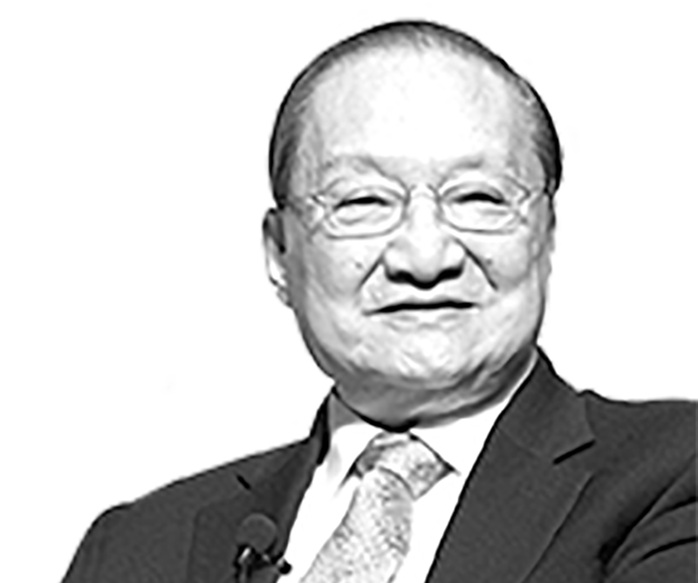
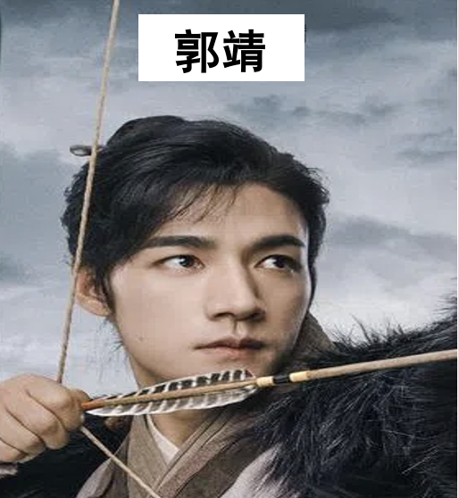
金庸
金庸你为何这样创作我？
“Jin Yong, why did you create me this way?”

Slide 16
创造者 creator
上帝
创造世界
权柄、掌管、主宰 authority, control, and sovereignly reign
神自己的目的
God’s own purpose

Slide 17
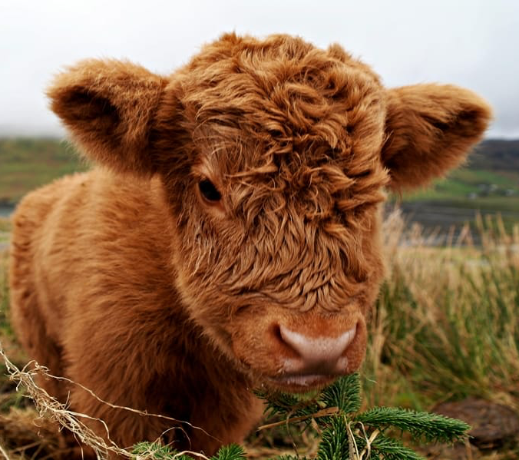
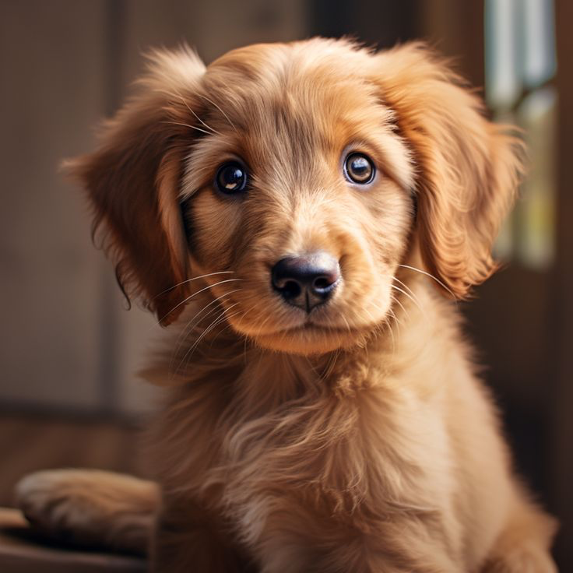
人
Human
1/4

Slide 18
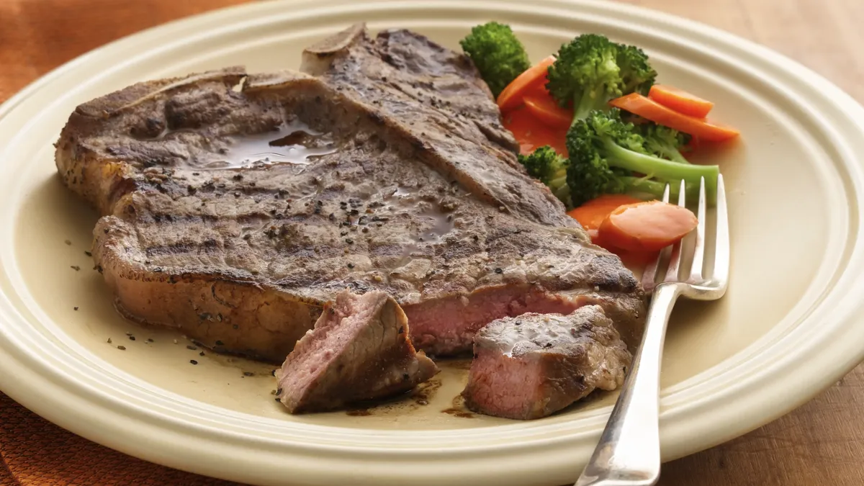
人
Human
2/4

Slide 19
人
Human
谢谢你
不公平
3/4

Slide 20
人
Human
人的主权决定饲养牛与狗，
人是他们的主人、
人定下了牛与狗的命运
Man sovereignty determines the raising of cattle and dogs;
man is their master,
man determined their destiny.
4/4

Slide 21
人
Human
为什么我们生下来不是
牲畜？
Why were we not born as animals?
不公平！
It is not fair!

Slide 22
约6:44.
若不是差我来的父吸引人，就没有能到我这里来的；到我这里来的，在末日我要叫他复活
John 6:44.
No one can come to me unless the Father who sent me draws him. And I will raise him up on the last day.

Slide 23
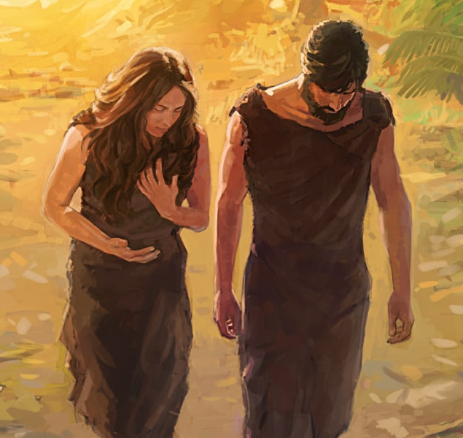
在魔鬼（撒旦）
的权势下
Under the dominion of the devil (Satan)
全人类
Whole Humanity

Slide 24
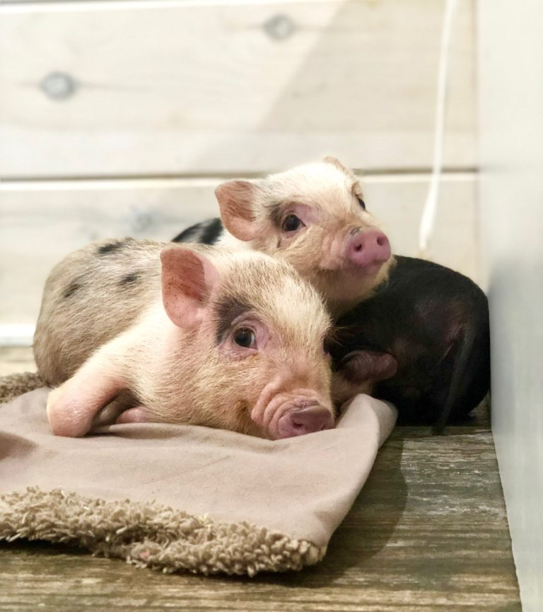


Slide 25
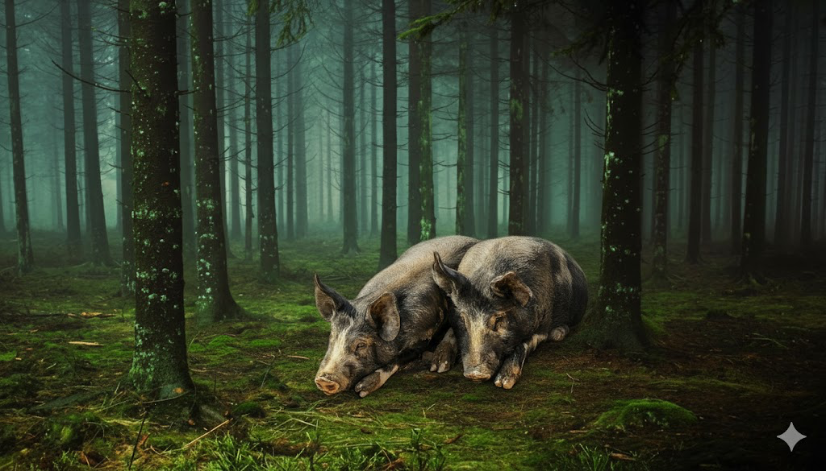
他们后来世世代代所生下来的都成了野猪
All the offspring they bore in later generations became wild boars.

Slide 26
西1:13.
他救了我们脱离黑暗的权势，把我们迁到他爱子的国里；
Colossians 1:13.
He has delivered us from the domain of darkness and transferred us to the kingdom of his beloved Son,

Slide 27
来 2:16.
他并不救拔天使，乃是救拔亚伯拉罕的后裔
Hebrews 2
16.For surely it is not angels that he helps, but he helps the offspring of Abraham.

Slide 28

不救拔！
救拔！
Do not save
save
堕落的天使
亚伯拉罕的后裔
Fallen Angels
Offspring of Abraham

Slide 29
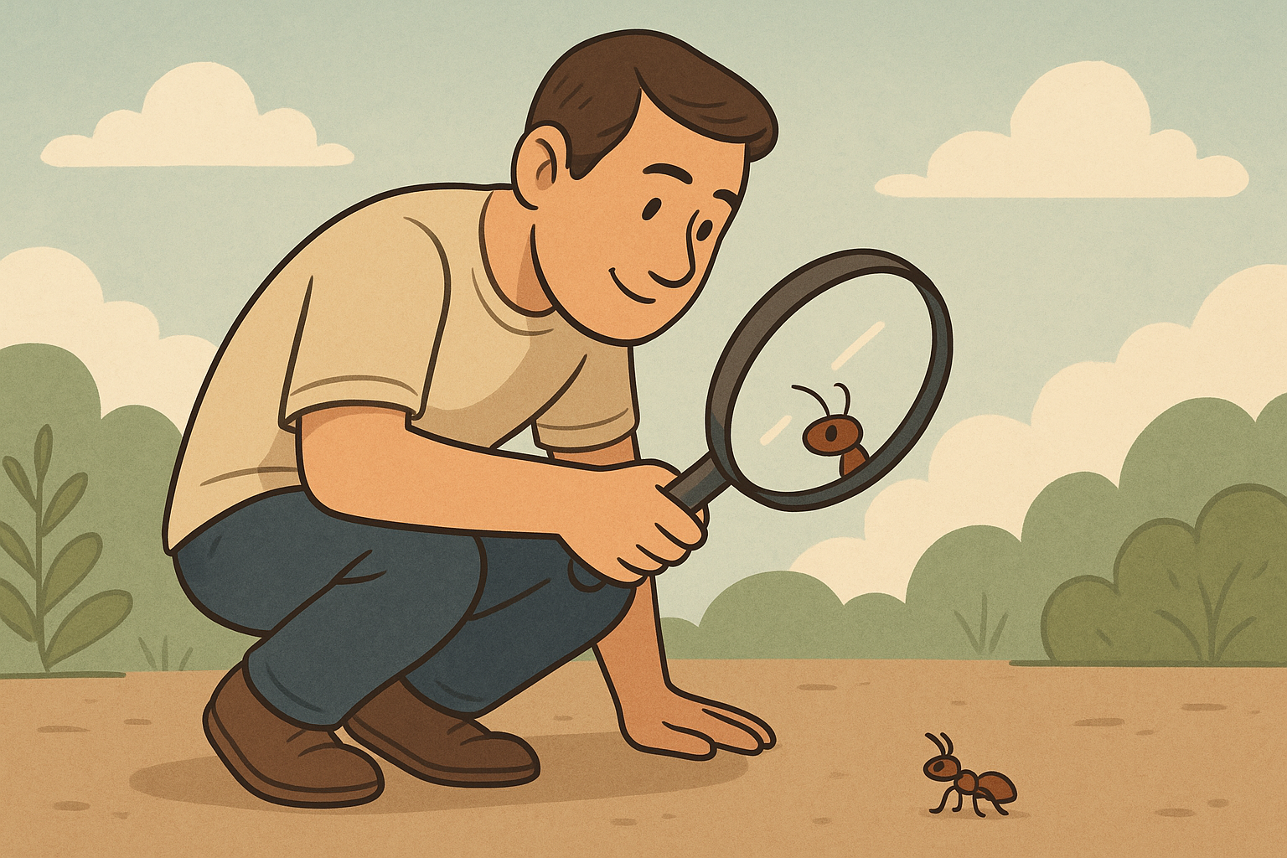
诗篇 8:4...人算什么，你竟顾念他！世人算什么，你竟眷顾他！
Psalms 8:4.what is man that you are mindful of him, and the son of man that you care for him?

Slide 30
约16:27.
父自己爱你们；因为你们已经爱我，又信我是从父出来的。
John 16:27.
for the Father himself loves you, because you have loved me and have believed that I came from God.

Slide 31
如果神有绝对主权，那人岂不是成了木偶？
If God has absolute sovereignty, does that not make man a puppet?

Slide 32
人堕落后有意志来选择吗?
After the fall of man, do we still have will and choice?

Slide 33
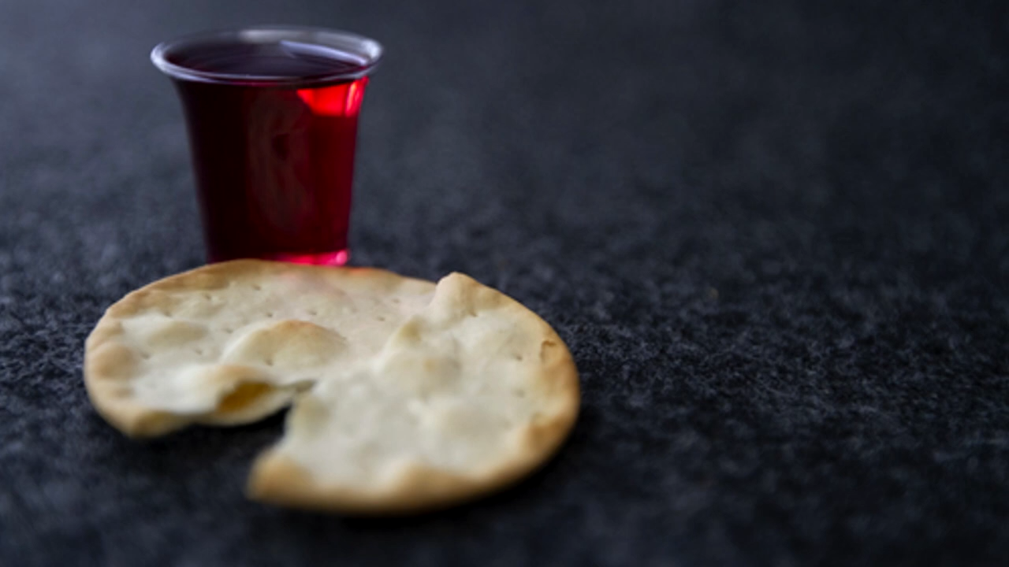
奇异恩典
圣餐

Slide 34

约壹 4:10 不是我们爱神，乃是神爱我们，差他的儿子为我们的罪作了挽回祭，这就是爱了。11 亲爱的弟兄啊，神既是这样爱我们，我们也当彼此相爱。
1Jn 4:10 In this is love, not that we have loved God but that he loved us and sent his Son to be the propitiation for our sins.11 Beloved, if God so loved us, we also ought to love one another.

