Slide 1
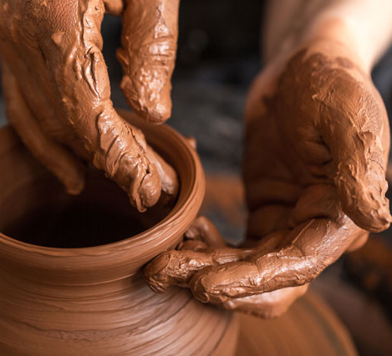

神的拣选与人的责任（下） The Predestination of God and the Responsibility of Man (Part 3)

Slide 2
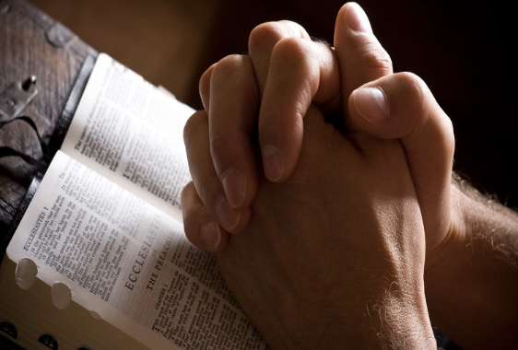


Slide 3
一些有关预定论的问题
Some questions concerning predestination
（3）如果神早已拣选谁得救，那人的努力还有意义吗？
If God has already chosen who will be saved, does human effort still have any meaning?

Slide 4
预定也强调人的责任 。 Predestination also emphasizes human responsibility.
【1】

Slide 5
避免走向两个极端
Avoid falling into two extremes
神的预定
God’s predestination
人的责任
Human responsibility

Slide 6
无法彻悟的奥秘
The unfathomable mystery
神性
God’s nature
人性
Human nature

Slide 7
无法彻悟的奥秘
The unfathomable mystery
神的预定
God’s predestination
人的责任
Human responsibility

Slide 8
无法彻悟的奥秘
The unfathomable mystery
神的预定
God’s predestination
人的责任
Human responsibility
第一因 First Cause
第二因 Secondary Cause

Slide 9

《威敏斯特信条》1648（Westminster Confession of Faith, 3.1）宣告：
...上帝并非罪的作者，也未强迫受造者的意志；并且并未废除第二因的自由与偶然性，反而使之得以确立。”
... a yet so as thereby neither is God the author of sin, nor is violence offered to the will of the creatures, nor is the liberty or contingency of second causes taken away, but rather established. WCF. 3:1

Slide 10
为人的救恩祈求祷告 。 Pray and intercede for the salvation of others. .
【2】

Slide 11
弗 1:4
就如神从创立世界以前，在基督里拣选了我们 ... ”
Eph 1:4 even as he chose us in him before the foundation of the world, ...

Slide 12
物质
Matter
被创
created
空间
Space
时间
Time
物质、空间与时间是不可分割地相互关联的。
Time, space, and matter are inseparably interrelated.

Slide 13
神在永恒
God in eternity
创造的开始
Creation’s beginning
时间、空间与物质
Time, space, and matter

Slide 14

什么是永恒
What is eternity
没有人知道什么是“永恒”
No one knows what “eternity” truly is.

Slide 15
永恒不是时间
Eternity is not time
1. 永恒不是时间的开始
Eternity is not the beginning of time.
2.永恒不是时间之前
Eternity is not time.
3. 永恒不是永无止境的时间。
Eternity is not endless time.

Slide 16
上帝
God
创造者
creator
被造物
creatures
时间、空间与物质
Time, space, and matter

Slide 17
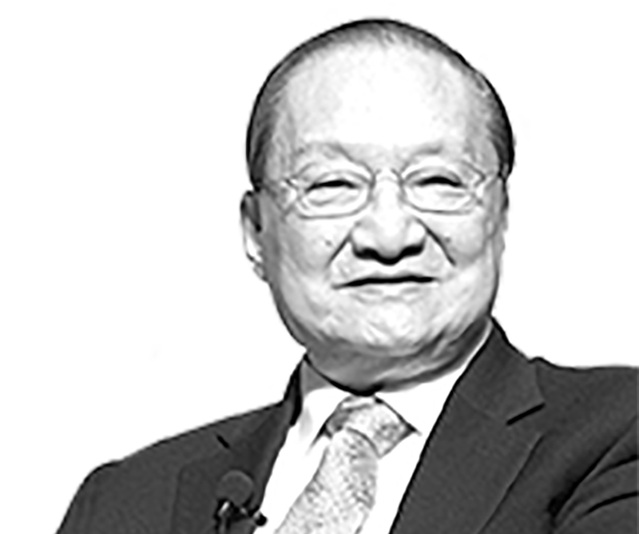


金庸
作家创造者
Writer and creator
这是一种假设性比喻。
a hypothetical metaphor
被创作
Is being composed
武侠世界《射雕英雄传 》

Slide 18

金庸
金庸超越武侠时间线之上
Jin Yong transcends the timeline of wuxia story
这是一种假设性比喻。
a hypothetical metaphor
开始
Beginning
结束
End
小郭静
武侠世界的时间线 The timeline of the martial arts world.

Slide 19
金庸在武侠时间线之上
Jin Yong transcends the timeline of wuxia story
金庸
这是一种假设性比喻。
a hypothetical metaphor
金庸求你听我呼求 HELP !
开始
Beginning
结束
End
小郭静
武侠世界的时间线 The timeline of the martial arts world.

Slide 20
罗10:1
弟兄们，我心里所愿的，向神所求的，是要以色列人得救。 ”
Rom 10:1 Brothers, my heart's desire and prayer to God for them is that they may be saved.

Slide 21
我们有责任去传。 Evangelism is our responsibility. .
【3】

Slide 22
罗10:14 然而，人未曾信他，怎能求他呢？未曾听见他，怎能信他呢？没有传道的，怎能听见呢？15 若没有奉差遣，怎能传道呢？如经上所记：「报福音、传喜信的人，他们的脚踪何等佳美。」
Rom 10:14 How then will they call on him in whom they have not believed? And how are they to believe in him of whom they have never heard? And how are they to hear without someone preaching?15 And how are they to preach unless they are sent? As it is written, “How beautiful are the feet of those who preach the good news!”
.

Slide 23

📅 日期：12月13日（周六） 12月20日（周六）
⏰ 时间：晚上 7:30 – 9:30
📍 地点：4-6个开放家园

Slide 24
福音传递者需谨慎。 Gospel messengers must be cautious. .
【4】

Slide 25
林前10:32.不拘是犹太人，是希腊人，是神的教会，你们都不要使他跌倒；33.就好像我凡事都叫众人喜欢，不求自己的益处，只求众人的益处，叫他们得救。
1Co 10:32 Give no offense to Jews or to Greeks or to the church of God,33 just as I try to please everyone in everything I do, not seeking my own advantage, but that of many, that they may be saved.

Slide 26
林前9:20 向犹太人,我就作犹太人,为要得犹太人;向律法以下的人,我虽不在律法以下,还是作律法以下的人,为要得律法以下的人。21 向没有律法的人，我就作没有律法的人，为要得没有律法的人....
1Co 9:20 To the Jews I became as a Jew, in order to win Jews. To those under the law I became as one under the law (though not being myself under the law) that I might win those under the law.21 To those outside the law I became as one outside the law (not being outside the law of God but under the law of Christ) that I might win those outside the law.

Slide 27
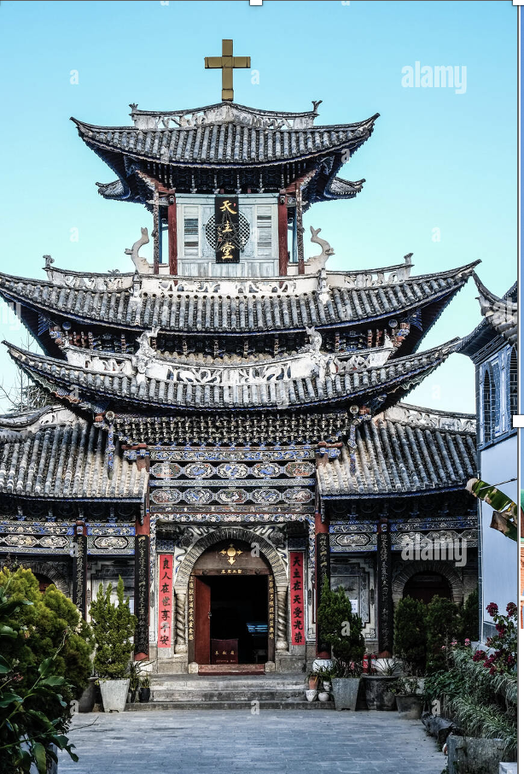
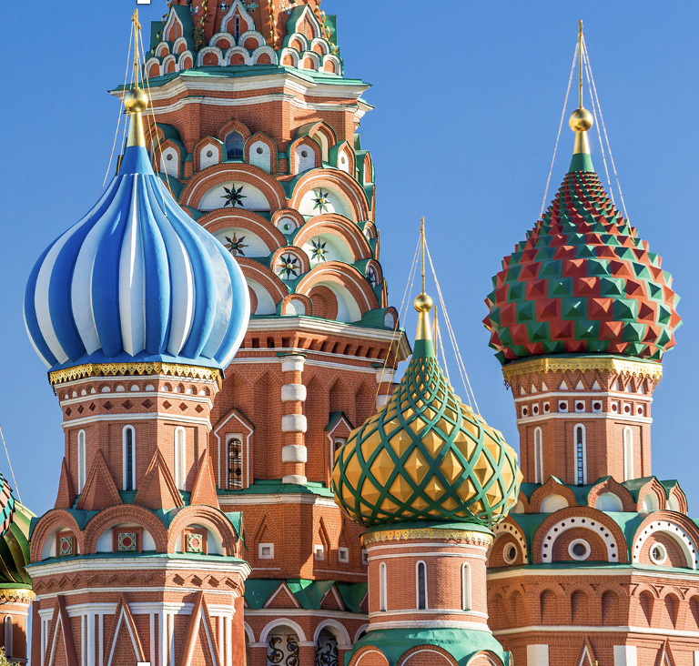
Singapore church building designs ? ?
新加坡教堂建筑
？
？

Slide 28

欢庆被救赎的敬拜 Worship that celebrates redemption

Slide 29
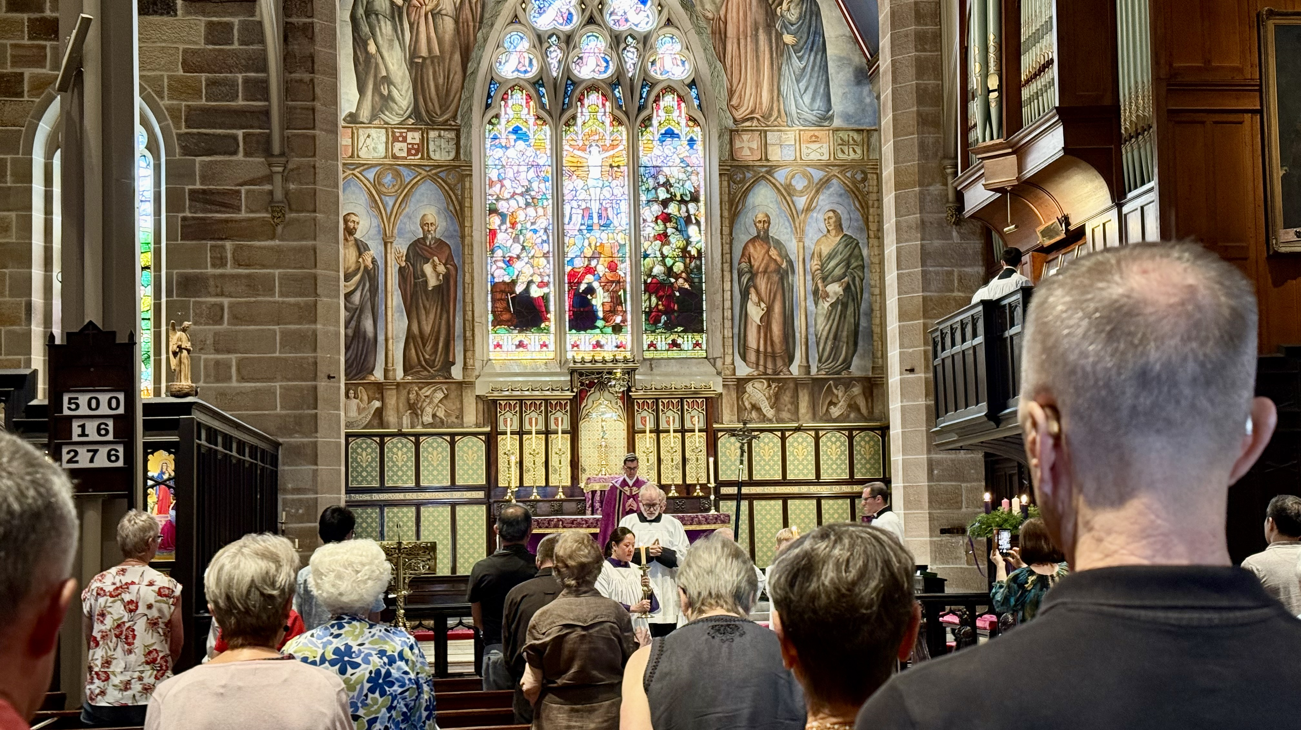
庄严悔罪的敬拜 Solemn and repentant worship

Slide 30
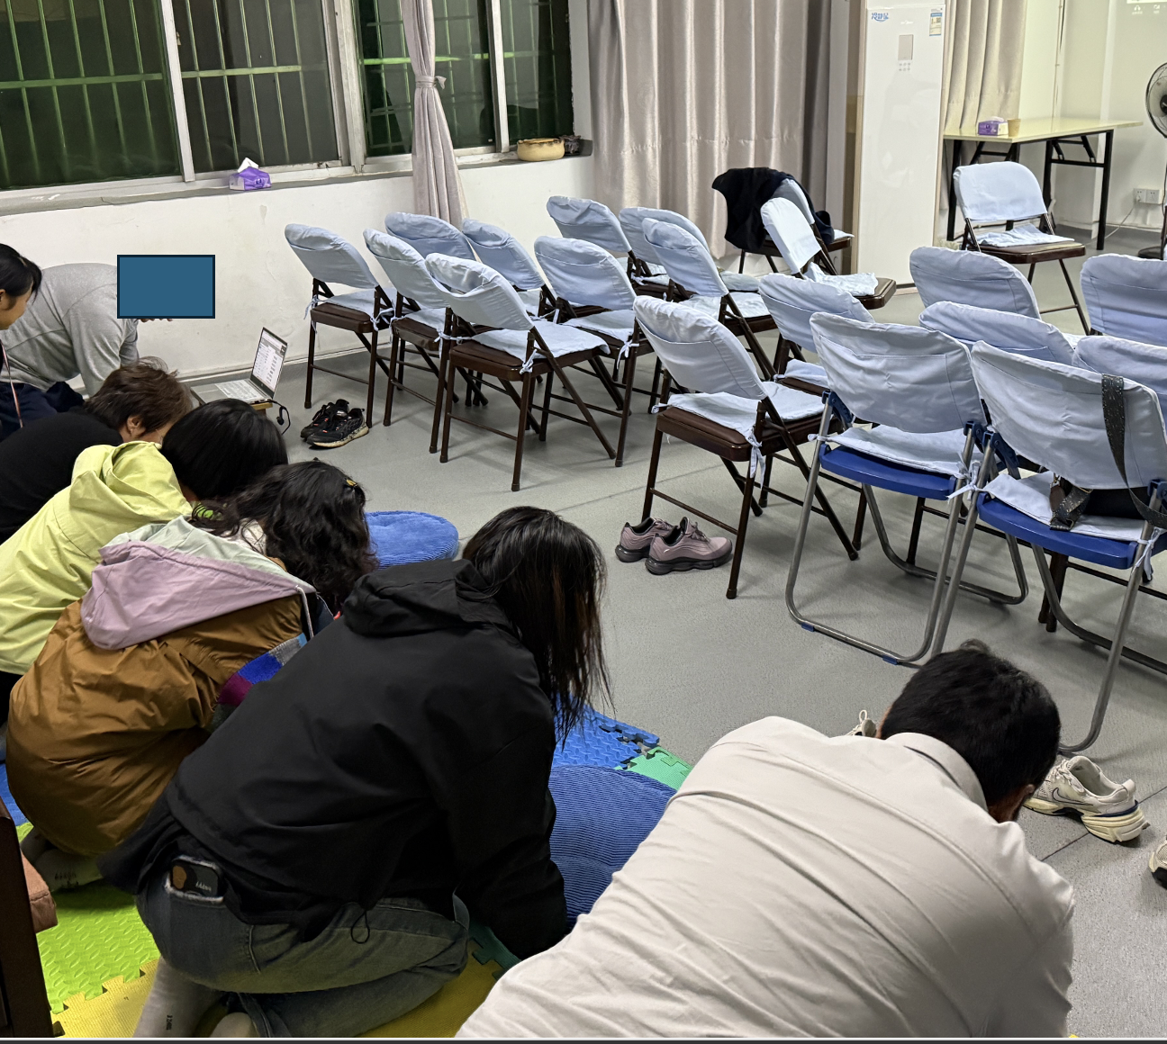
庄严敬虔的祷告 Solemn and Reverent Prayer Meeting

Slide 31
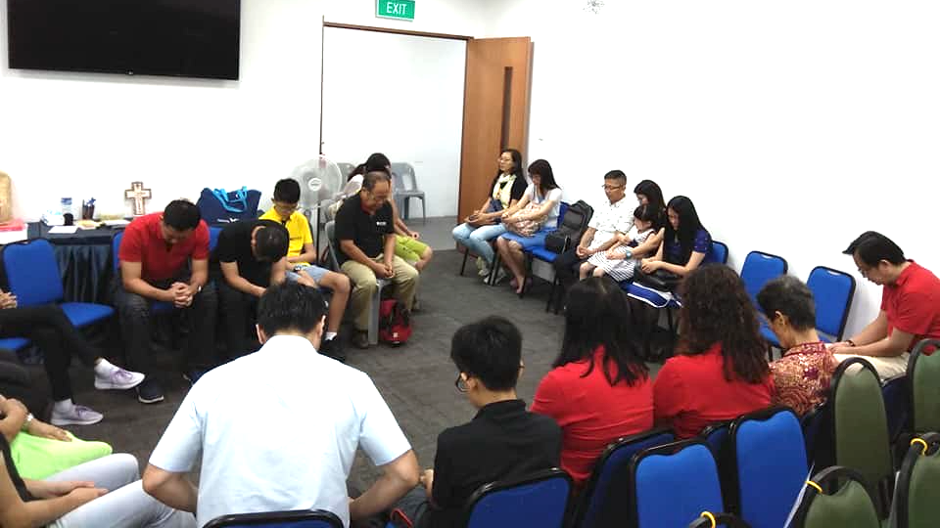
庄严敬虔的祷告 Solemn and Reverent Prayer Meeting

Slide 32
我们的责任
每一个不同时代、每一个不同文化、每一个不同环境。
福音的内容不变，
但需要以不同方式呈现、表达和应用。
contextualization without compromise.
Each different era, each different culture, and each different context— the content of the gospel remains unchanged, but it must be presented, expressed, and applied in different ways.

Slide 33
总结：
预定也强调人的责任
Predestination also emphasizes human responsibility.
为人的救恩祈求祷告
Pray and intercede for the salvation of others.
传福音是我们的责任
Evangelism is our responsibility.
福音传递者需谨慎
Gospel messengers must be cautious.

