Slide 1
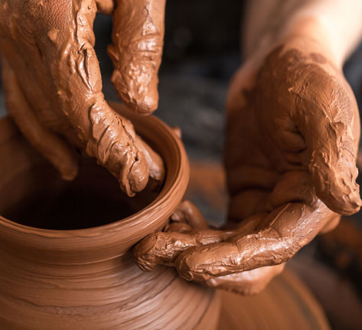

神的拣选与人的责任（中）
The Predestination of God and the Responsibility of Man (Part 2)

Slide 2
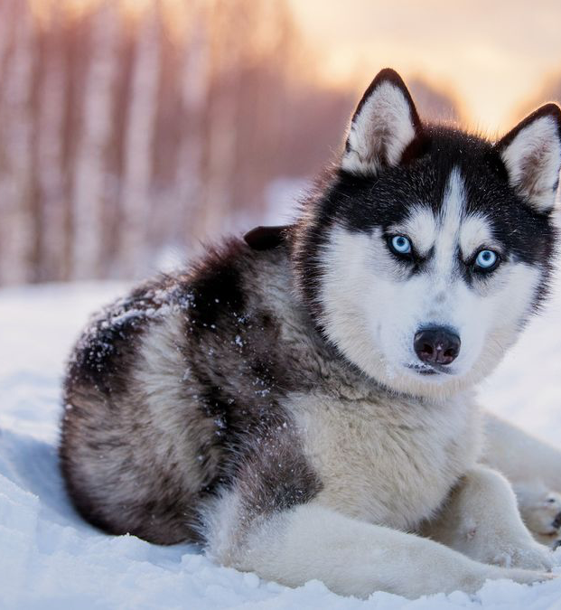
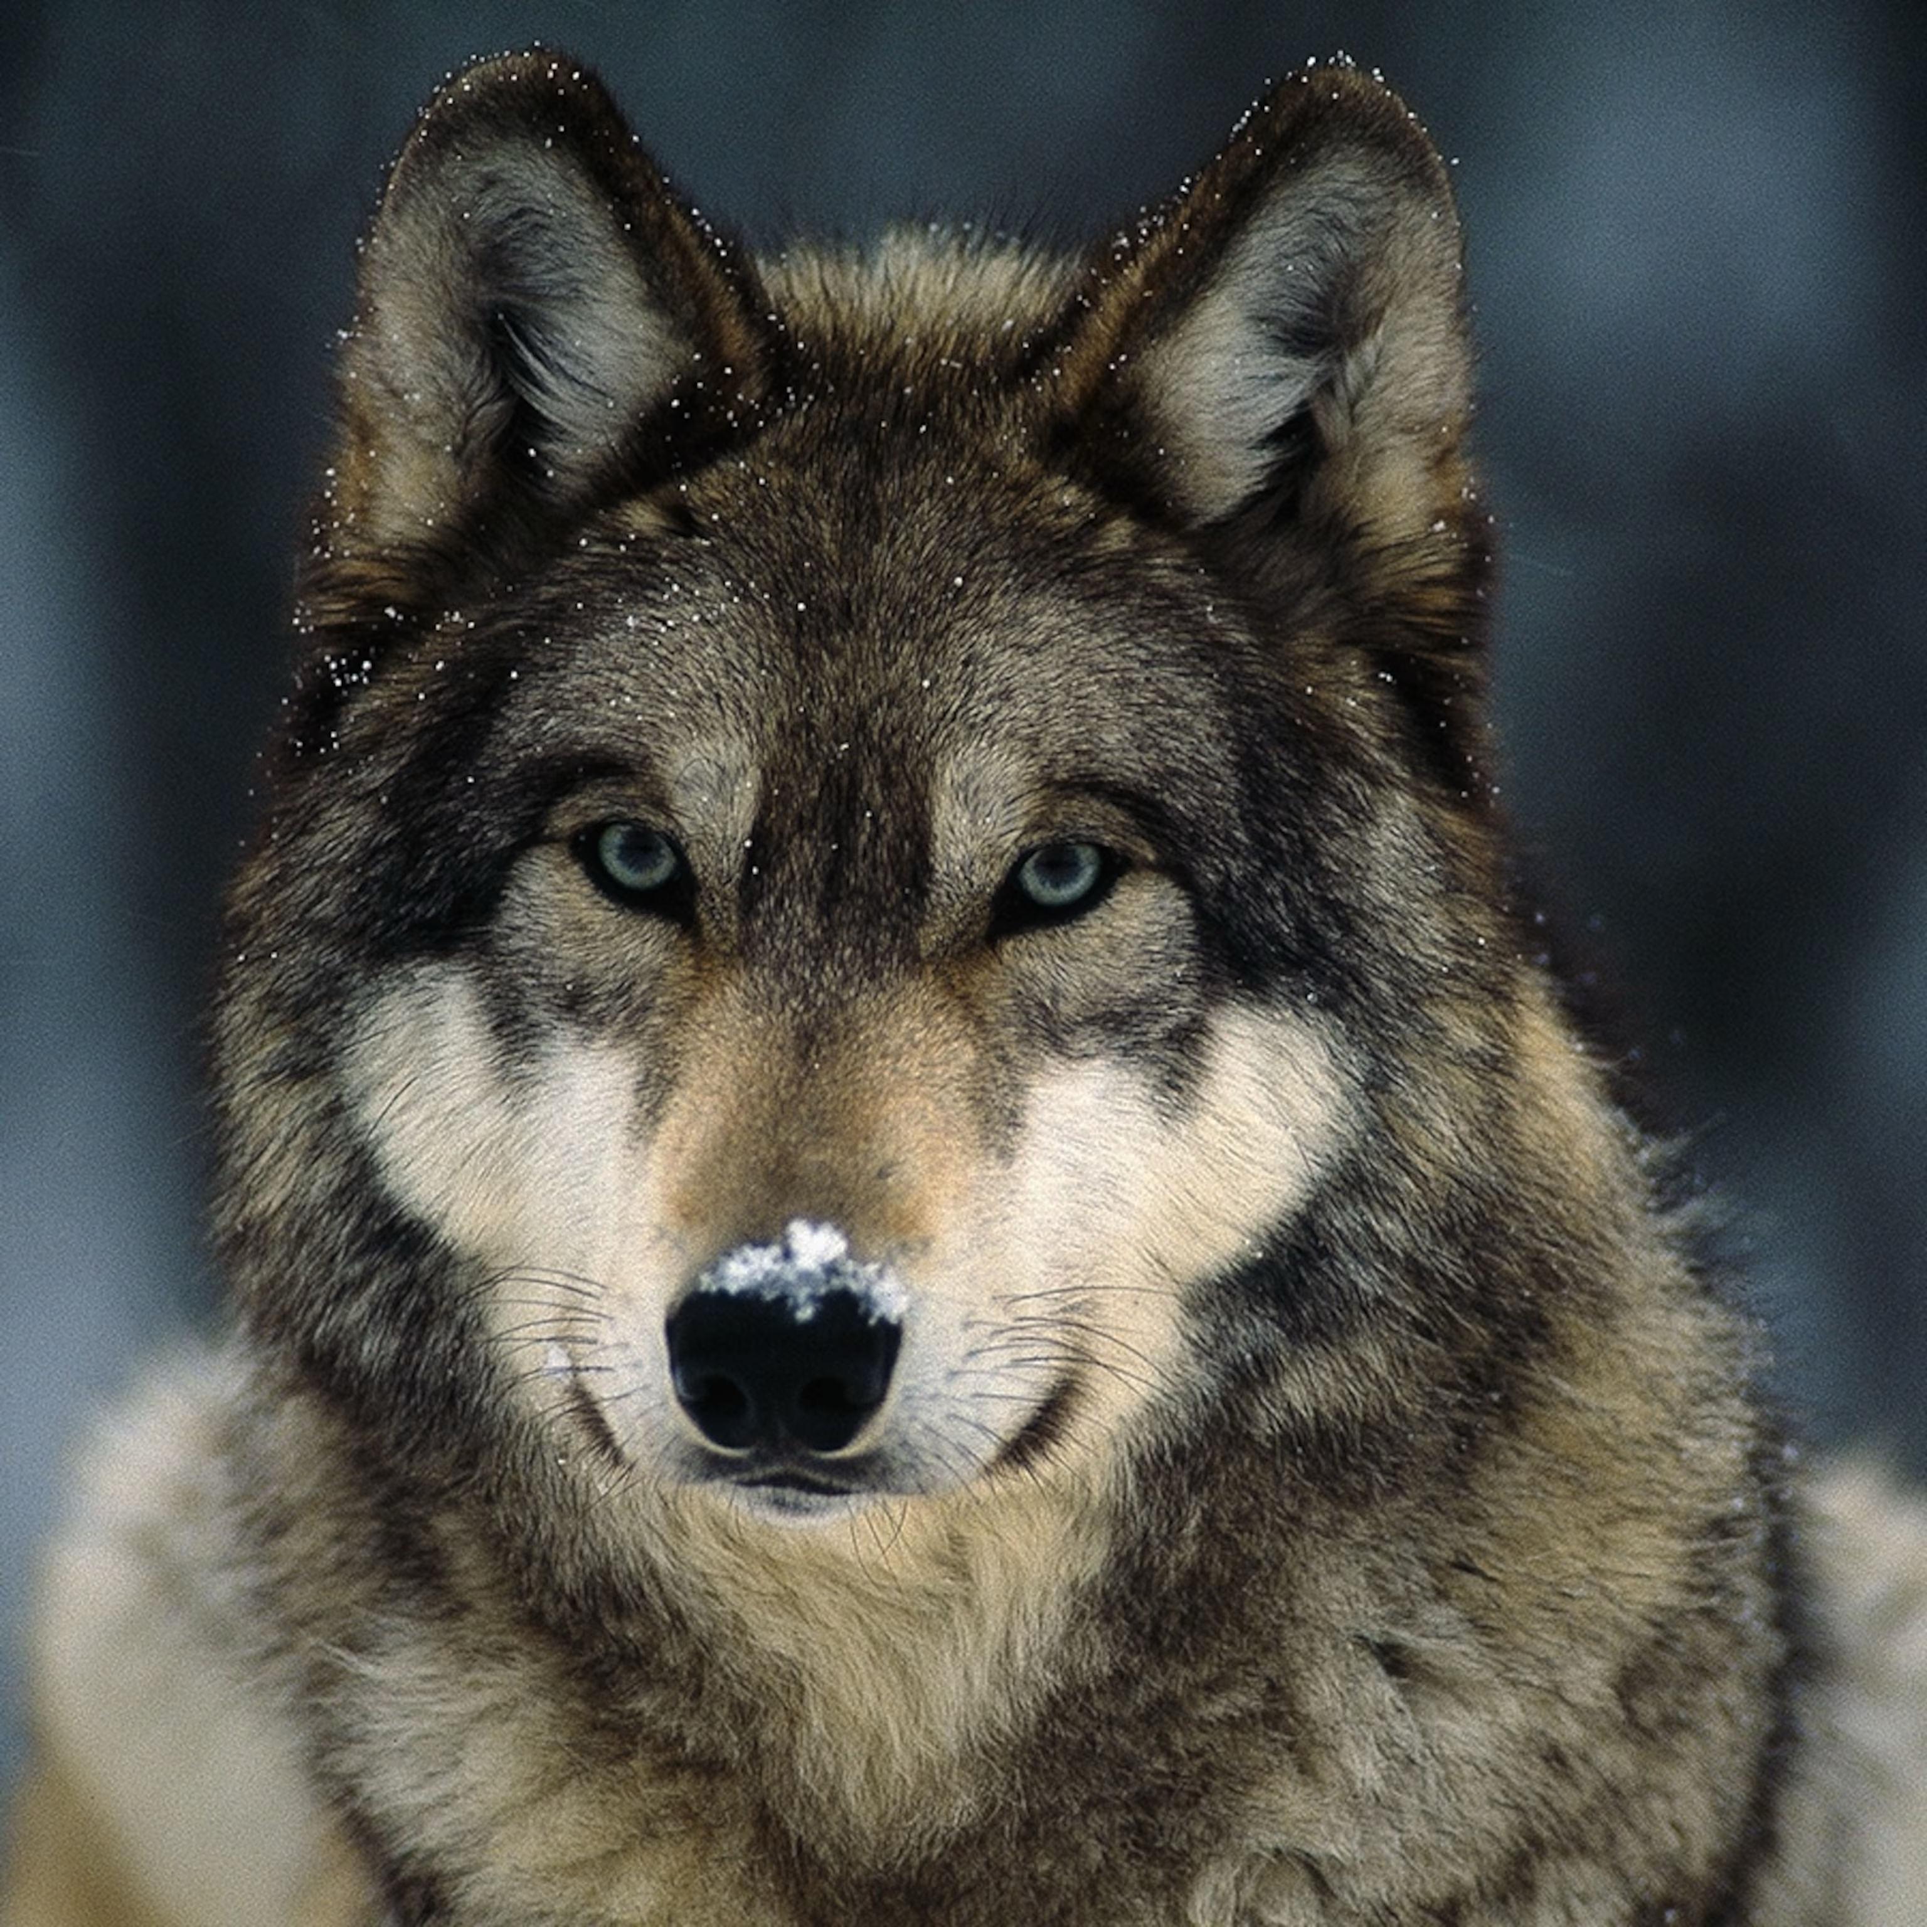
1
2
狗：哈士奇（Husky）
狼 wolf
猜一猜我是谁？

Slide 3
1
2
狗：哈士奇（Husky）
狼 wolf
狗有“忠诚”的本性
The dog nature is loyal
狼具有“独立”的本性
The wolf nature is independence

Slide 4
一些有关预定论的问题
Some questions concerning predestination
（1）若有些人不得救，神岂不是不公义吗？
If some people are not saved, does that mean God is unjust?
（2）如果神有绝对主权，那人岂不是成了木偶？
If God has absolute sovereignty, does that make man a puppet?
（3）如果神早已拣选谁得救，那人的努力还有意义吗？
If God has already chosen who will be saved, does human effort still have any meaning?

Slide 5
一些有关预定论的问题
Some questions concerning predestination
（2）如果神有绝对主权，那人岂不是成了木偶？
If God has absolute sovereignty, does that make man a puppet?

Slide 6
人堕落后，是人用自己的意志
选择去拒绝神。
After the fall, it was man who, by his own will, chose to reject God.
【1】

Slide 7

（主对犹太人说）
约 5:40. 然而，你们不肯到我这里来得生命。
John 5:40. yet you refuse to come to me that you may have life.

Slide 8
人的意志与选择取决于
他的本性。
A person’s will and choices are determined by his nature.
.
【2】

Slide 9
1
2
狗：哈士奇（Husky）
狼 wolf
狗有“忠诚”的本性
The dog nature is loyal
狼具有“独立”的本性
The wolf nature is independence

Slide 10


Slide 11
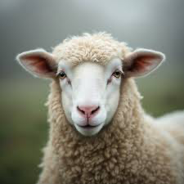
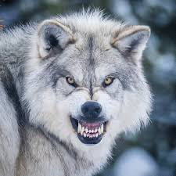

Slide 12


按设计方案正常运作
Function as intended by design.
不按设计方案运作
Not functioning as designed

Slide 13
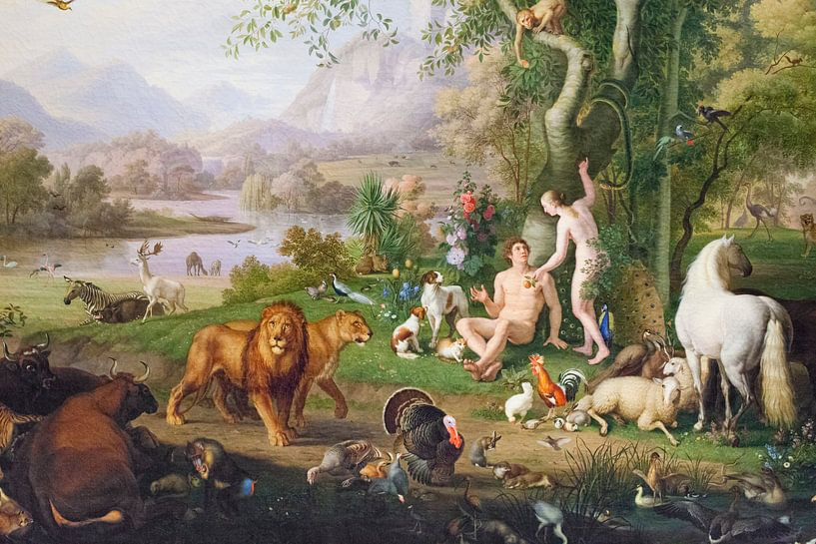
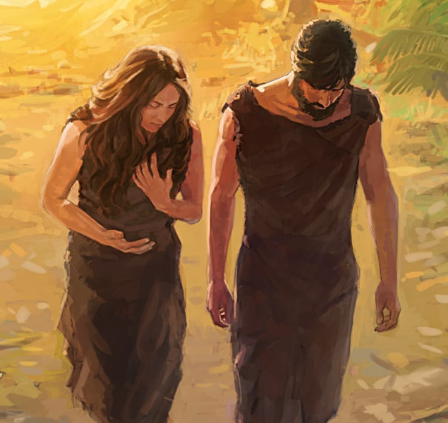
未堕落前
全人类堕落
Before the fall
Whole Humanity fallen in nature
在伊甸园与神同在
be with God in the Garden of Eden
在魔鬼（撒旦）权势下
Under the dominion of the devil (Satan)

Slide 14
创 6：5.
耶和华见人在地上罪恶很大，终日所思想的尽都是恶，
Genesis 6:5.
The Lord saw that the wickedness of man was great in the earth, and that every intention of the thoughts of his heart was only evil continually.

Slide 15
诗51:5
我是在罪孽里生的，在我母亲怀胎的时候就有了罪。
Psalms 51:5.
Behold, I was brought forth in iniquity, and in sin did my mother conceive me.

Slide 16

按本性行事
Act according to one’s nature.

Slide 17


想信却无法信
不想信，也不愿信
Want to believe, yet unable to believe.
Do not want to believe, nor are willing to believe.

Slide 18
因为人是死在罪中的，
所以他不愿意来接受神。。
Because man is dead in sin, he is therefore unwilling to come to God..
.
【3】

Slide 19
创 2:16.
耶和华神吩咐亚当说 ...
17...因为你吃的日子必定死！
Genesis 2:16.And the Lord God commanded the man, saying, ...17...., for in the day that you eat of it you shall surely die."

Slide 20
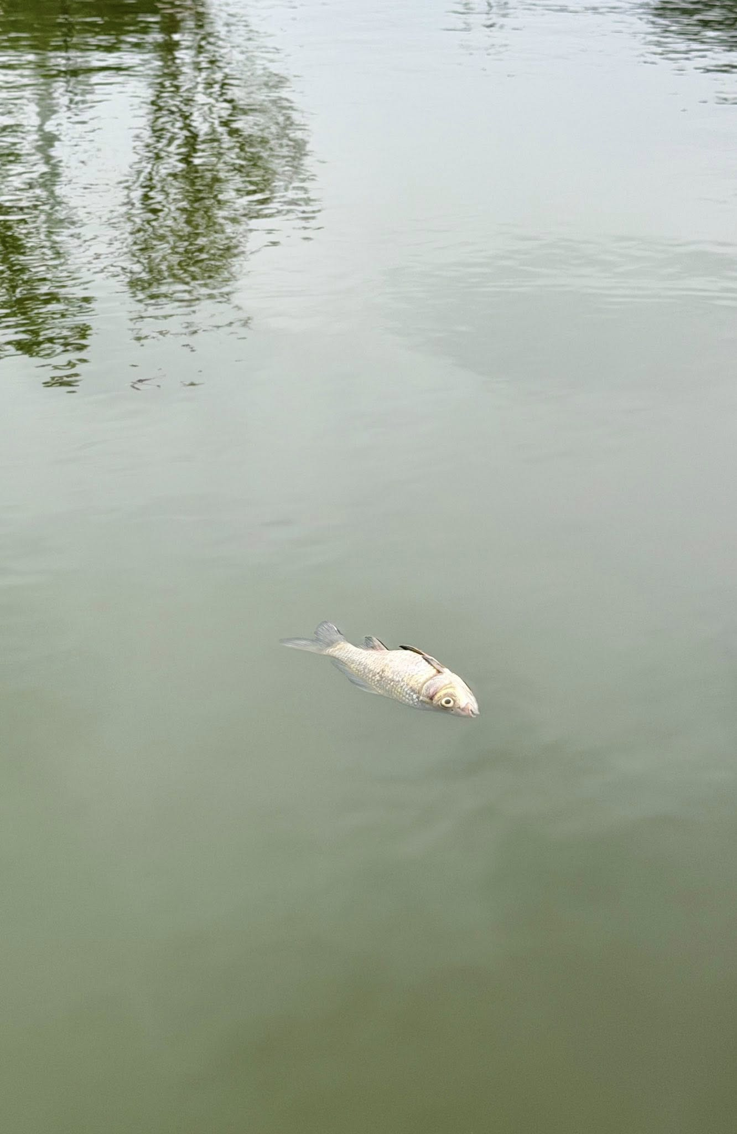
没有反应
No response.

Slide 21
弗2:1.你们死在过犯罪恶之中，他叫你们活过来。2.那时，你们在其中行事为人，随从今世的风俗，顺服空中掌权者的首领，就是现今在悖逆之子心中运行的邪灵。3.我们从前也都在他们中间，放纵肉体的私欲，随着肉体和心中所喜好的去行，本为可怒之子，和别人一样。
Ephesians 2:1.And you were dead in the trespasses and sins 2.in which you once walked, following the course of this world, following the prince of the power of the air, the spirit that is now at work in the sons of disobedience—3.among whom we all once lived in the passions of our flesh, carrying out the desires of the body and the mind, and were by nature children of wrath, like the rest of mankind..... 5. ....made us alive together with Christ....

Slide 22
死在过犯罪恶之中
dead in your transgressions and sins,
想信却无法信
不想信，也不愿信
Want to believe, yet unable to believe.
Do not want to believe, nor are willing to believe.

Slide 23
弗2:4.然而，神既有丰富的怜悯，因他爱我们的大爱，5.当我们死在过犯中的时候，便叫我们与基督一同活过来。你们得救是本乎恩。
Ephesians 2:4.
But because of his great love for us, God, who is rich in mercy, 5.made us alive with Christ even when we were dead in transgressions—it is by grace you have been saved.

Slide 24
预定论不是强迫论
Predestination does not do violence to the will..
【4】

Slide 25
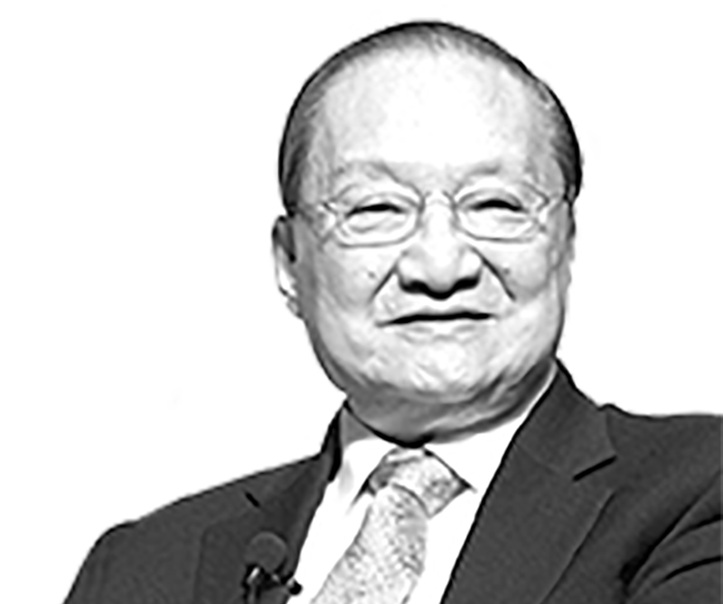

金庸
金庸无法创造具有
自由意志的人
Jin Yong unable to create beings who possess free will.

Slide 26
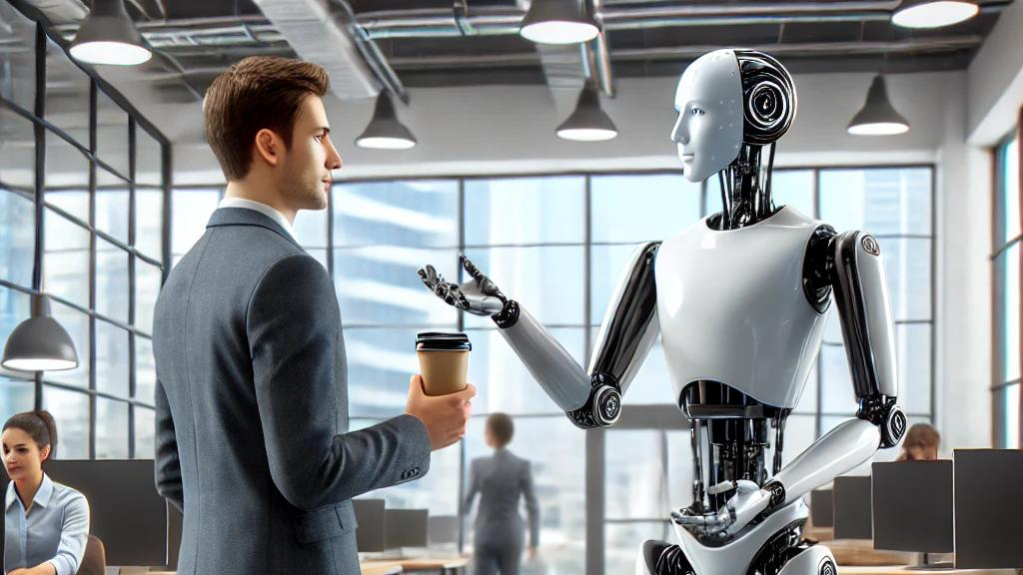
被赋予意志
Endowed with will
意志被编写
The will is encoded and programmed

Slide 27
林前 12:3
...若不是被圣灵感动的，也没有能说「耶稣是主」的。

Slide 28
我们愿意信主，因为神重生我们，赐我们新心与新生命
We believe because God gave us a new heart and new life.
【5】

Slide 29
西36:26.我也要赐给你们一个新心，将新灵放在你们里面，又从你们的肉体中除掉石心，赐给你们肉心。27.我必将我的灵放在你们里面，使你们顺从我的律例，谨守遵行我的典章。
Ezekiel 36:26.
And I will give you a new heart, and a new spirit I will put within you. And I will remove the heart of stone from your flesh and give you a heart of flesh. 27.And I will put my Spirit within you, and cause you to walk in my statutes and be careful to obey my rules.

Slide 30
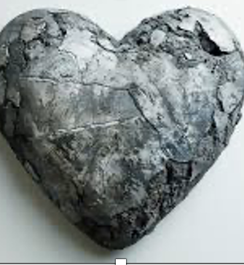

石心
the heart of stone
肉心
a heart of flesh

Slide 31
狼 wolf
狗：哈士奇（Husky）
“独立”的本性
nature is independence
“忠诚”的本性
nature is loyal

Slide 32
总结：
预定论不否认人有意志与决定
Predestination does not deny that man has a will and makes decisions.
人意志的决定是取决与他自身的本性
A person’s will and decisions are determined by his own nature.
以前我们的意志是自愿拒绝抵挡神
Before regeneration, our will voluntarily rejected and resisted God.
神的恩典临到我们，重生我们为我们换心
When the grace of God came upon us, He regenerated us and gave us a new heart.
重生后是我们是自愿信主、跟随主
After regeneration, we willingly believe in the Lord and follow Him.

