Slide 1
永约（ 恩约） eternal covenant （covenant of grace)

Slide 2
什么是约 ？
What is a covenant?

Slide 3
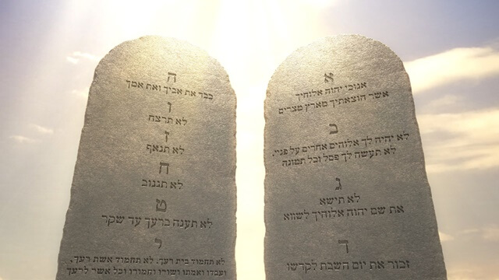
用约来表达关系？ express relationship thru a covenant ？
- 律法的关系？Legalistic ?
- 严肃(害怕)？strictness ? Fear?
- 交换条件？ Mutual exchange of favours ?
- 凭功绩，靠行为? Earn by Merit and by keeping covenant?
- 机械化？Mechanical?

Slide 4
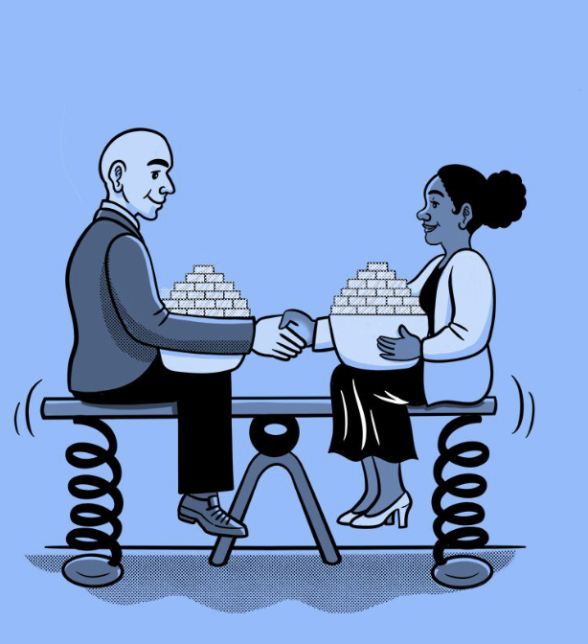

什么是约 ？
What is a covenant?
不是合约！
it is not a contract ！
要协商
Contract involves negotiation
交互筹码条件
Contract involves mutual exchange

Slide 5

什么是约 ？
What is a covenant?
不需协商!
Covenant needs no negotiation
不需交换筹码条件!
Covenant needs no mutual exchange
是白白的恩典给不配的罪人!
Covenant is a free gift to undeserving man

Slide 6


保证
神向祂所爱的起誓为证 （来6:13）
神不能说谎 (来6:18）
Guarantee
God swore by Himself (Heb 6:13)
God cannot lie (Heb 6:18)
“耶和华说：‘我指着自己起誓”
By myself have I sworn, saith the LORD
创 22:16-18、来6:13-18、诗110:4

Slide 7
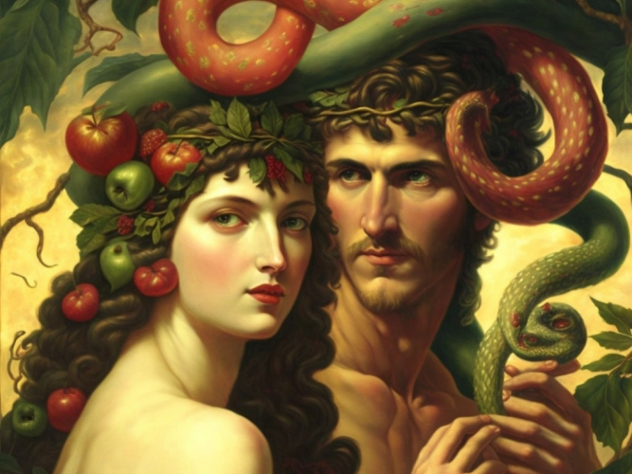
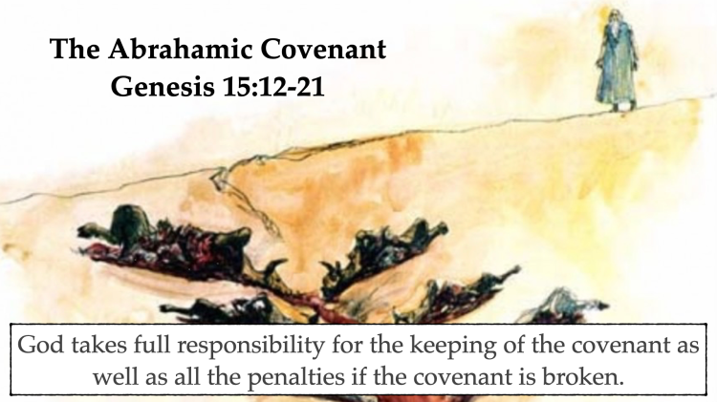
上帝把誓言立下在约中
人不信神、怀疑神的爱
Man disbelief God and doubt God’s love
God binds His oath in a covenant
创15:12-21 、
耶34:18-20*

Slide 8


they shall be my people and I will be their God
约是关系
Covenant is relational
我要作他们的神；
他们要作我的子民
创17:7、出6:7、利26:12、申7:6、申14:2 、申26:19、撒下7:24、耶7:23、耶11:4、耶24:7、耶30:22、耶30:1、耶31:33、耶32:28、结11:19-20、结36:26-28、结37:27、何2:23（罗9:25-26）、亚8:8、亚13:9、来8:10

Slide 9
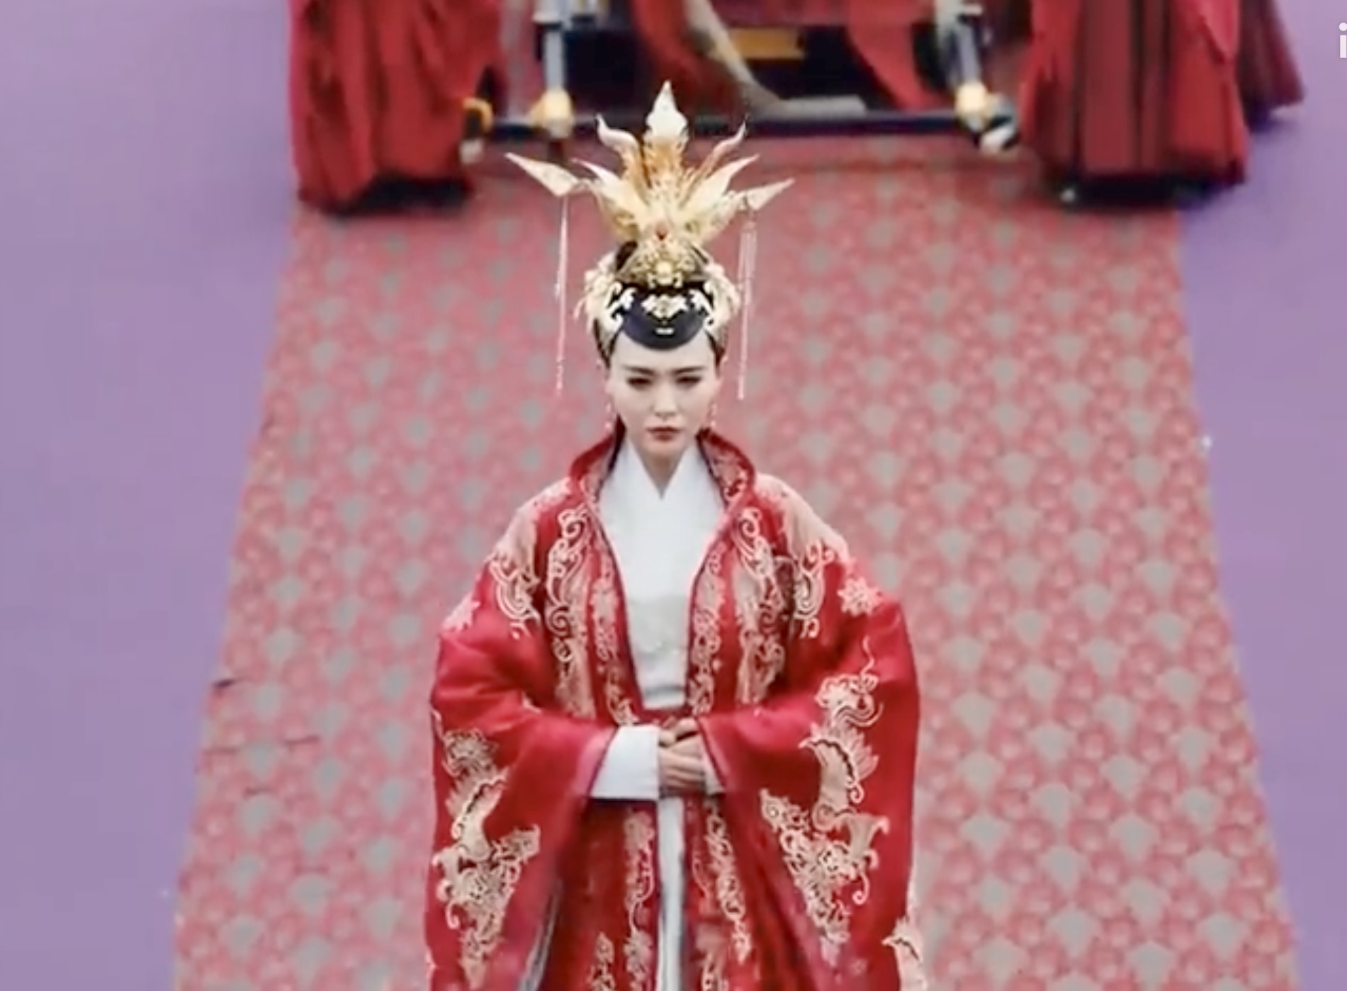
神视自己的子民如妻
（赛65:2、耶2:2、弗5:25-27、启21:2、启21:9
God regards His people like His wife in the covenant

Slide 10



平等婚约
皇帝赐婚约

Slide 11

神拣选的爱
结16:4-14、启19:7、启21:2、启22:17
又因爱我们，就按著自己意旨所喜悦的，预定我们藉著耶稣基督得儿子的名分,
弗1:5
...神从创立世界以前，在基督里拣选了我们
... 弗1:4
he chose us in him before the foundation of the world.... Eph 1:4
八荒四海，为你而来
In love he predestined us for adoption to himself as sons through Jesus Christ, according to the purpose of his will. Eph1:4-5
弗1:4-5、罗9:11-13、贴前1:4、提后1:9

Slide 12
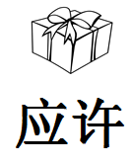
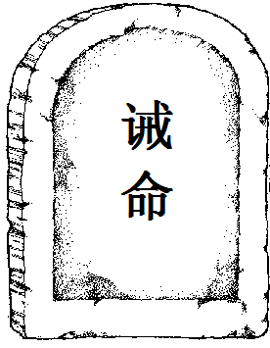


约中的内容 Covenantal content
恩
典
grace
promises
law
blessings
curses
挪亚 创 6:9、创 9:1
亚伯拉罕 创 17:1

Slide 13

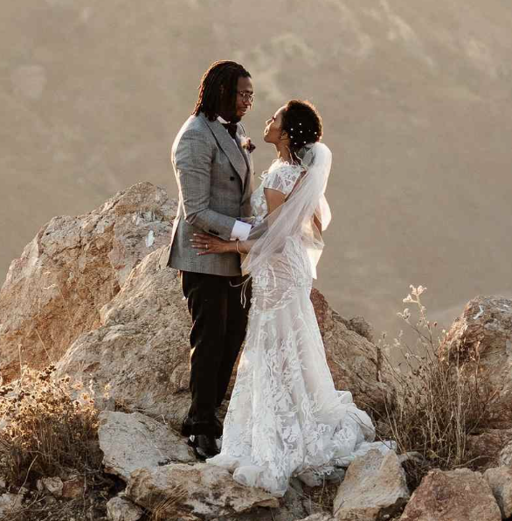


诫
关系破裂
Broken relationship
命
promises
Broken law
耶 3:8-9、结16:32、何1:2
curses
blessings

Slide 14
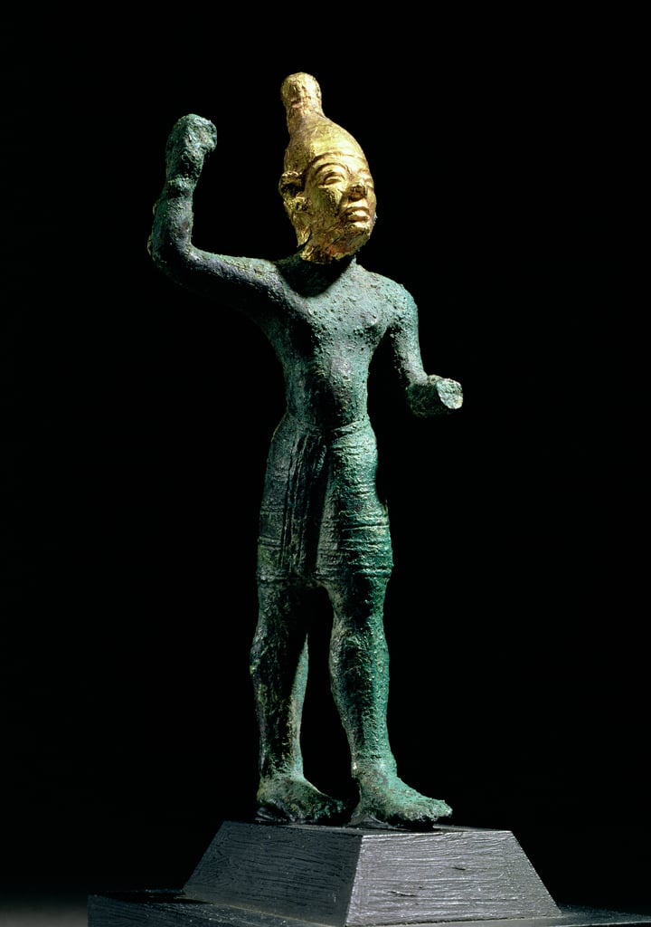
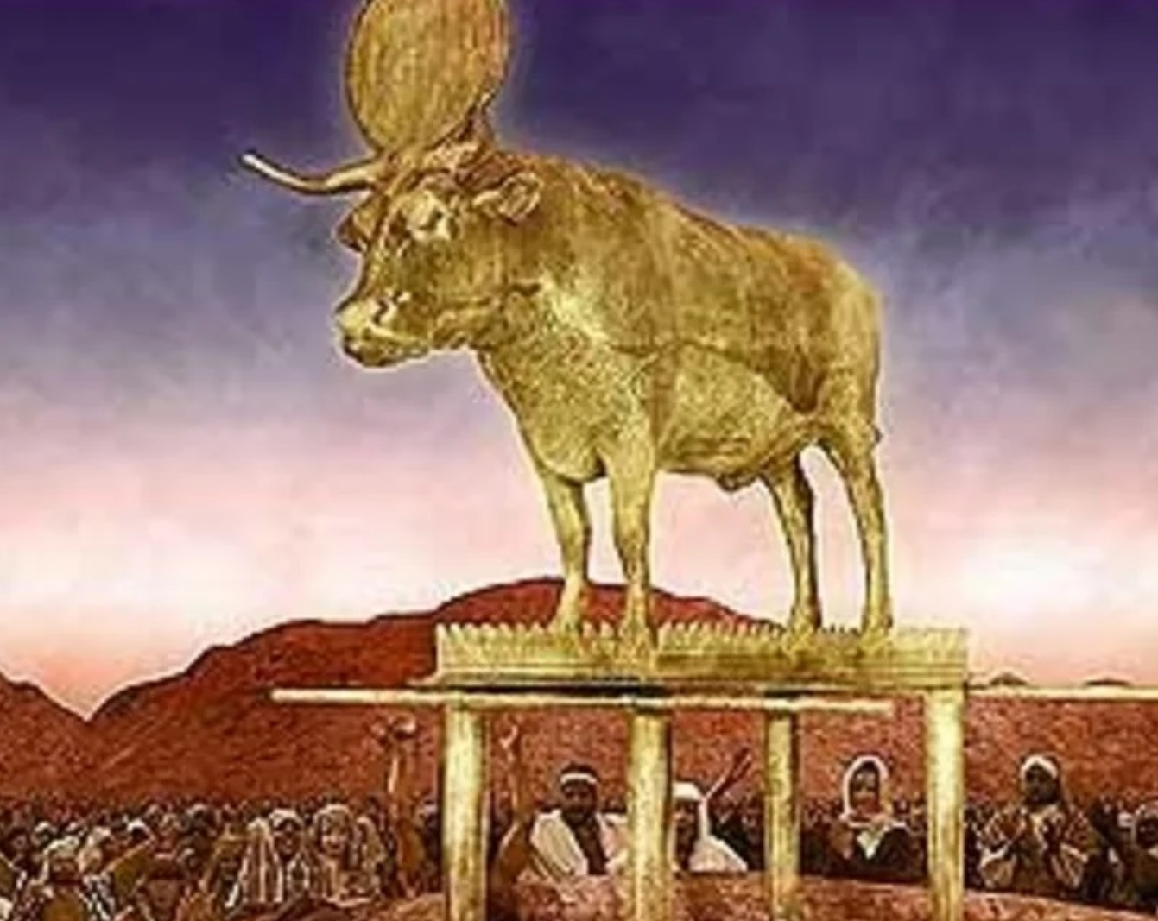
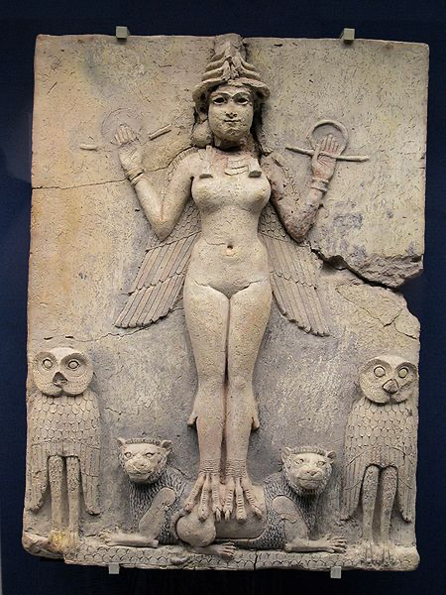
神的百姓淫乱背叛神
结16:8-32、
耶31:32、
赛54:5-10
The people of Israel commits adultery and betrayed God

Slide 15

寻回背叛不忠淫乱的妻
何2:14-19、 何3:5、何11:10-12、何13:14
何14:4 我必医治他们背道的病，甘心爱他们；因为我的怒气向他们转消。
Hos 14:4 I will heal their apostasy; I will love them freely, for my anger has turned from them.

Slide 16

约是神对妻子永远的爱
Covenant is God's eternal love for His wife
耶31:3、罗8:37-39、约壹4:9-10

Slide 17
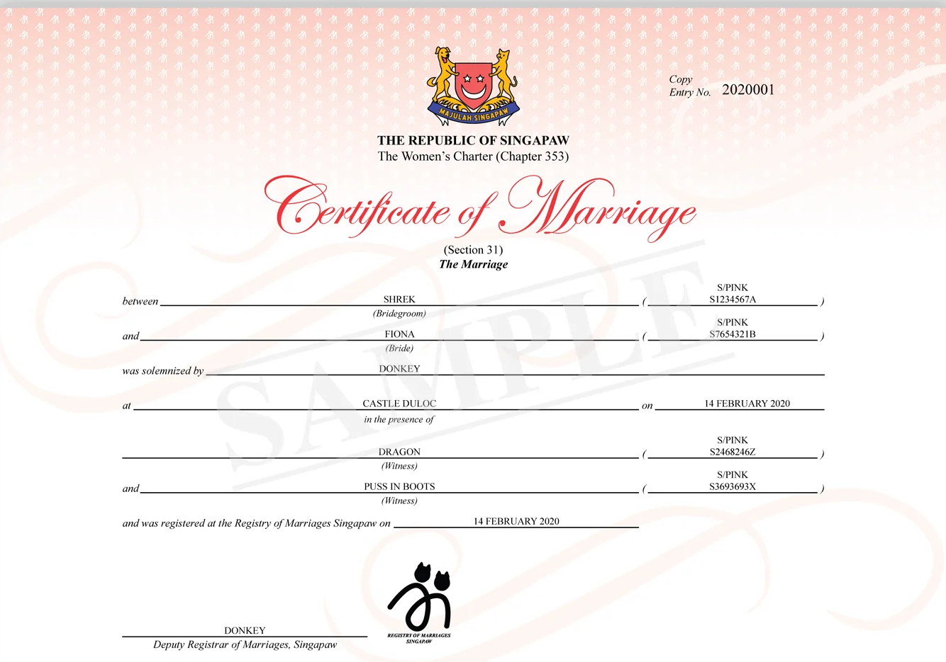
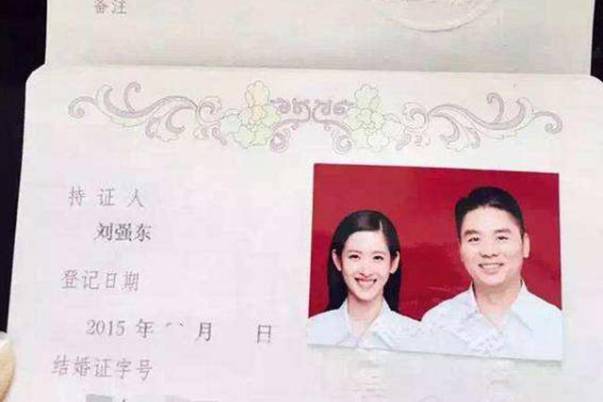
约是神爱的凭据
The covenant is the proof of God's love for us

Slide 18
旧约与新约的关系
Relation between Old and New covenants

Slide 19

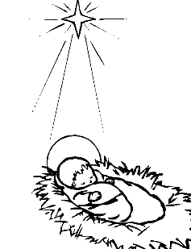

亚当与夏娃
淫乱背叛神
以色列与犹大国
淫乱背叛丈夫
为你而来
为你而生
为你而死

Slide 20
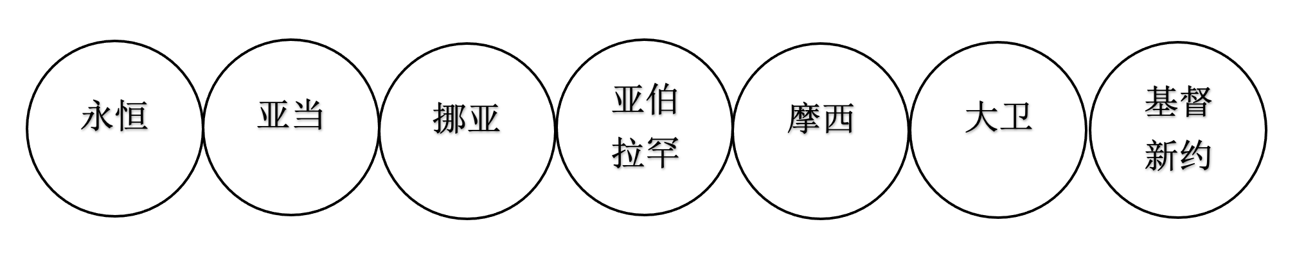
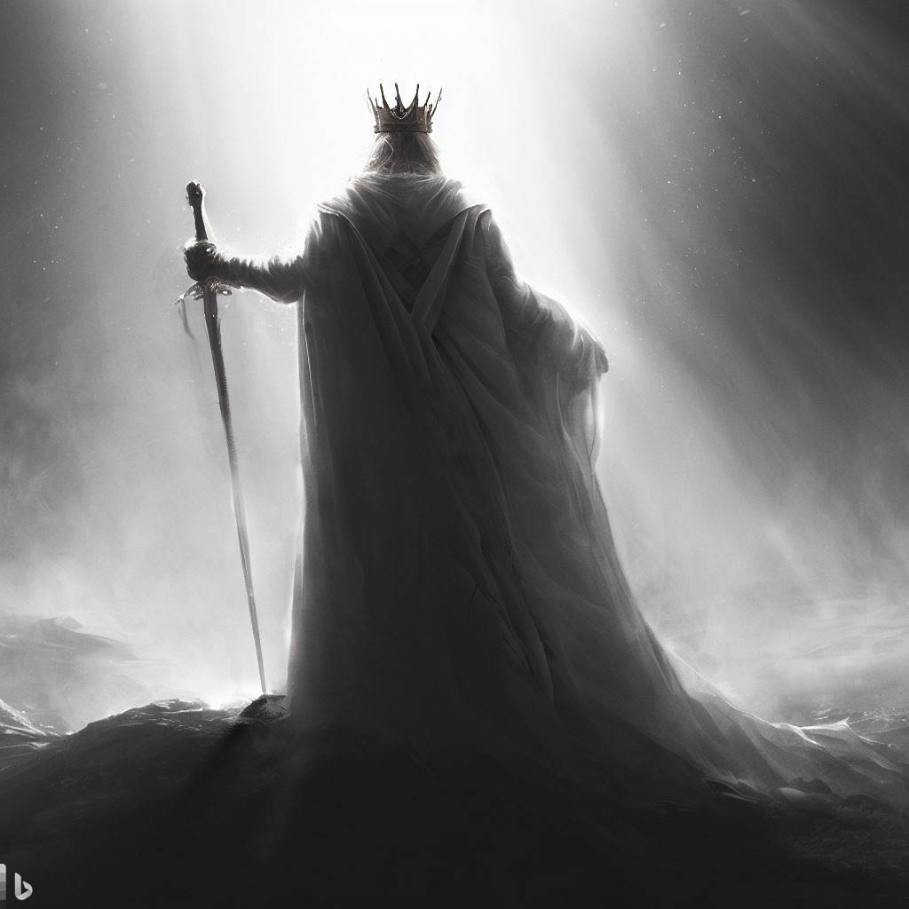
圣经中七个主要的约
7 major covenants
王归来
The return
of the
King
诸诅约是不同历史阶段的续集
Covenants are like different episodes of a series of historical events
末世
last Age
eternity
adam
noah
moses
david
Abraham
Christ
new covenant

Slide 21

永约 eternal covenant
来13:20
创9:16、创17:7、创17:19、撒下23:5、代上16:17、
诗105:10、赛24:5、赛61:8、结16:60、结37:26、来13:20
神是守约，
施慈爱的神
但9:4、但9:4-19
God, who keeps covenant
and steadfast love
平安的约
Covenant of peace
赛54:10、结37:26、

Slide 22


永远的约
Everlasting covenant
人造反
的开始
新天新地
New heavens and earth
救赎历史的开始
Beginning of redemptive history

Slide 24
王归来
The return
of the
King
末世
last Age
eternity
adam
noah
moses
david
Abraham
Christ
new covenant
诸诅约是不同历史阶段的续集
Covenants are like different episodes of a series of historical events

Slide 25
永恒中的约
（父、子、灵，的救赎计划）
The eternal Covenant (redemptive covenant)
The plan of redemption in eternity by the Father, Son and Spirit.

Slide 26
天地未造之前 Before creation
父爱我们（弗1:4-5，约3:16）
父与子之间的约定。
父差遣子来救赎
The Father loves us.The pact between father and Son.The Father sent the Son to redeem.
诗2、诗110:4、赛42:1-4、赛53、亚6:13、约6:38-40、约17:1-5、弗1:4-5、

Slide 27
Eph 1:4-5 even as he chose us in him before the foundation of the world,... in love he predestined us ...
天地未造之前 Before creation
弗1:4-5 就如神从创立世界以前，在基督里拣选了我们，。。。又因爱我们。预定我们藉著耶稣基督得儿子的名分

Slide 28
因为主耶稣为我们钉十字架赎我们的罪，
所以天父爱我们。
明白天父无条件的爱
有条件的爱 conditional love
无条件的爱 unconditional love
天父爱我们，所以祂差遣主耶稣来钉十字架，救赎我们。
第一因 FIRST CAUSE
无条件拣选、unconditional election
约3:16、弗1:4、罗8:29-30

Slide 29

神拣选的爱，神所拣选的，神必爱到底
God’s elective love, and those whom God elect, God loves till the end
爱中的拣选

Slide 30
无势力、无人能破坏神的计划（约）
No one can ruin God‘s plan（covenant）
赛 46:9 你们要追念上古的事。因为我是神，并无别神；我是神，再没有能比我的。10 我从起初指明末後的事，从古时言明未成的事，说：我的筹算必立定；凡我所喜悦的，我必成就。
Isa 46:9 remember the former things of old; for I am God, and there is no other; I am God, and there is none like me,10 declaring the end from the beginning and from ancient times things not yet done, saying, ‘My counsel shall stand, and I will accomplish all my purpose,’

Slide 31
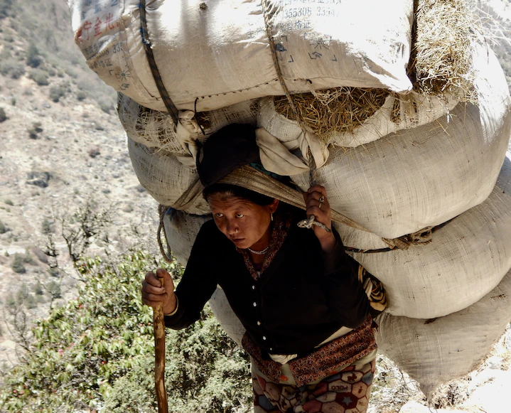
.... 都不能叫我们与神的爱隔绝；
这爱是在我们的主基督耶稣里的。
罗8:1-39
neither death nor life, nor angels nor rulers, nor things present nor things to come, nor powers, nor height nor depth, nor anything else in all creation, will be able to separate us from the love of God in Christ Jesus our Lord.
约10:27-29、罗8:38-39、腓1:6、彼前1:3-5

Slide 32
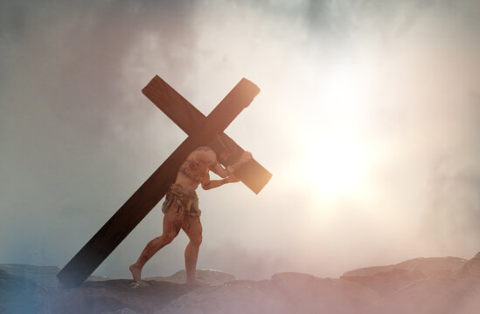
神差遣儿子来寻回神所爱的
救赎我们
受苦、羞辱、背叛、孽待、藐视、伤害、受死
To search for those whom God love
To redeem us.
Son to come and suffer. to redeem and die for us
Humiliated, betrayed, wronged, despised, hurt, and killed

Slide 34
王归来
The return
of the
King
末世
last Age
eternity
adam
noah
moses
david
Abraham
Christ
new covenant
诸约是不同历史阶段的续集
Covenants are like different episodes of a series of historical events

Slide 35
02.
神与亚当立约
God made a covenant with Adam (Adamic covenant)

Slide 36


Slide 37
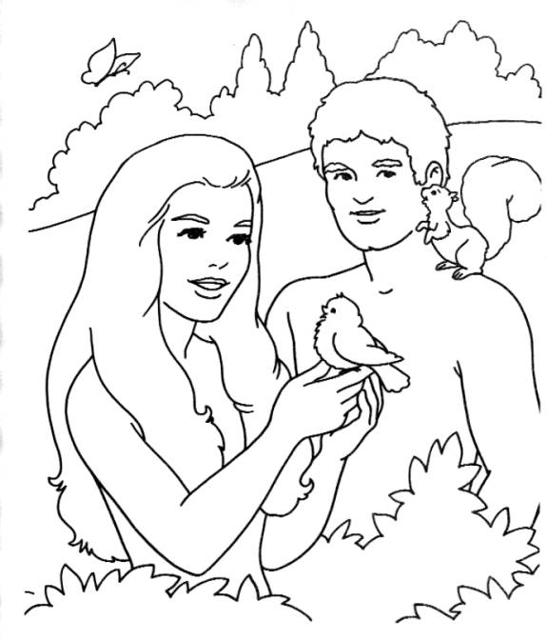
02.
亚当之约
(Adamic covenant)
亚当是立约之首
人的代表
Adam is the representative receipient
（head) of the covenant

Slide 38
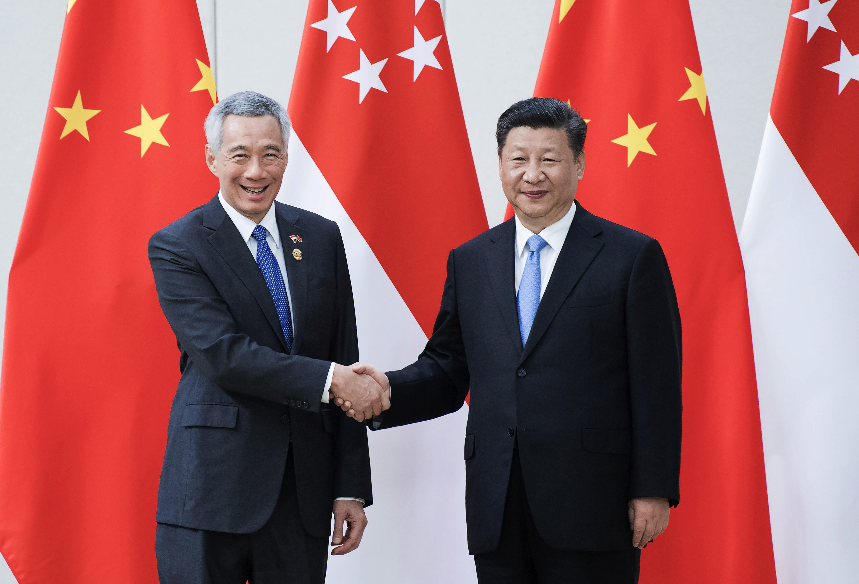
元首

Slide 39
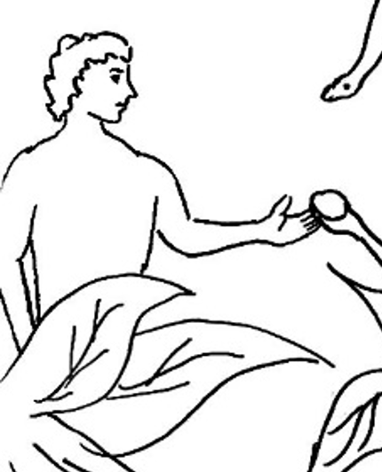
谋逆反叛
上帝
God
The Rebellion
撒旦 / “蛇”
Satan/ Serpent
天使
Angels
造反的天使
Angels who rebelled
人
Manking
人顺服撒旦
Mankind obeyed Satan

Slide 40


撒旦诱惑
罗 5:12 这就如罪是从一人入了世界，死又是从罪来的；於是死就临到众人，因为众人都犯了罪。 （林后5:21）
Rom 5:12 Therefore, just as sin came into the world through one man, and death through sin, and so death spread to all men because all sinned—

Slide 41

与神隔绝(死) 弗2:1-5 death (seperation from God)
神
God
撒旦
Satan

Slide 42
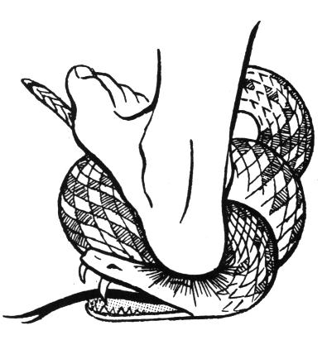
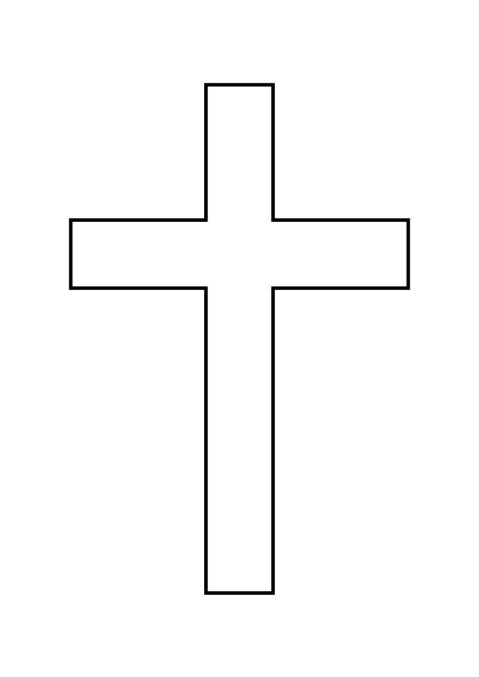
神应许拯救
God promised redemption
创 3:15
... 女人的後裔要伤你(蛇）的头；你(蛇）要伤他的脚跟。
Gen 3:15 ... he shall bruise your （serpent） head, and you（serpent） shall bruise his heel.”

Slide 43
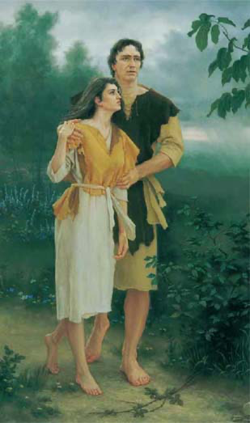
神救赎背叛的亚当与夏娃
（福音的开始）
God promised redemptive grace （promised gospel)
亚当与夏娃
期盼
那要来的孩子（后裔）
期盼
等候
创3:20、4:1、4:25、
神制的皮衣
创3:21
Adam and Eve
Expectant child
有一婴孩为我们而生 赛9:6
For to us a child is born Isa9:6

Slide 44

你(蛇）的後裔和女人的後裔也彼此为仇
（创3:15）
Gen 3:15 I will put enmity between you and the woman, and between your offspring and her offspring

Slide 45

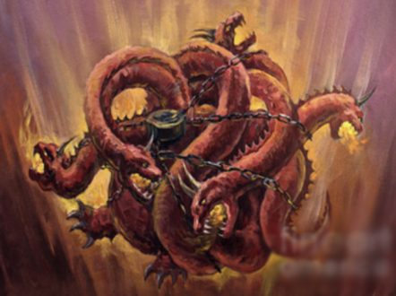

蛇的後裔
Seed of Serpent
女人的後裔
Seed of woman
信神
Faith
圣灵重生
创3:15、太13:38-39*、
约8:44、约壹3:10
弗 1:4、弗2:4-5、约10:27
神所爱的 God’s elective love

Slide 46
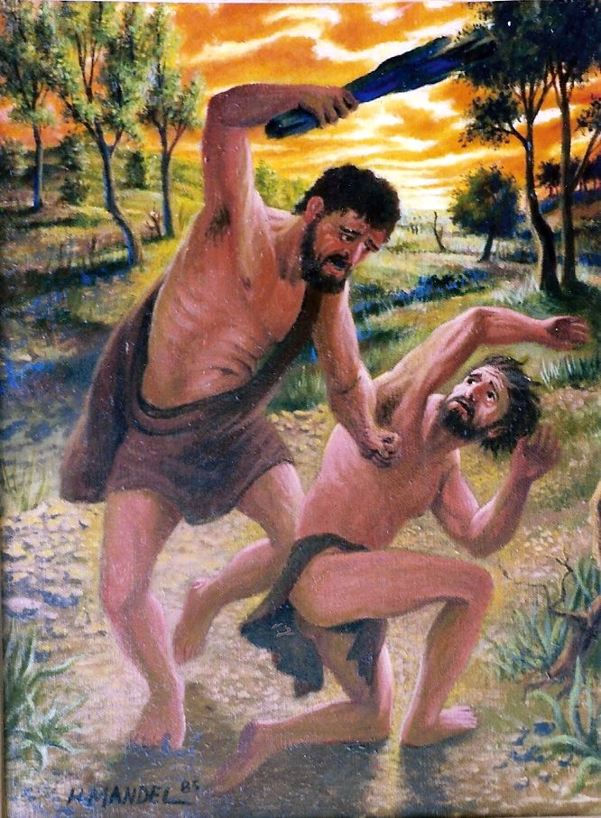

该隐他是属那恶者，
杀了他的兄弟（亚伯）
约壹3:12
Cain, who was of the evil one and murdered his brother.

Slide 47


亚当代表
基督代表
末后亚当
林前15:45
Adam is the head of the covenant
Christ the Last Adam
女人的後裔
Seed of woman
加3:16
女人的後裔
Seed of woman
罗16:20
不完美的人 imperfect man
因一人定罪 （罗5:12-14）
Condenmation thru one man
因一人基督（称义）（罗5:17-19）
Justification thru one man Christ

Slide 48
因信称义
Justification by faith
女人的後裔
新约中的人
旧约中的人
信
信
要击败撒旦
创3:15、罗16:20

Slide 49
创 6:5 耶和华见人在地上罪恶很大，终日所思想的尽都是恶，
Gen 6:5 The LORD saw that the wickedness of man was great in the earth, and that every intention of the thoughts of his heart was only evil continually.
蒙神所爱
余剩子民 remnant
赛10:21-22、耶23:3、罗11:5、

Slide 51
王归来
The return
of the
King
末世
last Age
eternity
adam
noah
moses
david
Abraham
Christ
new covenant
诸诅约是不同历史阶段的续集
Covenants are like different episodes of a series of historical events

Slide 52
03.
神与挪亚与大地立约
（保存大地与人类 ）
God made a covenant with Noah and earth
(Preservation of humanity and earth)
创9:15-17、耶33:25、何2:18*

Slide 53

审判全地的主
创 18:25 将义人与恶人同杀，将义人与恶人一样看待，
这断不是你所行的。审判全地的主岂不行公义吗？」
Gen 18:25 Far be it from you to do such a thing, to put the righteous to death with the wicked, so that the righteous fare as the wicked! Far be that from you! Shall not the Judge of all the earth do what is just?”

Slide 54
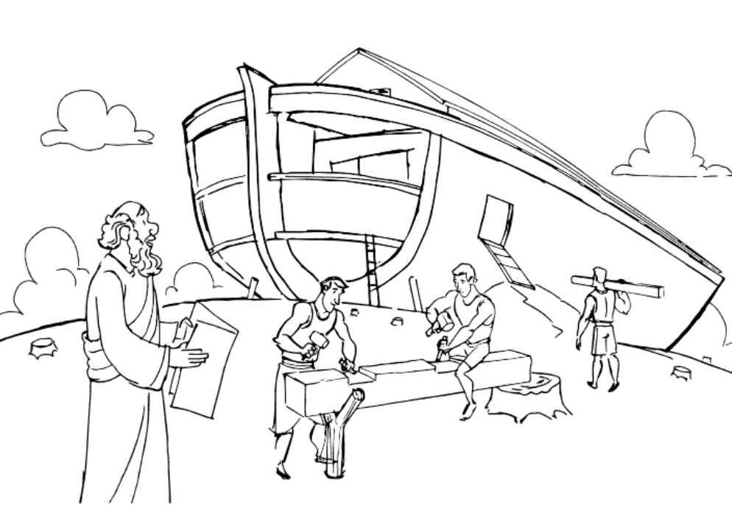

创 6:8 惟有挪亚在耶和华眼前蒙恩。
  Gen 6:8 But Noah found favor in the eyes of the LORD.
后裔 offspring
拯救信的人
蒙神所爱
余剩子民 remnant

Slide 55
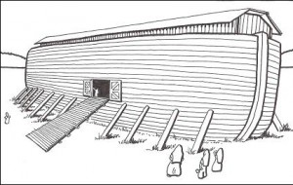
创 7:1 耶和华对挪亚说：你和你的全家都要进入方舟；因为在这世代中，我见你在我面前是义人。
  Gen 7:1 Then the LORD said to Noah, “Go into the ark, you and all your household, for I have seen that you are righteous before me in this generation.
救恩与审判
Salvation and judgemment

Slide 56
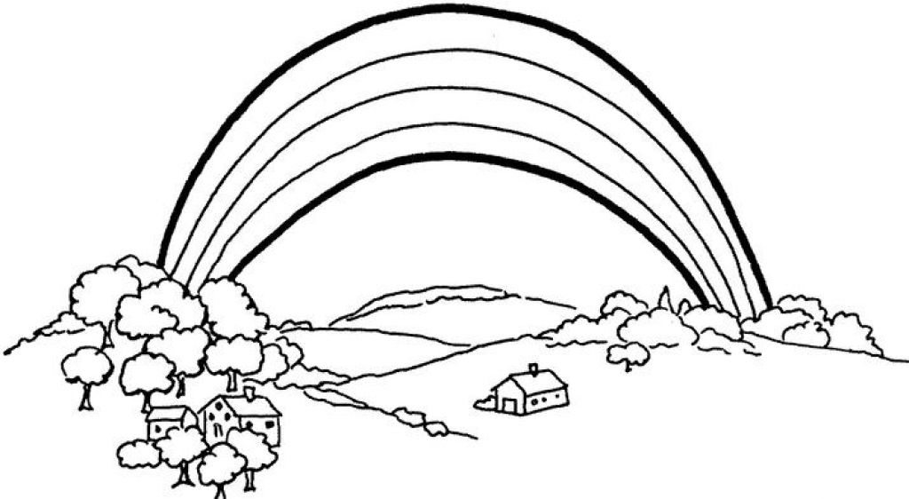

虹是神与大地立约的记号
The rainbow is a sign of the covenant between God and the earth
创 9:15 我便记念我与你们和各样有血肉的活物所立的约，水就再不泛滥、毁坏一切有血肉的物了。16 虹必现在云彩中，我看见，就要记念我与地上各样有血肉的活物所立的永约。」
Gen 9:15 I will remember my covenant that is between me and you and every living creature of all flesh. And the waters shall never again become a flood to destroy all flesh.16 When the bow is in the clouds, I will see it and remember the everlasting covenant between God and every living creature of all flesh that is on the earth.”

Slide 57

创 8:22
地还存留的时候，稼穑sè 、寒暑、冬夏、昼夜就永不停息了。
Gen 8:22 While the earth remains, seedtime and harvest, cold and heat, summer and winter, day and night, shall not cease.”

Slide 58

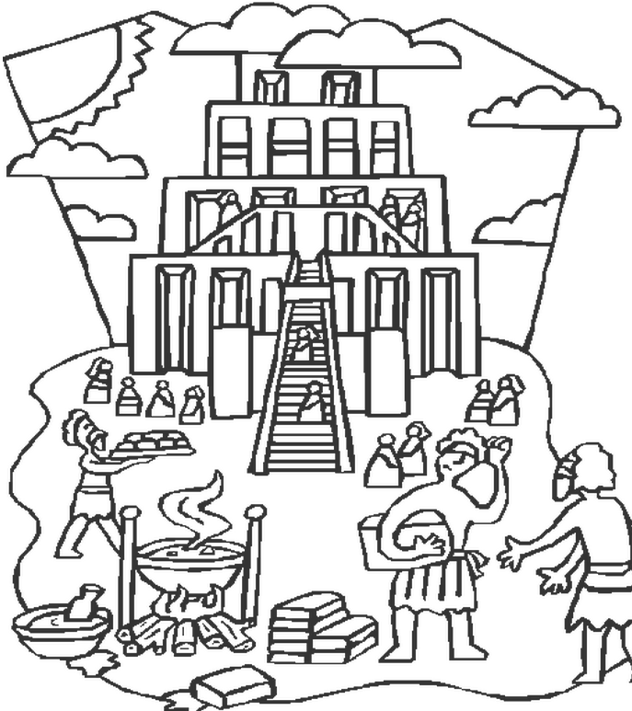
创 11:4 他们说：「来吧！我们要建造一座城和一座塔，塔顶通天，为要传扬我们的名，免得我们分散在全地上。
Gen 11:4 Then they said, “Come, let us build ourselves a city and a tower with its top in the heavens, and let us make a name for ourselves, lest we be dispersed over the face of the whole earth.”

Slide 59

神放弃了其它民族？Did God give up the nations?
变乱人的口音
confuse their language
耶和华使他们从那里分散在全地上
So the LORD dispersed them from there over the face of all the earth,
万国、万邦,不同语言、文化
nations and different cultures

Slide 61
王归来
The return
of the
King
末世
last Age
eternity
adam
noah
moses
david
Abraham
Christ
new covenant
约是不同历史阶段的续集
Like different episodes of a series of historical events

Slide 62
04.
神与亚伯拉罕和他的后裔立约
God made a covenant with Abraham and the offspring

Slide 63
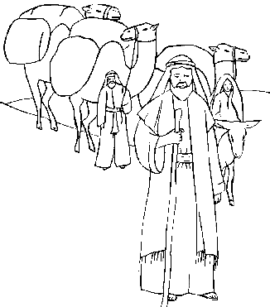
那后裔 the offspring
后裔 offspring
离开本地、本族、父家
离开天上
Go from your country and your kindred and your father's house
Depart from heaven
创12:1

Slide 64

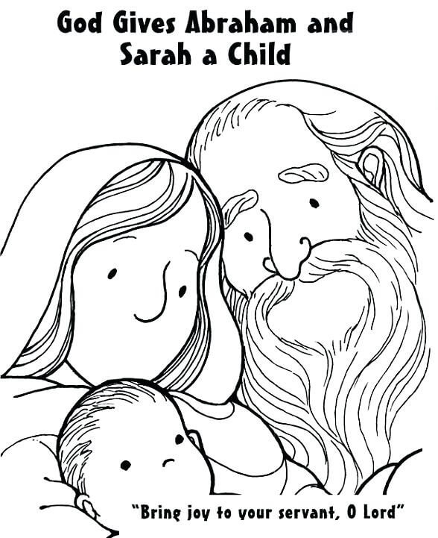
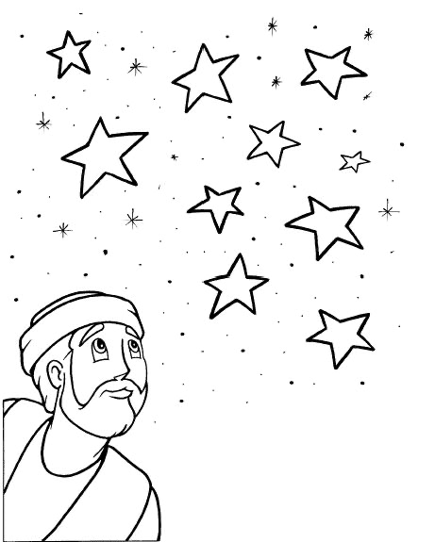
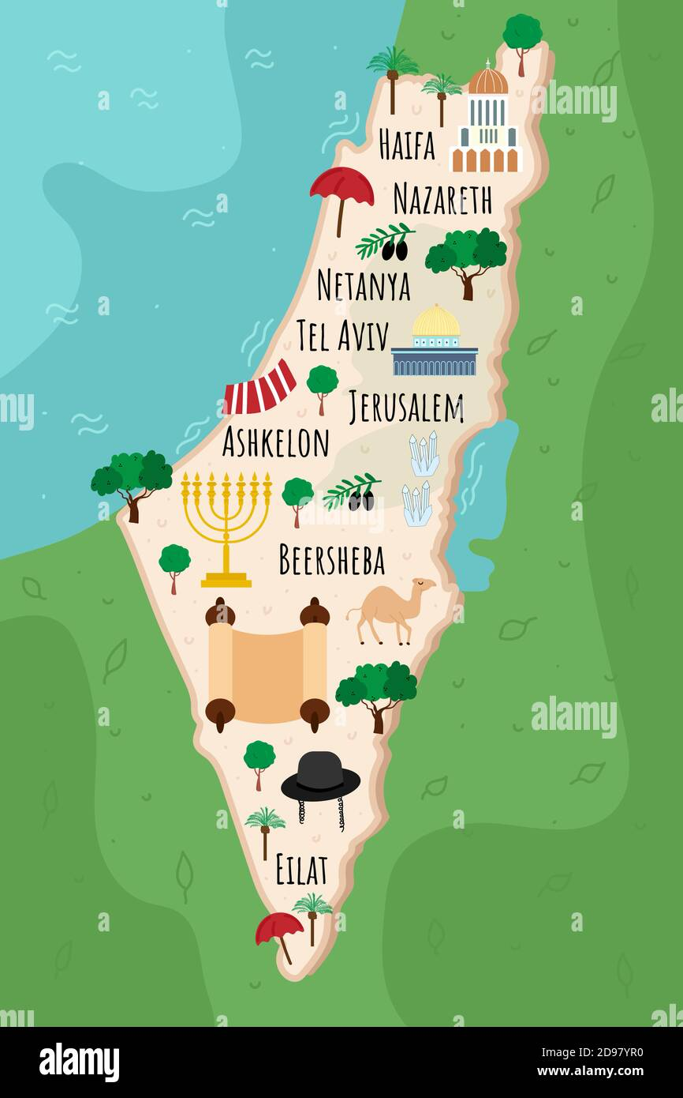
信
Faith
后裔
offspring
后裔（众）
offspring
土地/ 国度
land/ kingdom
创15:18
蒙神所爱
余剩子民 remnant

Slide 65

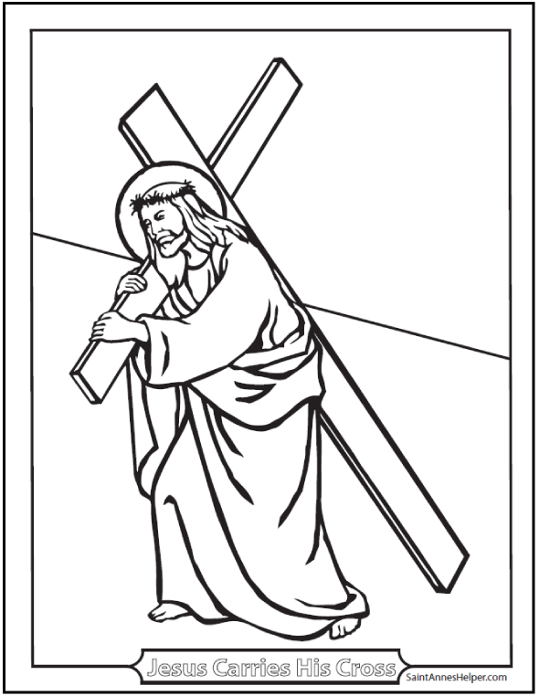
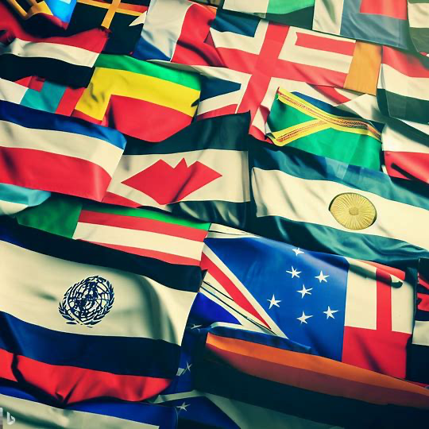

后裔
offspring
后裔(万国）
offspring （nations)
土地/国度
land/ kingdom
创15:18
预表
Typology
加3:16
罗4:16
加3:29
罗4:13

Slide 66
后裔
offspring
后裔（众）
Offspring
土地/ 国度
land/ kingdom
创15:18
信
Faith
后裔(万国）
Offspring （nations）
神的国
Kingdom of God
加3:16
罗4:16
加3:29
罗4:13
信
Faith

Slide 67
万国因后裔（基督）得福
All Nations be blessed in offspring (Christ)
创 22:18 并且地上万国都必因你的後裔得福，因为你听从了我的话。
(加3:16)
Gen 22:18 and in your offspring shall all the nations of the earth be blessed, because you have obeyed my voice.”

Slide 68
加 3:16 所应许的原是向亚伯拉罕和他子孙说的。神并不是说「众子孙」，指著许多人，乃是说「你那一个子孙」，指著一个人，就是基督。
Gal 3:16 Now the promises were made to Abraham and to his offspring. It does not say, “And to offsprings,” referring to many, but referring to one, “And to your offspring,” who is Christ.

Slide 69
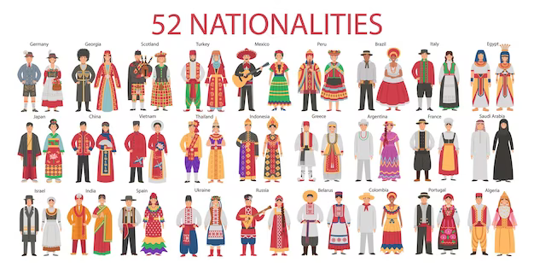
加 3:7 所以，你们要知道：那以信为本的人，就是亚伯拉罕的子孙。
Gal 3:7 Know then that it is those of faith who are the sons of Abraham.
罗9:7-8、加4:22-31 （V28*)

Slide 70
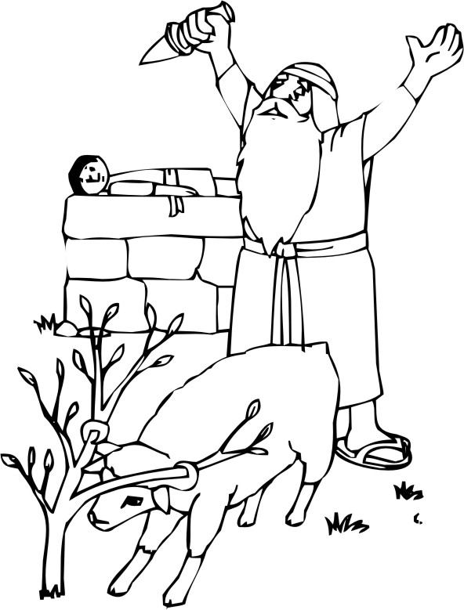
万国因后裔（基督）得福
All Nations be blessed in offspring (Christ)
后裔 offspring
预表
type
那后裔 the offspring

Slide 71
万国万邦 做 亚伯拉罕子孙
All Nations be descendants of Abraham
创17:4「我与你立约：你要作多国的父。5 从此以後，你的名不再叫亚伯兰，要叫亚伯拉罕，因为我已立你作多国的父。
Gen 17:4 “Behold, my covenant is with you, and you shall be the father of a multitude of nations.5 No longer shall your name be called Abram, but your name shall be Abraham, for I have made you the father of a multitude of nations.
加3:7、罗4:16、罗9:7-8 亚伯拉罕的后裔

Slide 72
亚伯拉罕子孙多得像星星一样多
descendants of Abraham as many as like the stars
创 22:17 论福，我必赐大福给你；论子孙，我必叫你的子孙多起来，如同天上的星，海边的沙。你子孙必得著仇敌的城门，
Gen 22:17 I will surely bless you, and I will surely multiply your offspring as the stars of heaven and as the sand that is on the seashore. And your offspring shall possess the gate of his enemies,

Slide 73
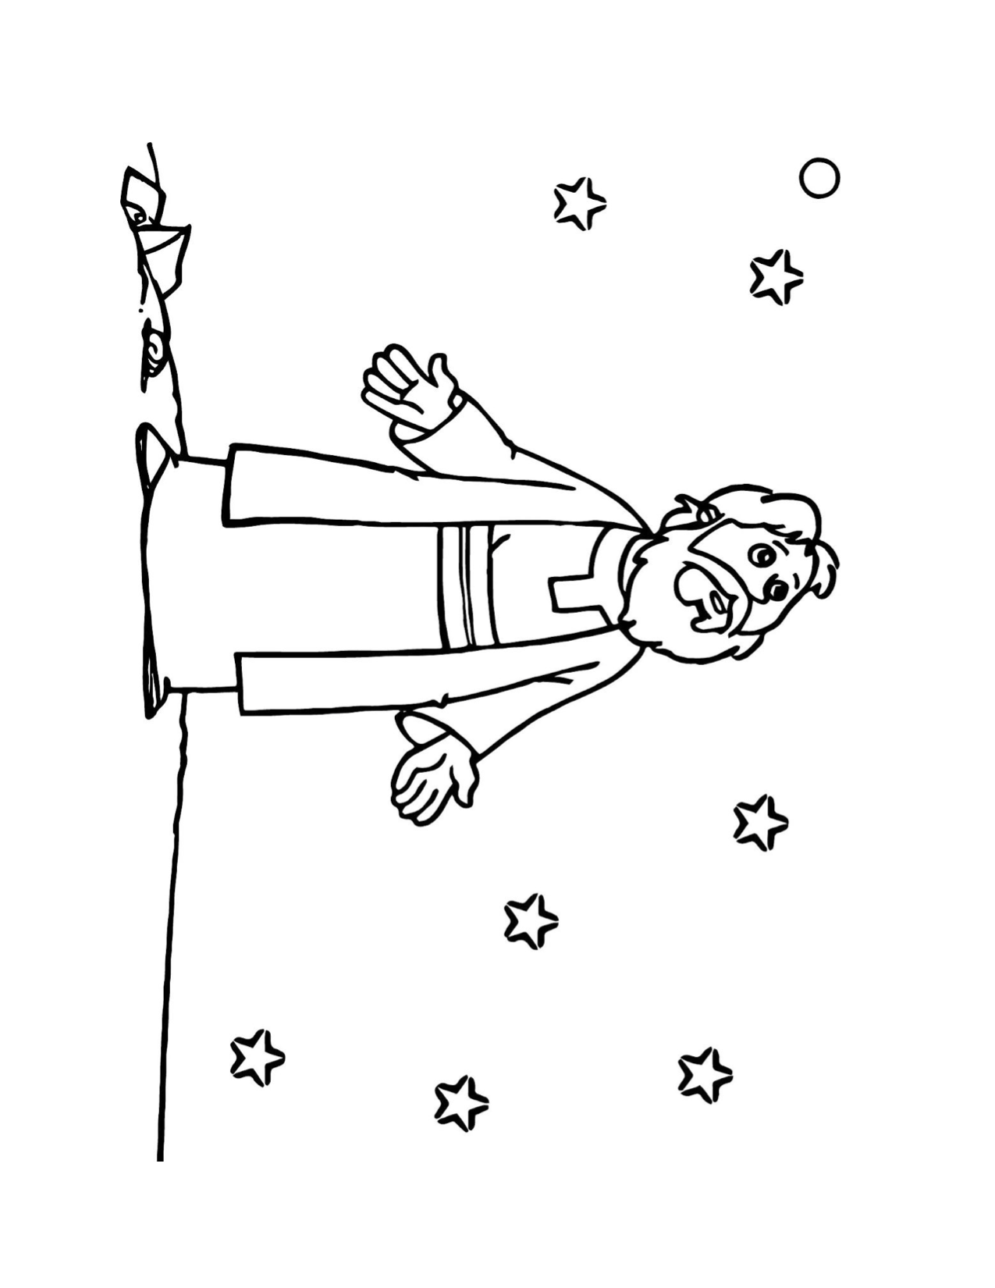
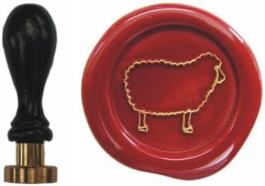
福音 Gospel (加3:8）
创 15:6
亚伯兰信耶和华，
耶和华就以此为他的义。
後裔像星星一样多
Offsprings like the number of stars
因信称义
Justification by faith
Gen 15:6 And he believed the LORD, and he counted it to him as righteousness.
罗4:1-24 (注V3，V22-25)

Slide 74
因信称义
Justified by faith
万国都必
因你的後裔得福
旧约的人
新约的人
信
信
in your offspring shall
all the nations of the earth be blessed

Slide 75
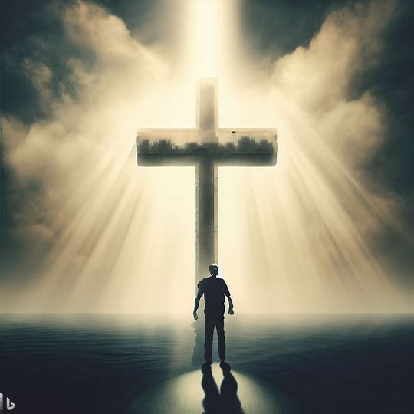

神与亚伯拉罕和他的后裔(基督与我们）立约 （创17:7-9、加3:16）
God made a covenant with BOTH Abraham and the offspring (christ) and us (offspring)
福音 Gospel
那后裔
the offspring
万国蒙福
All nations blessed
万国因信称义
justification by faith (all nations)

Slide 76

割礼
创15:12-21 、耶34:18-20*
割礼记号订立约。这与立约切割动物的肉有关，这是契约仪式的一部分。
Circumcision signifies to cut a covenant. That has to do with cutting the flesh of an animal that was a part of covenant ceremony.

Slide 77

罗 4:11 并且他受了割礼的记号，作他未受割礼的时候因信称义的印证，叫他作一切未受割礼而信之人的父，使他们也算为义；
称
义
Justified
信
割礼
福音 Gospel
创 15:6
称
义
Justified
我们
We All
信
洗礼
Rom 4:11 He received the sign of circumcision as a seal of the righteousness that he had by faith while he was still uncircumcised. The purpose was to make him the father of all who believe without being circumcised, so that righteousness would be counted to them as well,

Slide 78
迦南地预表将来的新天新地
应许之地
Promised land
（赛11:6-16、赛22:6-8、赛65:17-25、彼后3:13、来11:8-10、启21:1）
新天新地

Slide 79

罗4:13 因为神应许亚伯拉罕和他後裔，必得承受世界，不是因律法，乃是因信而得的义。
Rom 4:13 For the promise to Abraham and his offspring that he would be heir of the world did not come through the law but through the righteousness of faith.

Slide 80
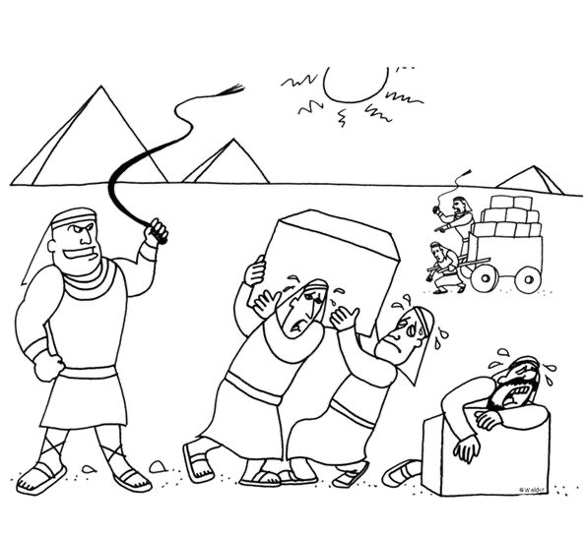
以色列
为奴400年
犹太人被奴役
神的百姓在埃及被奴役

Slide 82
王归来
The return
of the
King
末世
last Age
eternity
adam
noah
moses
david
Abraham
Christ
new covenant
诸诅约是不同历史阶段的续集
Covenants are like different episodes of a series of historical events

Slide 83
05.
神透过摩西与以色列立约
God made a covenant with Israel through Moses

Slide 84
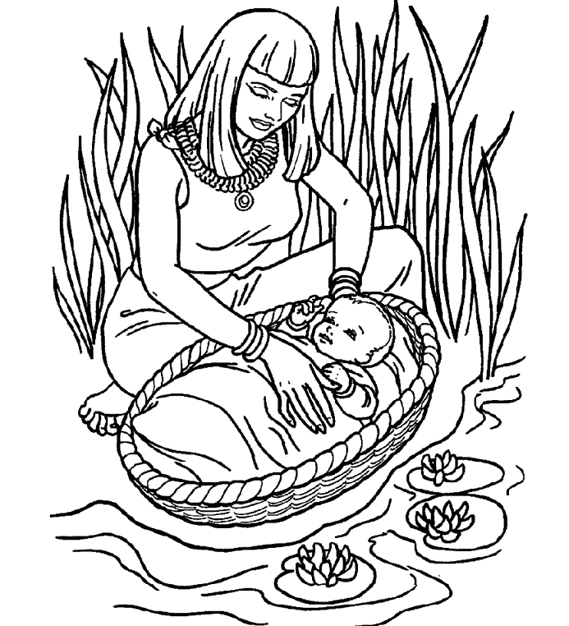
后裔 offspring 拯救者 deliverer

Slide 85
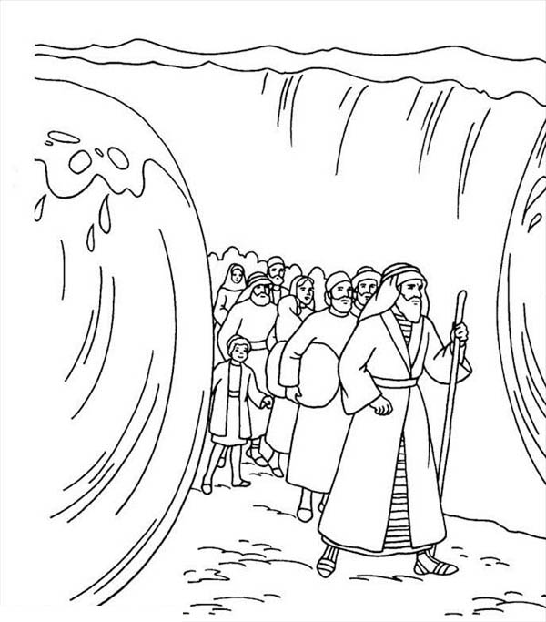
救赎出为奴之家
Redemption out of Slavery

Slide 86
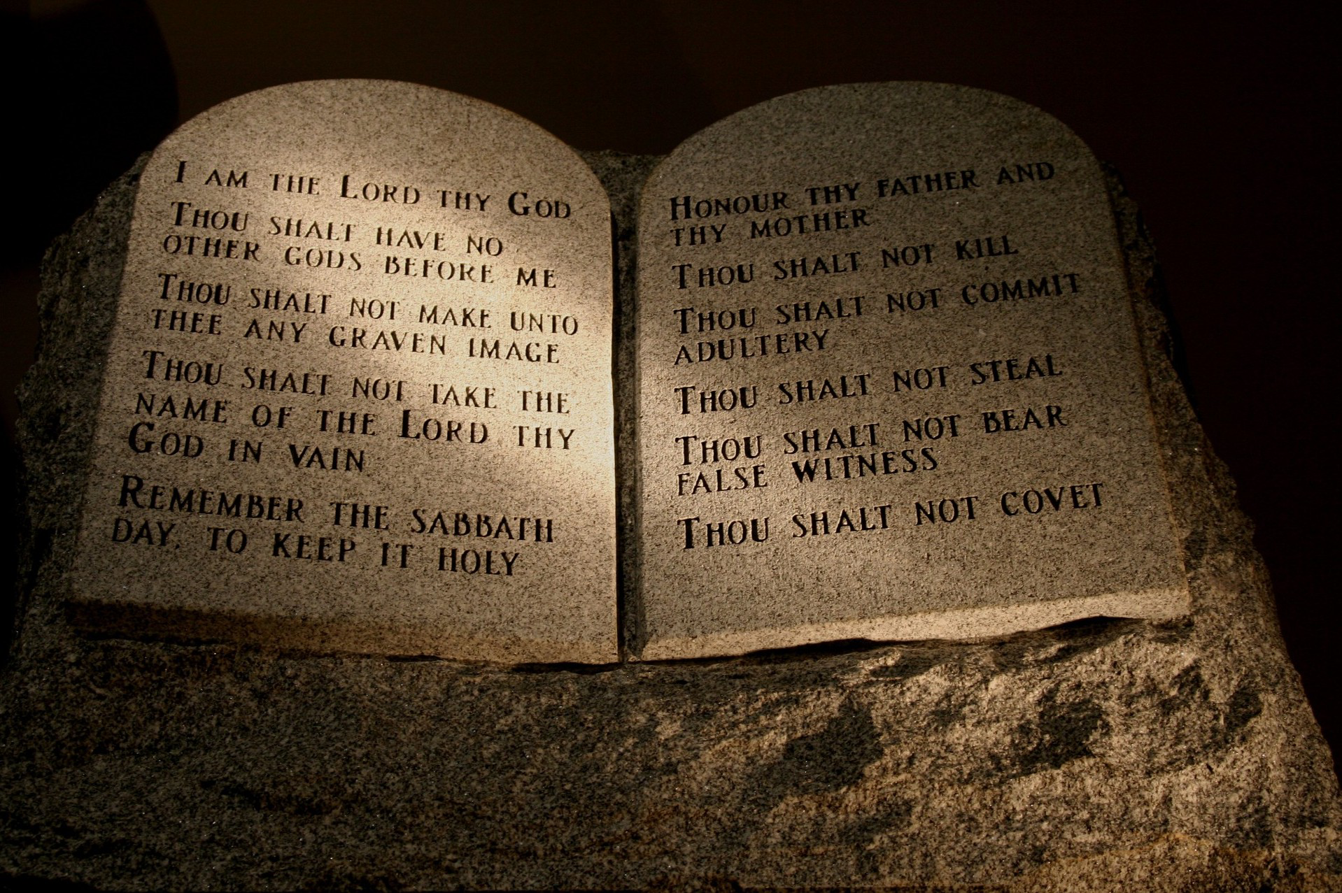
律法是恩典
Law is Grace
神愿与百姓同在，律法教导人认识圣洁爱他们的主。他们如何与主同行。
God desires to be among the people, and the law would teach them to know their holy and loving Lord and how they shall walk before God.

Slide 87

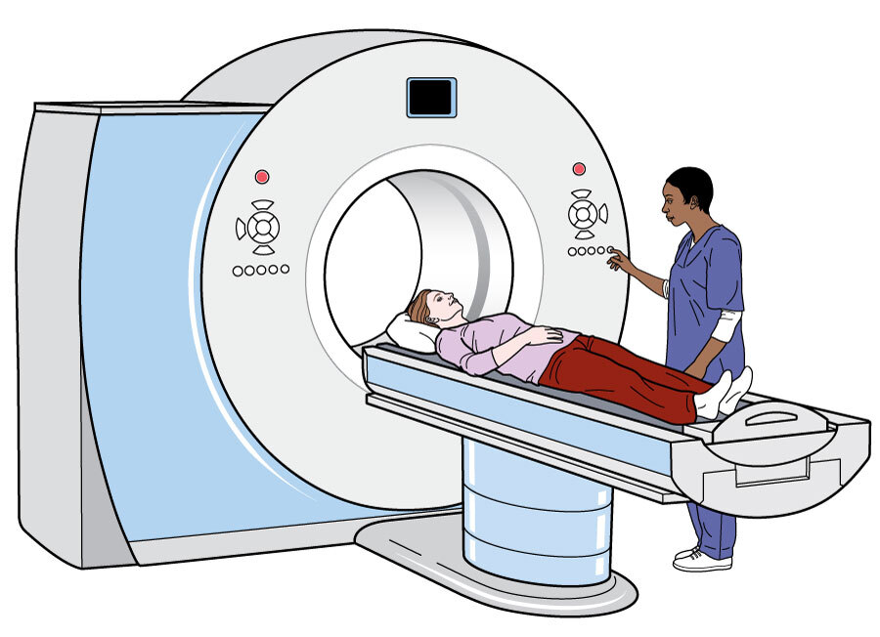
律法是恩典
Law is Grace
指引如何爱神、如何爱人(罗7:12、提后3:16-17）
The law instruct us how to live
让我们认识自己（知罪）（加3:18-19; 罗3:19-20; 林后3:6-11）
The Law help us know ourselves know sin
诊断出我们需要怜悯宽恕、（定罪） (罗3:20）
The law points we need mercy as law condemns us
告知我们需求医 (太9:12-13、加3:24、罗3:20-22）
The law points we need doctor
如扫描仪
like a scanner

Slide 88

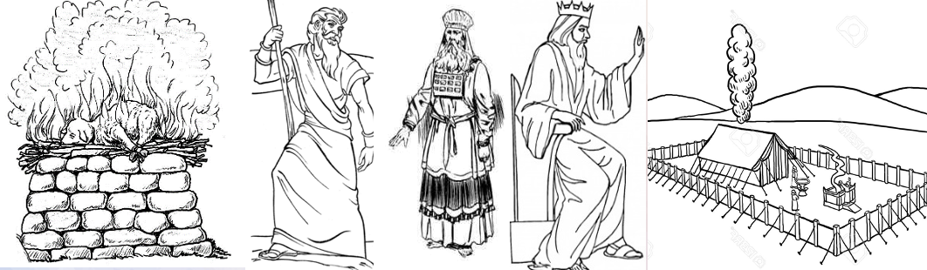
律法是恩典见证完美的后裔 (罗3:21）
Law is grace witness the perfect offspring
完美的后裔
律法见证基督 （罗3:21）
成全律法 (太5:17、路24:44）
承担违背律法的咒诅 （加3:13）

Slide 89
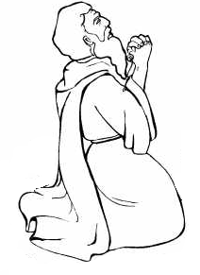
摩西
明白是唯独靠恩典
王下13:23
Moses understand it is by grace alone
求神纪念亚伯拉罕、以撒、雅阁的约 (出32:13-14）
Remember Abraham, Isaac, and Israel, your servants, to whom you swore by your own self
王下13:23

Slide 90
申 9:6 你当知道，耶和华你神将这美地赐你为业，并不是因你的义；你本是硬著颈项的百姓。
Deu 9:6 “Know, therefore, that the LORD your God is not giving you this good land to possess because of your righteousness, for you are a stubborn people.

Slide 91
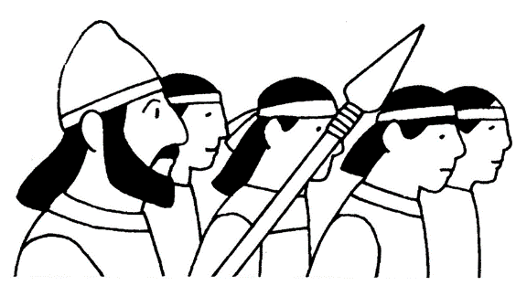
基利心山祝福
以巴路山咒诅
（申27:12-13)
Mount Gerizim blessings
Mount Ebal curses
毁约：
申28:15-29:1; 耶34:18-20;
王上14:11; 21:24;
耶7:33; 16:4; 19:7
基督为我们承担咒诅 加3:10-14
基督完全爱神
太5:17、约14:31

Slide 92
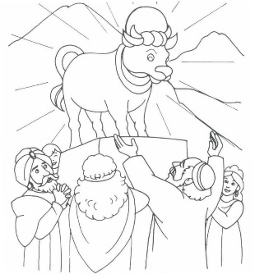


出32:1-6

Slide 93

他们的心刚硬的石头，约不是割在心上！
Covenant is not cut in the heart, they have heart of stone
心
无割礼
石头刚硬的心
Harden and stuborn heart

Slide 94
心未受割礼 uncircumcised heart
(利26:41、申10:16、申30:6、耶4:4、徒7:51）
不爱神石头的心 heart of stone
(结11:19、36:26）
不信神顽梗的心 stubborn heart
(诗81:12、赛46:12、耶3:17、徒7:51、罗2:29）
忘恩负义 ungrateful

Slide 95

申 30:6 耶和华你神必将你心里和你後裔心里的污秽除掉，好叫你尽心尽性爱耶和华你的神，使你可以存活。。
应
许
换
心
Deu30:6 And the LORD your God will circumcise your heart and the heart of your offspring, so that you will love the LORD your God with all your heart and with all your soul, that you may live.
申30:6、罗2:29、结11:19-20、结36:26-27、诗51:10、耶32:39、林后3:3

Slide 96
申 18:18 我必在他们弟兄中间给他们兴起一位先知，像你。我要将当说的话传给他；他要将我一切所吩咐的都传给他们。19 谁不听他奉我名所说的话，我必讨谁的罪。 （约1:45、徒3:22-23、7:37）
Deu 18:18 I will raise up for them a prophet like you from among their brothers. And I will put my words in his mouth, and he shall speak to them all that I command him.19 And whoever will not listen to my words that he shall speak in my name, I myself will require it of him.

Slide 97




律法中所设的
基督/弥赛亚：受膏者
The Christ/Messiah (anointed one) prescribed in the Law
先知
祭司
君王
掌管 Rule
Prophet
Priest
King
申18:15-18、
徒3:22-23
徒7:37
民25:12-13、耶33:20-21、
玛2:4-5
诗110:4、亚6:12-13
撒下7:12-16
赛9:6-7、耶23:5-6、
结34:23-24、路1:32-33
代求
Intercede
教导
Teach

Slide 98

（摩西）不得领这会众进我所赐给他们的地去
民20:12
完美的先知
约1:45、徒3:22-24、徒7:37
不完美的先知
民20:12

Slide 99

大祭司亚伦造金牛
完美的祭司
来 7: 26
不完美的祭司
出32:1-4 、来7:28

Slide 100

祭物
完美的赎罪祭
Sacrifice
Perfect sacrifice
Atonement for sin
约1:29、林前5:7
来 10:4-10

Slide 101

预表在
基督里的安息
安息日是
摩西之约的记号
（出31:13, 17）
太 11:28
凡劳苦担重担的人可以到我这里来，我就使你们得安息。
（太11:28、西2:17*、来4:1-11、10:1）

Slide 102

士 2:14 ...把他们交在抢夺他们的人手中，又将他们付与四围仇敌的手中，甚至他们在仇敌面前再不能站立得住。
Jdg 2:14 So the anger of the LORD was kindled against Israel, and he gave them over to plunderers, who plundered them. And he sold them into the hand of their surrounding enemies, so that they could no longer withstand their enemies.

Slide 103



神允许以色列
被她所迷恋的奸夫
家暴
Israel was beaten by the adulterer
she was infatuated with
结16:30-42、耶3:6-14、赛1:21-26、

Slide 104

士师时代
（神不断兴起不完美的
士师拯救）
The Lord Raises Up imperfect Judges as deliverer
士2:19-20

Slide 105
不完美的
士师拯救
完美的
士师拯救
来11:32-34

Slide 107
王归来
The return
of the
King
末世
last Age
eternity
adam
noah
moses
david
Abraham
Christ
new covenant
诸诅约是不同历史阶段的续集
Covenants are like different episodes of a series of historical events

Slide 108
06.
神与大卫立约 (后裔永远作王)
God made a covenant with David （offspring shall reign forever)

Slide 109




永远的约
（撒下 7:12-16、撒下23:5、诗篇89:3-4 ）
国度
kingdom
圣殿
temple
爱神合神心意的王
a man after God's own heart
徒13:22、撒上13:13-14

Slide 110
撒下 7:12 你寿数满足、与你列祖同睡的时候，我必使你的後裔接续你的位；我也必坚定他的国。13 他必为我的名建造殿宇；我必坚定他的国位，直到永远。
2Sa 7:12 When your days are fulfilled and you lie down with your fathers, I will raise up your offspring after you, who shall come from your body, and I will establish his kingdom.13 He shall build a house for my name, and I will establish the throne of his kingdom forever.
永远国度 诗89:3-4; 36-37; 耶33:14-22 （注: “约”一词诗篇89出现）

Slide 111

不完美的
君王
完美的
君王
Imperfect King
perfect King

Slide 112


完美的
圣殿
圣殿
约2:19-21
Temple
Greater Temple

Slide 113
毁约承受诅咒
（利26:14-46，王上9:4-9, 王下 17:7-23）
亡国被掳为奴
Captivity and enslaved
耶34: 18-20

Slide 114

圣殿被摧毁
被掠巴比伦（做奴隶）
Temple destroyed
Exile to Babylon

Slide 115
等候更大（完美）的救赎
A Greater Salavation
更大的拯救者 greater Deliverer
更大的赎罪 greater Atonement
更大的更新 greater Renewal

Slide 116



超越大祭司
Greater than high Priest
超越先知摩西大
Greater than prophet Moses
超越大卫王
Greater than King David
麦基洗德等次大祭司
创14:17-18、诗110:4、来5:6-10、来6:20、来7:1-17、亚6:13
第二次出埃及、
（出巴比伦）
离开为奴之家
Second Exodus ,
exit Babylon
Depart slavery
要来的大卫
The coming of second David
Melchizedek Priesthood

Slide 117

被掳掠时期的先知们预言
要来的大卫(大卫的子孙)
会拯救
（撒下 7:12-16、zec亚6:11-13; 耶23:5-6; 30:8-9; 33:15-16; 结34:23-24；37:24-27; 徒13:22-23；路1:31-33）
Prophets prophesizes during exilic period the coming David （Son of David) will deliver them

Slide 118


应许新约
（撒下 7:12-16、zec亚6:11-13; 耶23:5-6; 30:8-9; 33:15-16; 结34:23-24；37:24-27; 徒13:22-23；路1:31-33）
The promised of a greater new covenant
换心 （重生）
圣灵 Holy Spirit
(赛11:1-2； 44:3；
结36:26-29,39:28-29;
珥2:28-32;徒2:16-21)

Slide 119

结 36:24 我必从各国收取你们，从列邦聚集你们，引导你们归回本地。25 我必用清水洒在你们身上，你们就洁净了。我要洁净你们，使你们脱离一切的污秽，弃掉一切的偶像。我也要赐给你们一个新心，将新灵放在你们里面，又从你们的肉体中除掉石心，赐给你们肉心。27 我必将我的灵放在你们里面，使你们顺从我的律例，谨守遵行我的典章。28 你们必住在我所赐给你们列祖之地。你们要作我的子民，我要作你们的神。
Eze 36:24 I will take you from the nations and gather you from all the countries and bring you into your own land.25 I will sprinkle clean water on you, and you shall be clean from all your uncleannesses, and from all your idols I will cleanse you.26 And I will give you a new heart, and a new spirit I will put within you. And I will remove the heart of stone from your flesh and give you a heart of flesh.27 And I will put my Spirit within you, and cause you to walk in my statutes and be careful to obey my rules.28 You shall dwell in the land that I gave to your fathers, and you shall be my people, and I will be your God.

Slide 120

新约 New covenant
来8:7-13、路22:20
耶31:31 耶和华说：「日子将到，我要与以色列家和犹大家另立新约，32 不像我拉著他们祖宗的手，领他们出埃及地的时候，与他们所立的约。我虽作他们的丈夫，他们却背了我的约。这是耶和华说的。」
Jer 31:31 “Behold, the days are coming, declares the LORD, when I will make a new covenant with the house of Israel and the house of Judah,32 not like the covenant that I made with their fathers on the day when I took them by the hand to bring them out of the land of Egypt, my covenant that they broke, though I was their husband, declares the LORD.

Slide 121
33 耶和华说：「那些日子以後，我与以色列家所立的约乃是这样：我要将我的律法放在他们里面，写在他们心上。我要作他们的神，他们要作我的子民。34 他们各人不再教导自己的邻舍和自己的弟兄说：『你该认识耶和华』，因为他们从最小的到至大的都必认识我。我要赦免他们的罪孽，不再记念他们的罪恶。这是耶和华说的。」
Jer 31:33 For this is the covenant that I will make with the house of Israel after those days, declares the LORD: I will put my law within them, and I will write it on their hearts. And I will be their God, and they shall be my people.34 And no longer shall each one teach his neighbor and each his brother, saying, ‘Know the LORD,’ for they shall all know me, from the least of them to the greatest, declares the LORD. For I will forgive their iniquity, and I will remember their sin no more.”

Slide 122

被掳归回
重建圣殿
Return from exile
Rebuilt temple
?
亚 Zechariah 6:12-13 预言祭司与君王结合（像麦基洗德）
亚 6:13 他要建造耶和华的殿，并担负尊荣，坐在位上掌王权；又必在位上作祭司，使两职之间筹定和平

Slide 124
王归来
The return
of the
King
末世
last Age
eternity
adam
noah
moses
david
Abraham
Christ
new covenant
约是不同历史阶段的续集
Like different episodes of a series of historical events

Slide 125
07.
后裔基督赐新约
The coming offspring Christ gives new covenant

Slide 126


亚伯拉罕
以撒与雅各
女人
挪亚
摩西
大卫
那要来的后裔
加3:16
后裔 offspring
路1:54-55、路1:68-73、路1:69

Slide 127
路 22:20 饭後也照样拿起杯来，说：这杯是用我血所立的新约，是为你们流出来的。
Luk 22:20 And likewise the cup after they had eaten, saying, “This cup that is poured out for you is the new covenant in my blood.

Slide 128

那后裔是完美的基督/弥赛亚：受膏者
The offspiring is the perfect Christ/Messiah :The anointed one

Slide 129

后裔是献祭与赎罪祭 （赛53：7-12）
Sacrifice and atonement
约 1:36 他见耶稣行走，就说：「看哪！这是神的羔羊！」
Joh 1:36 and he looked at Jesus as he walked by and said, “Behold, the Lamb of God!”

Slide 130

信
信
因信称义
Justification by faith
罗 4:22 所以，这就算为他的义。23「算为他义」的这句话不是单为他(亚伯拉罕）写的，24 也是为我们将来得算为义之人写的，就是我们这信神使我们的主耶稣从死里复活的人。
Rom 4:22 That is why his faith was “counted to him as righteousness.”23 But the words “it was counted to him” were not written for his sake alone,24 but for ours also. It will be counted to us who believe in him who raised from the dead Jesus our Lord,

Slide 131
新约 （更美的约）
完美永活的祭司代求
完美永活的君王治理
完美永活的先知教导
完美的赎罪祭，完美的救赎
圣灵保惠师被赐下
万国的外邦人归回主
来7:22、8:6、12:24
New covenant (a better covenant)

Slide 132
圣灵重生
新造的人
石头的心
约不是切割在心上
结36:25-28
赐给你们一个新心

Slide 133
赐圣灵
加 3:14 这便叫亚伯拉罕的福，因基督耶稣可以临到外邦人，使我们因信得著所应许的圣灵。
Gal 3:14 so that in Christ Jesus the blessing of Abraham might come to the Gentiles, so that we might receive the promised Spirit through faith.

Slide 134


徒 1:8 但圣灵降临在你们身上，你们就必得著能力，并要在耶路撒冷、犹太全地，和撒玛利亚，直到地极，作我的见证。
圣灵降临
基督升天
Act 1:8 But you will receive power when the Holy Spirit has come upon you, and you will be my witnesses in Jerusalem and in all Judea and Samaria, and to the end of the earth.”

Slide 135

五旬节开始
外邦人归主的时刻到了
The time of Gentiles return to the Lord has arrived
应许给亚伯拉罕和他后裔（基督），万国都要得福
创12:1-3;22:18;26:4;加3:8;3;28-29;
外邦人成为国民 何1:10; 弗2:11-22；加6:13-16; 彼前2:9-10;
连接上去的野橄榄 ✗罗11:17-32

Slide 136


Slide 137



新约记号
Sign and seal
of new covenant
洗礼
Baptism
圣餐
Holy communion
旧约记号
Sign and seal
of old covenant
割礼
Circumcision
逾越节
Passover 林前5:7

Slide 138
来 8:6 如今耶稣所得的职任是更美的，正如他作更美之约的中保；这约原是凭更美之应许立的。7 那前约若没有瑕疵，就无处寻求後约了。8 所以主指著他的百姓说：日子将到，我要与以色列家和犹大家另立新约，9 不像我拉著他们祖宗的手，领他们出埃及的时候，与他们所立的约。因为他们不恒心守我的约，我也不理他们。这是主说的。
Heb 8:6 But as it is, Christ has obtained a ministry that is as much more excellent than the old as the covenant he mediates is better, since it is enacted on better promises.7 For if that first covenant had been faultless, there would have been no occasion to look for a second.8 For he finds fault with them when he says: “Behold, the days are coming, declares the Lord, when I will establish a new covenant with the house of Israel and with the house of Judah,9 not like the covenant that I made with their fathers on the day when I took them by the hand to bring them out of the land of Egypt. For they did not continue in my covenant, and so I showed no concern for them, declares the Lord.

Slide 139
10 主又说：那些日子以後，我与以色列家所立的约乃是这样：我要将我的律法放在他们里面，写在他们心上；我要作他们的神；他们要作我的子民。11 他们不用各人教导自己的乡邻和自己的弟兄，说：你该认识主；因为他们从最小的到至大的，都必认识我。12 我要宽恕他们的不义，不再记念他们的罪愆。13 既说新约。就以前约为旧了；但那渐旧渐衰的，就必快归无有了。
Heb 8:10 For this is the covenant that I will make with the house of Israel after those days, declares the Lord: I will put my laws into their minds, and write them on their hearts, and I will be their God, and they shall be my people.11 And they shall not teach, each one his neighbor and each one his brother, saying, ‘Know the Lord,’ for they shall all know me, from the least of them to the greatest.12 For I will be merciful toward their iniquities, and I will remember their sins no more.”13 In speaking of a new covenant, he makes the first one obsolete. And what is becoming obsolete and growing old is ready to vanish away.

Slide 140
我要作他们的神；他们要作我的子民
I will be their God; And they shall be my people
律法写在心上
The law is written on the heart
从最小的到至大的，都必认识我（圣灵的重生） from the least to the greatest shall know me (the regeneration of the Holy Spirit)
宽恕他们的不义，不再记念他们的罪愆 and shall forgive their unrighteousness, and remember their sins no more
新约 New Covenant
来 8:6-13

Slide 141
不再被定罪!
No longer condemned !
罗 8:1 如今，那些在基督耶稣里的就不定罪了。
Rom 8:1 There is therefore now no condemnation for those who are in Christ Jesus.
约3:18、约5:24、徒10:43、罗6:14-15、罗8:1、罗10:4、罗10:13、约壹1:9

Slide 142

新约中的新命令
New commandment in new covenant
基督律法写在心上
The law of Christ is written on the heart
约 13:34 我赐给你们一条新命令，乃是叫你们彼此相爱；我怎样爱你们，你们也要怎样相爱。
Joh 13:34 A new commandment I give to you, that you love one another: just as I have loved you, you also are to love one another.

Slide 143
A 新命令使我们谦卑不骄傲
The new command teaches us to be humble and not proud
B 新命令提醒我们需要主耶稣的救赎
The new command reminds us of the need for salvation from the Lord Jesus
C 新命令教我们明白主的心意
The new command teaches us to understand the Lord's will

Slide 144

蛇的后裔(敌基督）
The offspring of Satan （AntiChrist)
666
但7:23-25、但8:23-25、但11:36-39、赛14:12-15、结28:12-17、结38-39、太24:15、帖后2:3-4、约壹2:18、约壹4:3、启13:1-18

Slide 145
王归来
The return
of the
King

Slide 146

启20:10 那迷惑他们的魔鬼被扔在硫磺的火湖里，就是兽和
假先知所在的地方。他们必昼夜受痛苦，直到永永远远。
Rev 20:10 and the devil who had deceived them was thrown into the lake of fire and sulfur where the beast and the false prophet were, and they will be tormented day and night forever and ever.

Slide 147
启19:7 我们要欢喜快乐，将荣耀归给他。因为，羔羊婚娶的时候到了；新妇也自己预备好了，
Rev 19:7 Let us rejoice and exult and give him the glory, for the marriage of the Lamb has come, and his Bride has made herself ready;

Slide 148


Slide 149

身体复活
Resurrection ultimate fulfillment of（new creation)
林前 15:12-58
荣耀的、灵性的、不朽坏的、不死的
Glorious、spiritual、imperishable、immortality

Slide 150


天国降临
圣城新耶路撒冷从天而降
新天地
应许之地
万国蒙福
赛11:1-16、赛65:17-25、彼后3:13、启21:1-2

Slide 151
神爱我们
God Love us
约
（誓言）
Covenant
（binding oath）
神信实
永不离弃我们
神为我们牺牲
God sacrifice Himself for us
God is Faithful and He will never forsake us

Slide 152
王归来
The return
of the
King
末世
last Age
eternity
adam
noah
moses
david
Abraham
Christ
new covenant

Slide 154

旧约 Old Testament
新约 New Testament

Slide 155




Slide 156

预表论 typology

Slide 157

预表论 typology

Slide 158
预表论 typology
先知
祭司
君王

Slide 159
(1)类比 类似 对应 analogical correspondence
摩西是拯救者、被拒绝
(2) 历史性 historicity
摩西是历史人物
(3) 预表/初型有指向未来的征兆 a pointing-forwardness (i.e., an aspect of foreshadowing or presignification)
(4) 意义上提升与进展 escalation e.g.耶稣是比摩西更加的完美
(5) 能从原型antitype回顾找到预表/初型type（事件、人物、情况）retrospection
从耶稣身上看见摩西的影子。
（6）能够在救赎历史redemptive history中看见。
摩西在历史救赎中扮演救赎的角色
(7) 显示出一种有机的关系 organic relationship（连续、延续、成长、进展、扩大）。
摩西之后的先知们

Slide 160




旧约预言新约
Old Testament prophesied the New
旧约圣经
Old Testament
新约圣经
New Testament

Slide 161


主题：渐进、延续、发展、高峰
Themes : Progresive, Continuation, development, peak
e.g.后裔、国度、约、赎罪祭、敌基督、审判、拯救

Slide 162



王的归来
渐进、延续、发展、高峰
Progresive, Continuation, development, peak

Slide 163
林前 10:11
他们遭遇这些事，
都要作为监戒；并且写在经上，
正是警戒我们这末世的人。
1Co 10:11 Now these things happened to them as an example,
but they were written down for our instruction,
on whom the end of the ages has come.

Slide 164
身份特质？
神所爱的子民 God’s beloved people
女人的後裔
Seed of woman
Identity marker ？

Slide 165

身份特质
神所爱的子民 God’s beloved people
女人的後裔
Seed of woman
Identity marker
爱主
信
信
顺服主
依靠主

Slide 166

神爱我们
所以我们能信
God loves us therefore we can believe
我们信
所以神爱我们
we believe therefore
God loves us
第一因 First cause
弗1:4-5、弗2:4-5

Slide 167

旧人
在亚当里
新人
在基督里
Old self in Adam
We are in Christ
女人的後裔
Seed of woman
死（与神隔绝）
永生（与神同在）

Slide 168
信神、
唯独靠后裔、
不信靠自己
不信神、靠自己：
靠行为、靠律法、靠善行
by works、by law keeping、by works
罗3:20、加 3:10
罗3:24

Slide 169



不信不寄望
将要来的后裔
Do not hope or believe the coming offspring
不信拒绝
那来的后裔
Do not believe and reject the offspring that came
属肉体的以色列人
耶9:25-26、罗2:28-29、罗9:6-8
属肉体的以色列人约3:3-7、约8:44

Slide 170
无律法主义
antinomian
律法主义
Legalist
不信神
毁约废弃神律法
Breaks covenant, discards the law
不信神
靠律法、行为、功绩
by law keeping、by works、by merit
骄傲
Pride
属肉体的以色列人
耶9:25-26、罗2:28-29、罗9:6-8
属肉体的以色列人约3:3-7、约8:44

Slide 171
属肉体的以色列人
耶9:25-26、罗2:28-29、罗9:6-8
属肉体的以色列人约3:3-7、约8:34-44
无圣灵，完全被肉体私欲支配。
与神为仇，不服神的律法
Without Spirit controlled by the lust of flesh
enmity with God, do not submit to God’s law
无圣灵，完全被肉体私欲支配。
与神为仇, 不服神的律指他们是罪奴
Without Spirit controlled by the lust of flesh
enmity with God, do not submit to God’s law and refuse the law points they are slaves of sin
不认罪

Slide 172

路18:13 那税吏远远的站著，连举目望天也不敢，只捶著胸说：『神啊，开恩可怜我这个罪人！』14 我告诉你们，这人回家去比那人倒算为义了；因为，凡自高的，必降为卑；自卑的，必升为高。」
Luk 18:13 But the tax collector, standing far off, would not even lift up his eyes to heaven, but beat his breast, saying, ‘God, be merciful to me, a sinner!’14 I tell you, this man went down to his house justified, rather than the other. For everyone who exalts himself will be humbled, but the one who humbles himself will be exalted.”
祈求神的恩典
知道按律法自己是败坏
祈求主的宽恕与怜悯
不信福音
不敢按律法看见自己的罪恶
用一些能遵守的律法行为来掩饰自己

Slide 173
立约群体
Covenantal community
属肉体
Born of the flesh
属圣灵
Born by Holy Spirit
神拣选的爱
结16:4-14、启19:7、启21:2、启22:17
旧约时弃主的人
法利赛人
弃主
罗8:9
不信神（毁约）
信靠神（守约）
disbelieve in God (breaks covenant)
believe in God （keeps covenant)

Slide 174
所有来攻击耶路撒冷列国中剩下的人，必年年上来敬拜大君王－万军之耶和华，并守住棚
节。 地上万族中，凡不上耶路撒冷敬拜大君王－万军之耶和华的，必无雨降在他们的地上。
当那日，马的铃铛上必有「归耶和华为圣」的这句话。耶和华殿内的锅必如祭坛前的碗一
样。撒迦利亚书 14:16‭-‬17‭, ‬20
If this is not the millenium kingdom, how else do we see this happening?
Biblical genres, such as apocalyptic and prophecy. Consider the understanding given Daniel of Nebuchadnezzar’s dream-vision in Daniel 2:31-45; the prophecy was entirely couched in symbolic imagery.
If we read zec 12 it is prophecy of Jesus and the Spirit coming [Zec 12:10 “And I will pour out on the house of David and the inhabitants of Jerusalem a spirit of grace and pleas for mercy, so that, when they look on me, on him whom they have pierced, they shall mourn for him, as one mourns for an only child, and weep bitterly over him, as one weeps over a firstborn. ]
If we read zec 12 we will notice very clearly that all mentioned is not taken literally . Especially if you read the upper verse Zec 12:4 -9 which precedes no one will interpret literally but symbolically of its thematic meaning .[Zec 12:3 On that day I will make Jerusalem a heavy stone for all the peoples. All who lift it will surely hurt themselves. And all the nations of the earth will gather against it.4 On that day, declares the LORD, I will strike every horse with panic, and its rider with madness. But for the sake of the house of Judah I will keep my eyes open, when I strike every horse of the peoples with blindness.]
*In context is referring to Christ crucification and Pentecost *
Zec 12:10 “And I will pour out on the house of David and the inhabitants of Jerusalem a spirit of grace and pleas for mercy, so that, when they look on me, on him whom they have pierced, they shall mourn for him, as one mourns for an only child, and weep bitterly over him, as one weeps over a firstborn.
If they employ a non literal approach for Zec 12 why then employ a liberal approach only at zec 14:16-21 ? Just because it fits millennium assumption ?
Zec 14:16-17 to me personally mean God’s complete rule over all nations and all wicked . His rule is perfect and complete at the last day. No longer wickedness experience delayed punishement as like present .

Slide 175
 | 旧约 old covenant | 新约 new covenant
神的应许 | 等待基督 | 基督到来
神的律法 | 训蒙的师傅 | 基督完全律法
约的印记 | 割礼 | 洗礼
祭司 | 有罪、会离世 | 无罪、永远代求
祭物 | 牛、羊 | 神的羔羊
君王 | 有罪、会离世 | 无罪、永远做王
先知 | 预言基督到来 | 基督要来的先知

Slide 176
 | 旧约 old covenant | 新约 new covenant
旧约礼仪 | 预表基督 | 基督到来
中保 | 摩西 | 神的儿子基督
耶路撒冷 | 在迦南地 | 天上的耶路撒冷（加4:26; 启21:2)
心 | 绝大部分心未受割礼 （申10:16; 30:6; 耶4:4; 9:26 ） | 除掉石心，赐给你们肉心 （结36:26）。 圣灵的重生
以色列 | 小部分外邦人 | 外邦人是亚伯拉罕后裔
圣灵 | 一部分人 | 所有信基督的人
圣经 | 一部分 | 启示完毕

