Slide 1
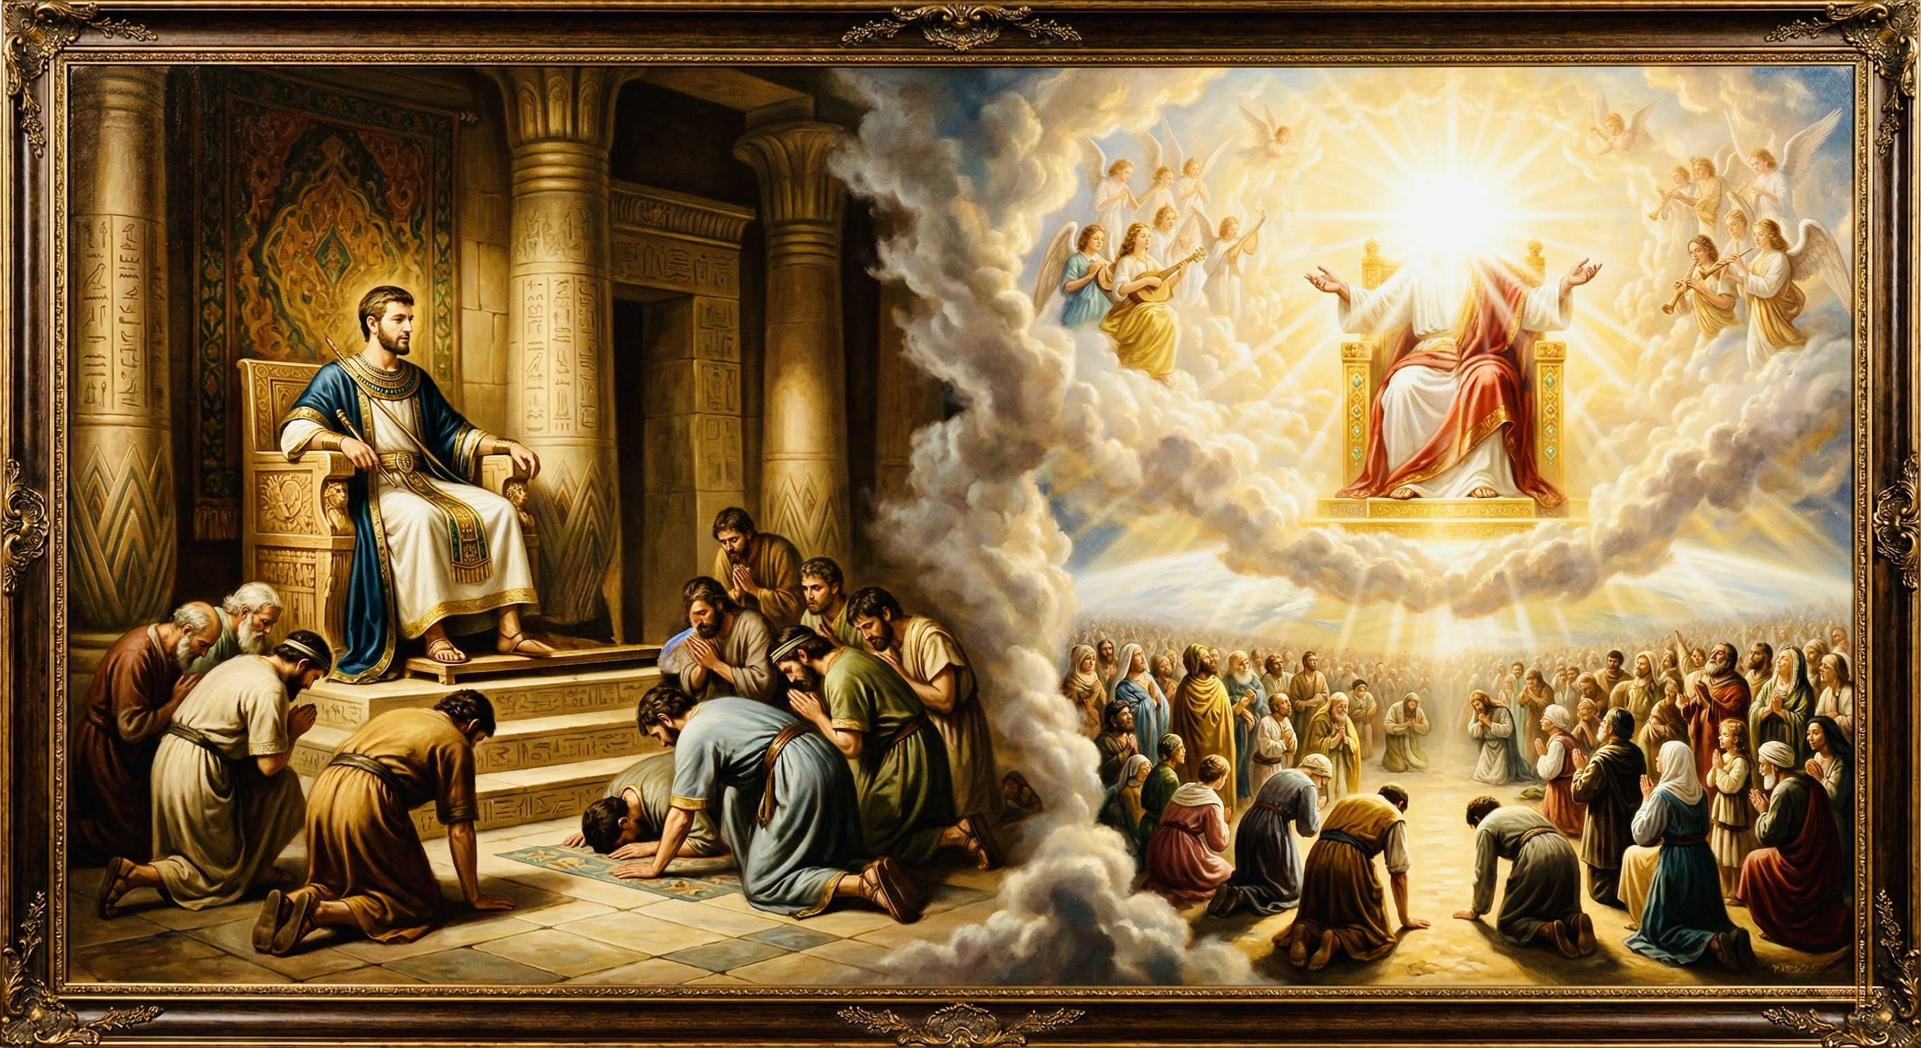
高升、救赎、饶恕
创世纪看约瑟与基督（下）
exaltation; redemption; forgiveness
Looking at Joseph and Christ in Genesis

Slide 2



Slide 3
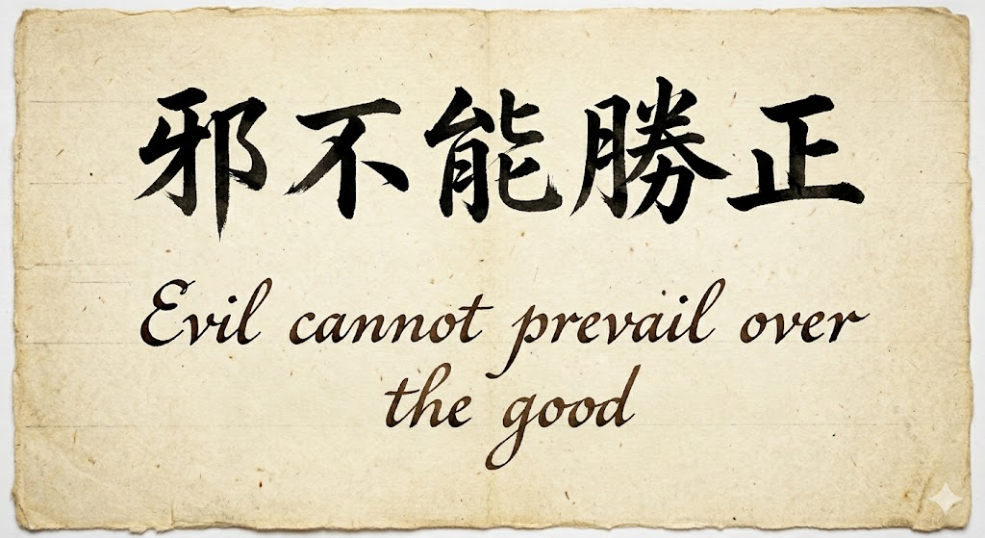

Slide 4
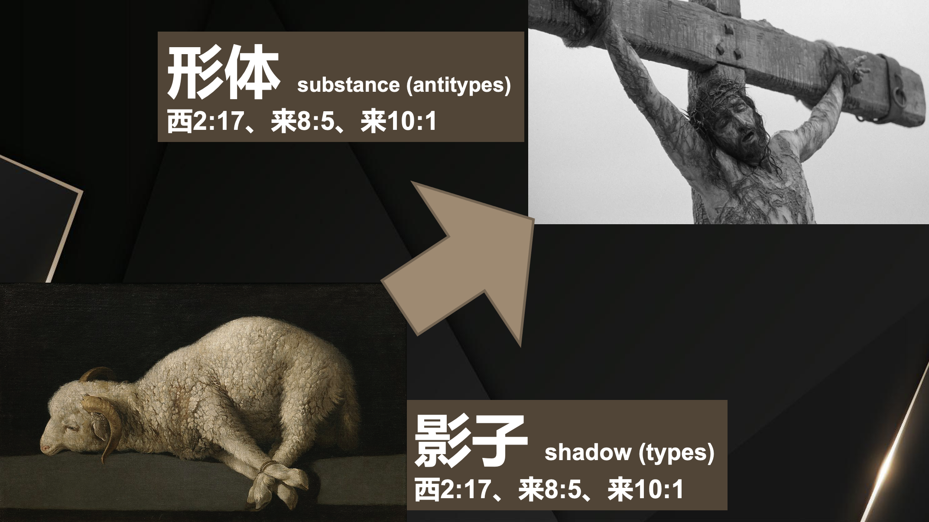

Slide 5
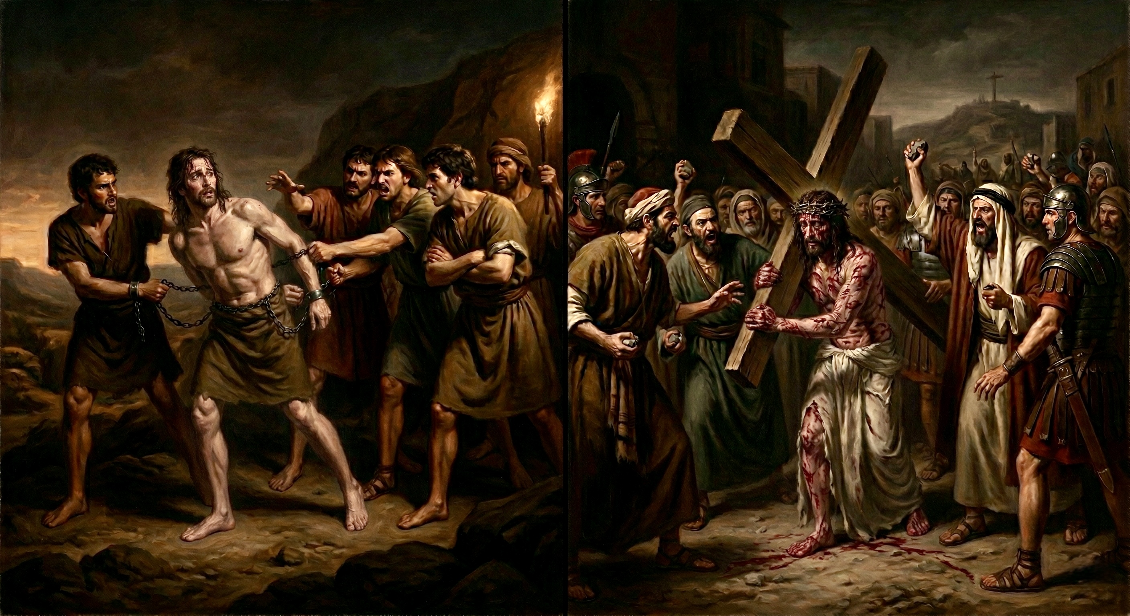
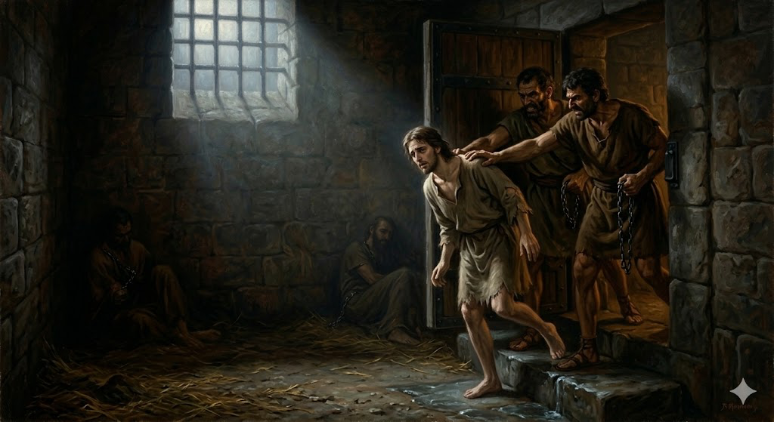
被出卖成为奴隶
Being betrayed and sold into slavery
被陷害进入牢狱
falsely accused and imprisoned

Slide 6
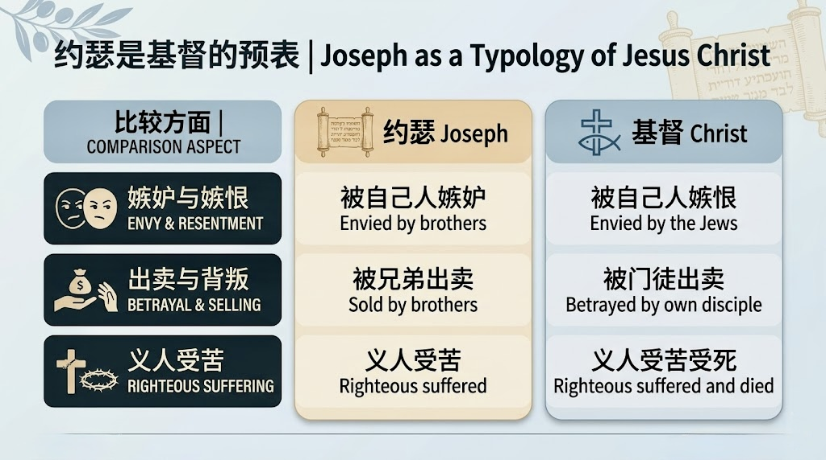

Slide 7
【1】
上帝与受苦的义人同在
God is with the suffering righteous.

Slide 8
创世记 39:11.有一天，约瑟进屋里去办事，家中人没有一个在那屋里，12.妇人就拉住他的衣裳，说：「你与我同寝吧！」约瑟把衣裳丢在妇人手里，跑到外边去了。13.妇人看见约瑟把衣裳丢在她手里跑出去了，14.就叫了家里的人来，对他们说：「你们看！他带了一个希伯来人进入我们家里，要戏弄我们。他到我这里来，要与我同寝，我就大声喊叫。15.他听见我放声喊起来，就把衣裳丢在我这里，跑到外边去了。」 16.妇人把约瑟的衣裳放在自己那里，等着他主人回家，
Genesis 39:11.But one day, when he went into the house to do his work and none of the men of the house was there in the house,12.she caught him by his garment, saying, "Lie with me." But he left his garment in her hand and fled and got out of the house.13.And as soon as she saw that he had left his garment in her hand and had fled out of the house,14.she called to the men of her household and said to them, "See, he has brought among us a Hebrew to laugh at us. He came in to me to lie with me, and I cried out with a loud voice.15.And as soon as he heard that I lifted up my voice and cried out, he left his garment beside me and fled and got out of the house."16.Then she laid up his garment by her until his master came home,
1/2

Slide 9
17.就对他如此如此说:「你所带到我们这里的那希伯来仆人进来要戏弄我，18.我放声喊起来,他就把衣裳丢在我这里，跑出去了。」19.约瑟的主人听见他妻子对他所说的话,说「你的仆人如此如此待我」,他就生气,20.把约瑟下在监里,就是王的囚犯被囚的地方。于是约瑟在那里坐监。21.但耶和华与约瑟同在,向他施恩,使他在司狱的眼前蒙恩。22.司狱就把监里所有的囚犯都交在约瑟的手下；他们在那里所办的事都是经他的手。23.凡在约瑟手下的事,司狱一概不察,因为耶和华与约瑟同在；耶和华使他所做的尽都顺利。
17.and she told him the same story, saying, "The Hebrew servant, whom you have brought among us, came in to me to laugh at me.18.But as soon as I lifted up my voice and cried, he left his garment beside me and fled out of the house."19.As soon as his master heard the words that his wife spoke to him, "This is the way your servant treated me," his anger was kindled.20.And Joseph's master took him and put him into the prison, the place where the king's prisoners were confined, and he was there in prison.21.But the Lord was with Joseph and showed him steadfast love and gave him favor in the sight of the keeper of the prison.22.And the keeper of the prison put Joseph in charge of all the prisoners who were in the prison. Whatever was done there, he was the one who did it.23.The keeper of the prison paid no attention to anything that was in Joseph's charge, because the Lord was with him. And whatever he did, the Lord made it succeed.
2/2

Slide 10
创世记 40:1.这事以后，埃及王的酒政和膳长得罪了他们的主—埃及王，2.法老就恼怒酒政和膳长这二臣，3.把他们下在护卫长府内的监里，就是约瑟被囚的地方。4.护卫长把他们交给约瑟，约瑟便伺候他们；他们有些日子在监里。5.被囚在监之埃及王的酒政和膳长二人同夜各做一梦，各梦都有讲解。
1.Some time after this, the cupbearer of the king of Egypt and his baker committed an offense against their lord the king of Egypt. 2.And Pharaoh was angry with his two officers, the chief cupbearer and the chief baker,3.and he put them in custody in the house of the captain of the guard, in the prison where Joseph was confined.4.The captain of the guard appointed Joseph to be with them, and he attended them. They continued for some time in custody.5.And one night they both dreamed—the cupbearer and the baker of the king of Egypt, who were confined in the prison—each his own dream, and each dream with its own interpretation.

Slide 11
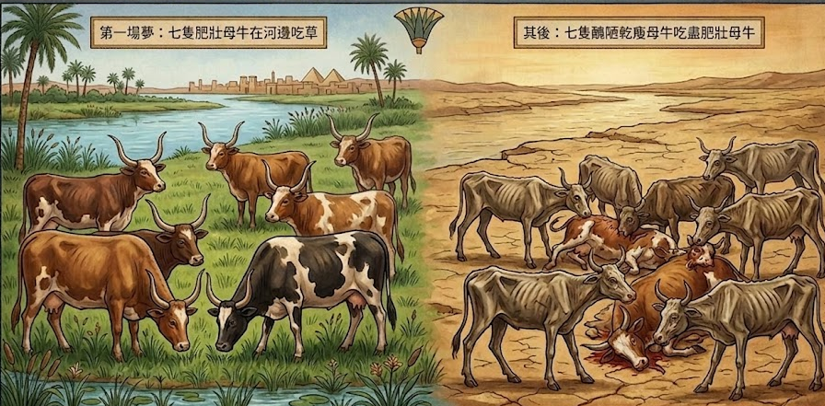

Slide 12
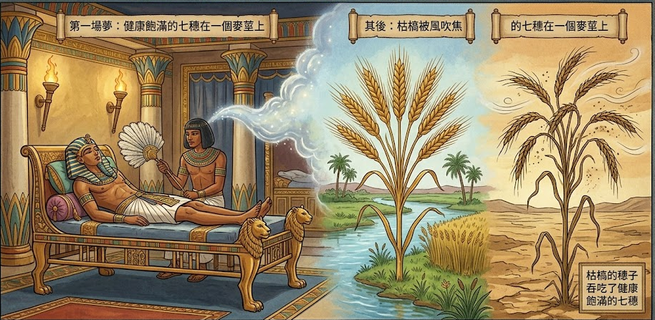
7个焦弱穗suì子吞了7个肥大穗suì子
The seven thin ears swallowed up the seven full ears.

Slide 13
41:25.约瑟对法老说:法老的梦乃是一个。神已将所要做的事指示法老了。26.七只好母牛是七年,七个好穗子也是七年；这梦乃是一个。27.那随后上来的七只又干瘦又丑陋的母牛是七年,那七个虚空、被东风吹焦的穗子也是七年,都是七个荒年。28.这就是我对法老所说,神已将所要做的事显明给法老了。29.埃及遍地必来七个大丰年，30 随后又要来七个荒年,甚至在埃及地都忘了先前的丰收,全地必被饥荒所灭。31.因那以后的饥荒甚大,便不觉得先前的丰收了。32.至于法老两回做梦,是因神命定这事,而且必速速成就。
41:25.Then Joseph said to Pharaoh, "The dreams of Pharaoh are one; God has revealed to Pharaoh what he is about to do.26.The seven good cows are seven years, and the seven good ears are seven years; the dreams are one.27.The seven lean and ugly cows that came up after them are seven years, and the seven empty ears blighted by the east wind are also seven years of famine.28.It is as I told Pharaoh; God has shown to Pharaoh what he is about to do.29.There will come seven years of great plenty throughout all the land of Egypt,30.but after them there will arise seven years of famine, and all the plenty will be forgotten in the land of Egypt. The famine will consume the land,31.and the plenty will be unknown in the land by reason of the famine that will follow, for it will be very severe.

Slide 14
【2】
义人受苦后有被上帝高升的盼望
After suffering, the righteous have the hope of being exalted by God.

Slide 15
34.法老当这样行，又派官员管理这地。当七个丰年的时候，征收埃及地的五分之一，35.叫他们把将来丰年一切的粮食聚敛liǎn起来，积蓄五谷，收存在各城里做食物，归于法老的手下。36.所积蓄的粮食可以防备埃及地将来的七个荒年，免得这地被饥荒所灭。37.法老和他一切臣仆都以这事为妙。38.法老对臣仆说：「像这样的人，有神的灵在他里头，我们岂能找得着呢？」39.法老对约瑟说：「神既将这事都指示你，可见没有人像你这样有聪明有智慧。
34.Let Pharaoh proceed to appoint overseers over the land and take one-fifth of the produce of the land of Egypt during the seven plentiful years.35.And let them gather all the food of these good years that are coming and store up grain under the authority of Pharaoh for food in the cities, and let them keep it.36.That food shall be a reserve for the land against the seven years of famine that are to occur in the land of Egypt, so that the land may not perish through the famine.“37.This proposal pleased Pharaoh and all his servants. 38.And Pharaoh said to his servants, ”Can we find a man like this, in whom is the Spirit of God?“ 39.Then Pharaoh said to Joseph, "Since God has shown you all this, there is none so discerning and wise as you are.
1/2

Slide 16
40.你可以掌管我的家；我的民都必听从你的话。惟独在宝座上我比你大。」 41.法老又对约瑟说：「我派你治理埃及全地。」42.法老就摘下手上打印的戒指，戴在约瑟的手上，给他穿上细麻衣，把金链戴在他的颈项上，43.又叫约瑟坐他的副车，喝道的在前呼叫说：「跪下。」这样，法老派他治理埃及全地。44.法老对约瑟说：「我是法老，在埃及全地，若没有你的命令，不许人擅自办事。」
40.You shall be over my house, and all my people shall order themselves as you command. Only as regards the throne will I be greater than you." 41.And Pharaoh said to Joseph, "See, I have set you over all the land of Egypt."42.Then Pharaoh took his signet ring from his hand and put it on Joseph's hand, and clothed him in garments of fine linen and put a gold chain about his neck.43.And he made him ride in his second chariot. And they called out before him, "Bow the knee!" Thus he set him over all the land of Egypt.44.Moreover, Pharaoh said to Joseph, "I am Pharaoh, and without your consent no one shall lift up hand or foot in all the land of Egypt."
2/2

Slide 17
彼得前书 5：6.
所以，你们要自卑，服在神大能的手下，到了时候，他必叫你们升高。
1 Peter 5:6.
Humble yourselves, therefore, under the mighty hand of God so that at the proper time he may exalt you,

Slide 18
彼前 3:22.
耶稣已经进入天堂，在神的右边；众天使和有权柄的，并有能力的，都服从了他。
1 Peter 3:22.
who has gone into heaven and is at the right hand of God, with angels, authorities, and powers having been subjected to him.

Slide 19
【3】
上帝兴起义人来拯救
God raises up the righteous to save.

Slide 20
42:5.来籴dí 粮的人中有以色列的儿子们，因为迦南地也有饥荒。6.当时治理埃及地的是约瑟；粜tiào 粮给那地众民的就是他。约瑟的哥哥们来了，脸伏于地，向他下拜。7.约瑟看见他哥哥们，就认得他们，却装作生人，向他们说些严厉话，问他们说：「你们从哪里来？」他们说：「我们从迦南地来籴tiào 粮。」8.约瑟认得他哥哥们，他们却不认得他。
42:5.Thus the sons of Israel came to buy among the others who came, for the famine was in the land of Canaan.6.Now Joseph was governor over the land. He was the one who sold to all the people of the land. And Joseph's brothers came and bowed themselves before him with their faces to the ground.7.Joseph saw his brothers and recognized them, but he treated them like strangers and spoke roughly to them. "Where do you come from?" he said. They said, "From the land of Canaan, to buy food."8.And Joseph recognized his brothers, but they did not recognize him.

Slide 21
45:4.约瑟又对他弟兄们说:「请你们近前来。」他们就近前来。他说:「我是你们的兄弟约瑟，就是你们所卖到埃及的。5.现在，不要因为把我卖到这里自忧自恨。这是神差我在你们以先来，为要保全生命。6.现在这地的饥荒已经二年了，还有五年不能耕种，不能收成。7.神差我在你们以先来，为要给你们存留余种在世上，又要大施拯救，保全你们的生命。8.这样看来，差我到这里来的不是你们，乃是神。他又使我如法老的父，作他全家的主，并埃及全地的宰相。
45:4.So Joseph said to his brothers, "Come near to me, please." And they came near. And he said, "I am your brother, Joseph, whom you sold into Egypt.5.And now do not be distressed or angry with yourselves because you sold me here, for God sent me before you to preserve life.6.For the famine has been in the land these two years, and there are yet five years in which there will be neither plowing nor harvest.7.And God sent me before you to preserve for you a remnant on earth, and to keep alive for you many survivors.8.So it was not you who sent me here, but God. He has made me a father to Pharaoh, and lord of all his house and ruler over all the land of Egypt.

Slide 22
使徒行传 5:31.
神且用右手将他高举，叫他作君王，作救主，将悔改的心和赦罪的恩赐给以色列人。
Acts 5:31. God exalted him at his right hand as Leader and Savior, to give repentance to Israel and forgiveness of sins.

Slide 23
【4】
上帝兴起的义人饶恕伤害他的人
The righteous man raised up by God forgives those who harmed him.

Slide 24
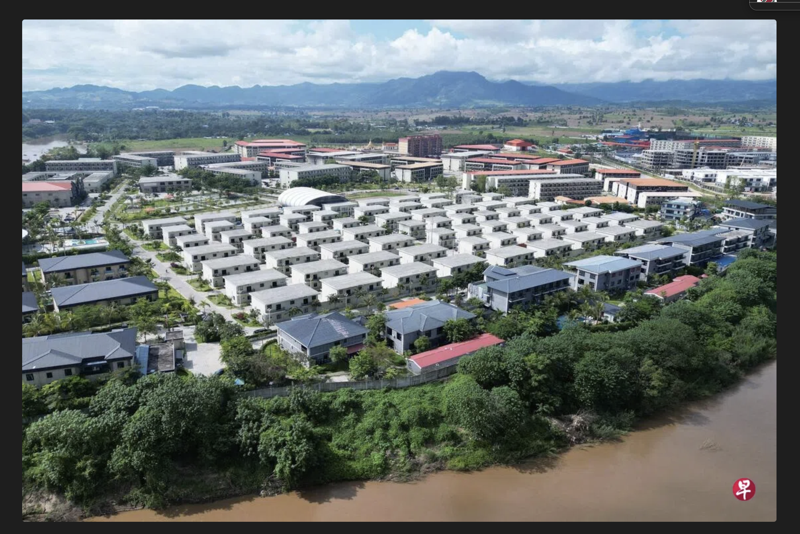
缅甸电信诈骗KK 园区
Myanmar cyber scam KK Park

Slide 25
创世记 50:18.他的哥哥们又来俯伏在他面前，说：「我们是你的仆人。」19.约瑟对他们说：「不要害怕，我岂能代替神呢？20.从前你们的意思是要害我，但神的意思原是好的，要保全许多人的性命，成就今日的光景。21.现在你们不要害怕，我必养活你们和你们的妇人孩子。」于是约瑟用亲爱的话安慰他们。
Genesis 50:18.His brothers also came and fell down before him and said, "Behold, we are your servants."
19.But Joseph said to them, "Do not fear, for am I in the place of God?20.As for you, you meant evil against me, but God meant it for good, to bring it about that many people should be kept alive, as they are today.21.So do not fear; I will provide for you and your little ones." Thus he comforted them and spoke kindly to them.

Slide 26
歌罗西书 3:13.
倘若这人与那人有嫌隙，总要彼此包容，彼此饶恕；主怎样饶恕了你们，你们也要怎样饶恕人。
Colossians 3:13.
bearing with one another and, if one has a complaint against another, forgiving each other; as the Lord has forgiven you, so you also must forgive.

Slide 27
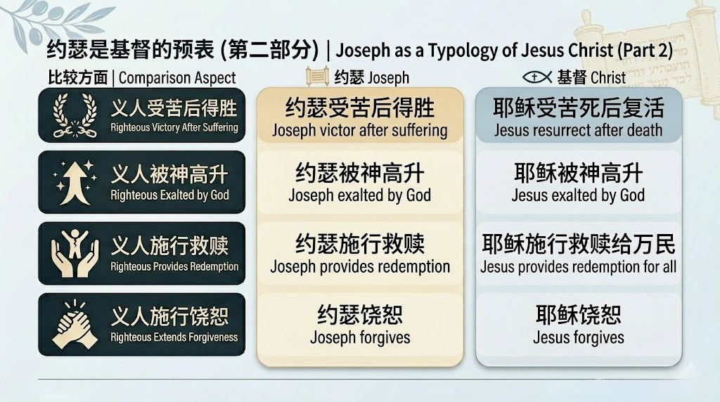

Slide 28
1 你在受苦吗？不要害怕，因神与你同在
1 Are you suffering? Do not be afraid, for God is with you. 2 神的儿女在受苦后有高升的盼望
2 God’s children have the hope of exaltation after suffering.
3 求主不仅赐我们将来的高升，求主也赐我们今世得胜
3 Pray that the Lord not only grants us future exaltation, but also grants us present victory. 4 神使你脱离困境后，当拯救周围的人
4 After God delivers you from distress, you should help save those around you. 5 因我们是神的义人，就当饶恕人
5 Because we are God’s righteous people, we ought to forgive others.

Slide 29

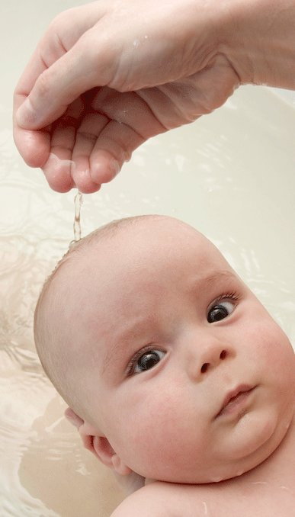
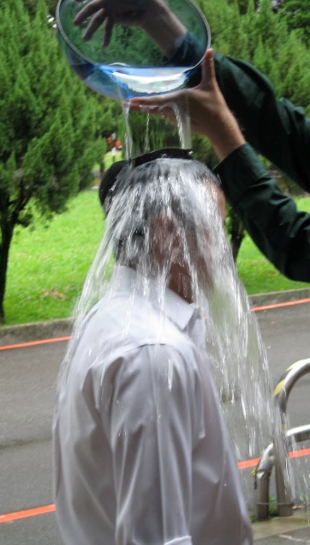
洗礼

Slide 30

马太福音 16:24
於是耶稣对门徒说：
若有人要跟从我，就当舍己，背起他的十字架来跟从我。
Mat 16:24
Then Jesus told his disciples,
“If anyone would come after me, let him deny himself
and take up his cross and follow me.

Slide 31
问：你是否接受耶稣基督是上帝的独生爱子，祂就是上帝？
问：你是否承认自己是罪人，并接受耶稣基督为你的罪钉在十字架上 ？
问：你是否相信耶稣基督赦免你的罪并赐你永生？

Slide 32
问：你是否愿意背起十字架来跟随主耶稣，作主耶稣的门徒？
问：你是否愿意坚守神与你所立的约？一生信主、爱主、顺服主。

Slide 33
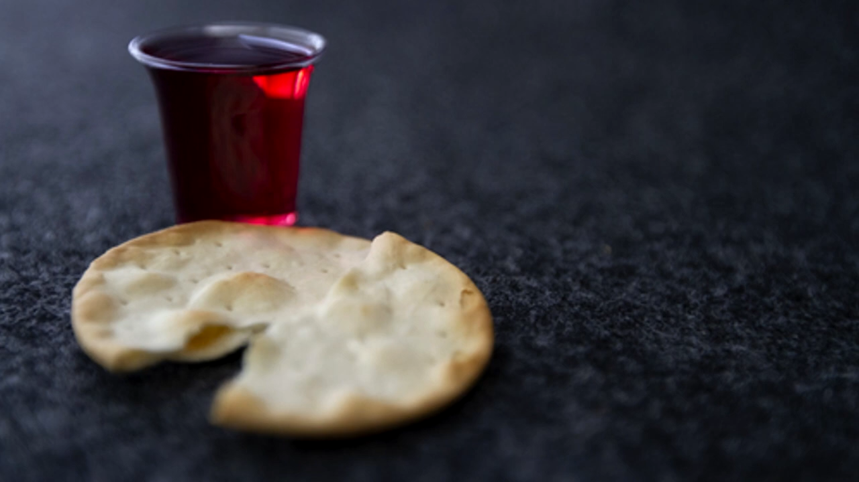
奇异恩典
圣餐

Slide 34

约壹 4:10 不是我们爱神，乃是神爱我们，差他的儿子为我们的罪作了挽回祭，这就是爱了。11 亲爱的弟兄啊，神既是这样爱我们，我们也当彼此相爱。
1Jn 4:10 In this is love, not that we have loved God but that he loved us and sent his Son to be the propitiation for our sins.11 Beloved, if God so loved us, we also ought to love one another.

